Slide 1
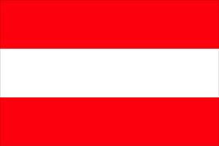
Austria
By Rachel Connolly

Slide 2
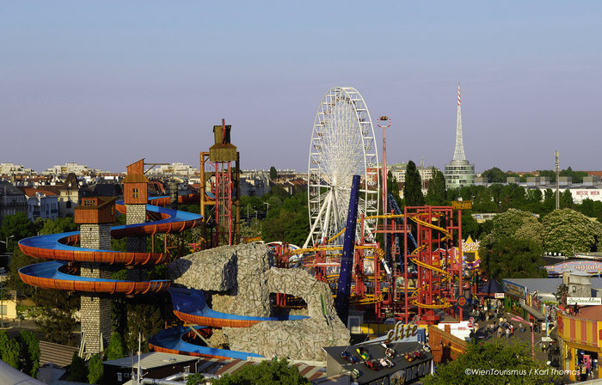
Vienna Prater: This is a large public park in the middle of Vienna. It also houses an amusement park with over 250 rides, including the Riesenrad, which is a ferris wheel. Emperor Joseph II opened the park to the public in 1766.
Capital: Vienna
Size: 83,858km²
Population: 8.3 million
Language: German
National Day: 26th October

Slide 3
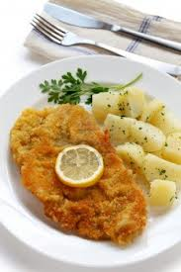
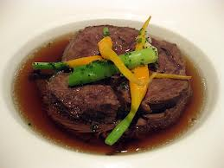
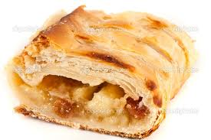
Food
Austrians enjoy
Wiener Schnitzel(breaded veal cutlet) ,
Tafelspitz(boiled beef served with apple and horseradish sauce)
Apfelstrudel(apple and pastry dessert).

Slide 4
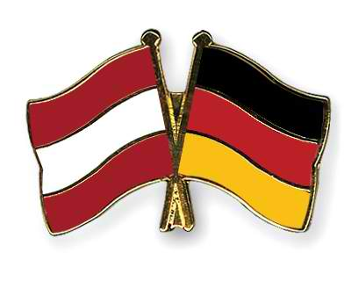
Language
German is the official language of Austria. More than 90 per cent of the people are German-speaking.
The small minority groups include Czechs, Croats, Slovenes, and Hungarians.
The Roman Catholic religion is predominant in Austrian society.
There are a few Protestants and Jews living mainly in Vienna.

Slide 5
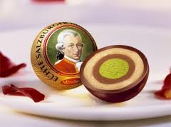
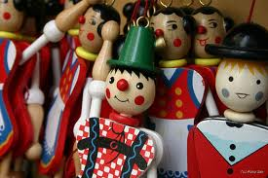
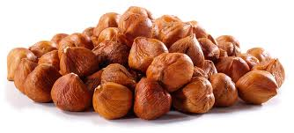
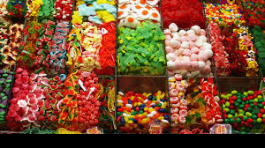
Christmas traditions
The feast of St Nicholas marks the beginning of Christmas in Austria. The saint accompanied by the devil asks children for a list of their good and bad deeds. Good children are given sweets, toys and nuts. Gifts that are placed under the tree are opened after dinner on Christmas Eve.
Brass instruments play chorale music room church steeples, and carol singers, carrying blazing torches and a manger from house to house, gather on the church steps.
Silent Night was first sung in 1818, in the village church of Oberndorf. There is a story told of how Christmas was almost spoiled for the villagers that year. On Christmas Eve, the priest went into the church and found that the organ was not working. The leather bellows that are used to pump the air through the pipes were full of holes. Christmas without music would not do so the priest showed the organist Franz Bauer a new Christmas hymn he had written. Franz quickly composed a tune for it that could be played on a guitar. So Oberndorf had music after all.
In Austria baked carp is served for the traditional Christmas dinner.

Slide 6
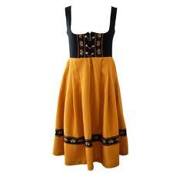
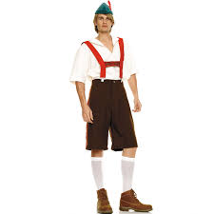
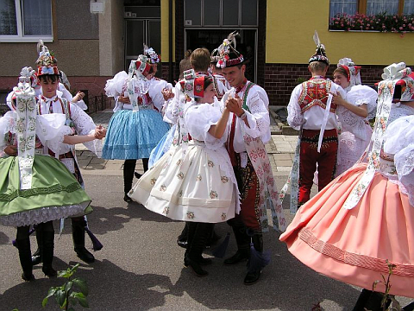
Clothes
They wear virtually identical things to everyone else. And it does get quite cold in Austria in many places in the winter, so scarves and gloves are required, depending on where you live. In summer, t shirts, shorts and skirts are very popular, as are flip-flops

Slide 7
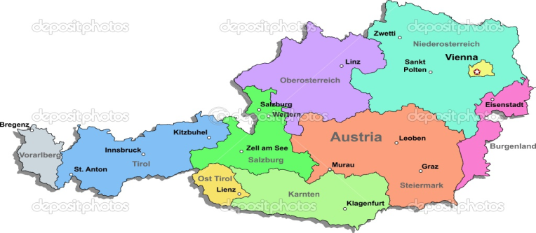
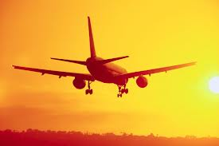
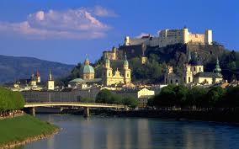
Where is Austria?
Travelling to Austria by air couldn't be easier. With an average direct flying time of only 2 hours from most major UK airports to a choice of popular Austrian destinations, flights to Austria are probably the quickest and easiest travel option.

Slide 8
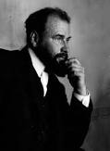
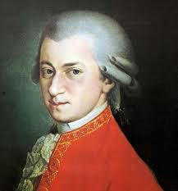
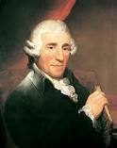
Famous Austrians
Gustav Klimt (artist),
Wolfgang Amadeus Mozart(composer),
Joseph Haydn(composer)

Slide 9
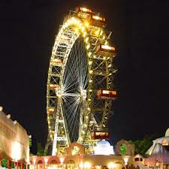
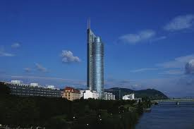
Famous buildings
Millennium Tower
Riesenrad
Height: 202 m
Floors: 51
Type: skyscraper
Year: 1999
Height: 65 m
Type: Ferris wheel
Year: 1897

Slide 10
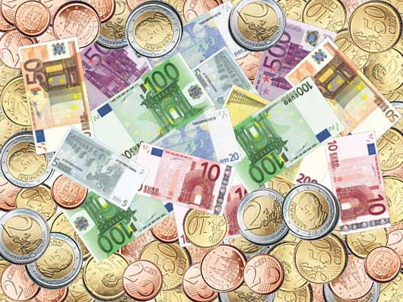
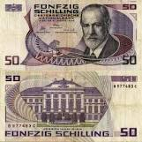
Money
Since 2002 Austria has used the Euro.
Since Austria is part of the Eurozone, Austrians pay with Euros.
1 US Dollar is approximately 0,763 EUR.
Euro (before 2002: Schilling)
Austria is member of the European Union since 1995

Slide 11
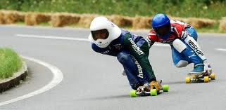
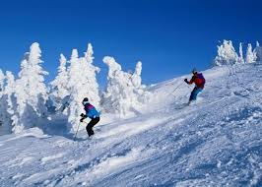
Sport
Skiing and other sports connected to ice and snow are very popular in Austria.

Slide 12
THE END!

