Slide 1
Biodiversity on Shanco Lane
By Cathal and Eadaoin O’ Reilly

Slide 2
What We Did
We went around collecting rubbish on the lane for an eco-friendly environment for the animals and the people living around the area. My mummy and daddy started by cleaning up the bank and took out all the rubbish. We wanted to help but they said it was too dirty because of fly dumping.

Slide 3
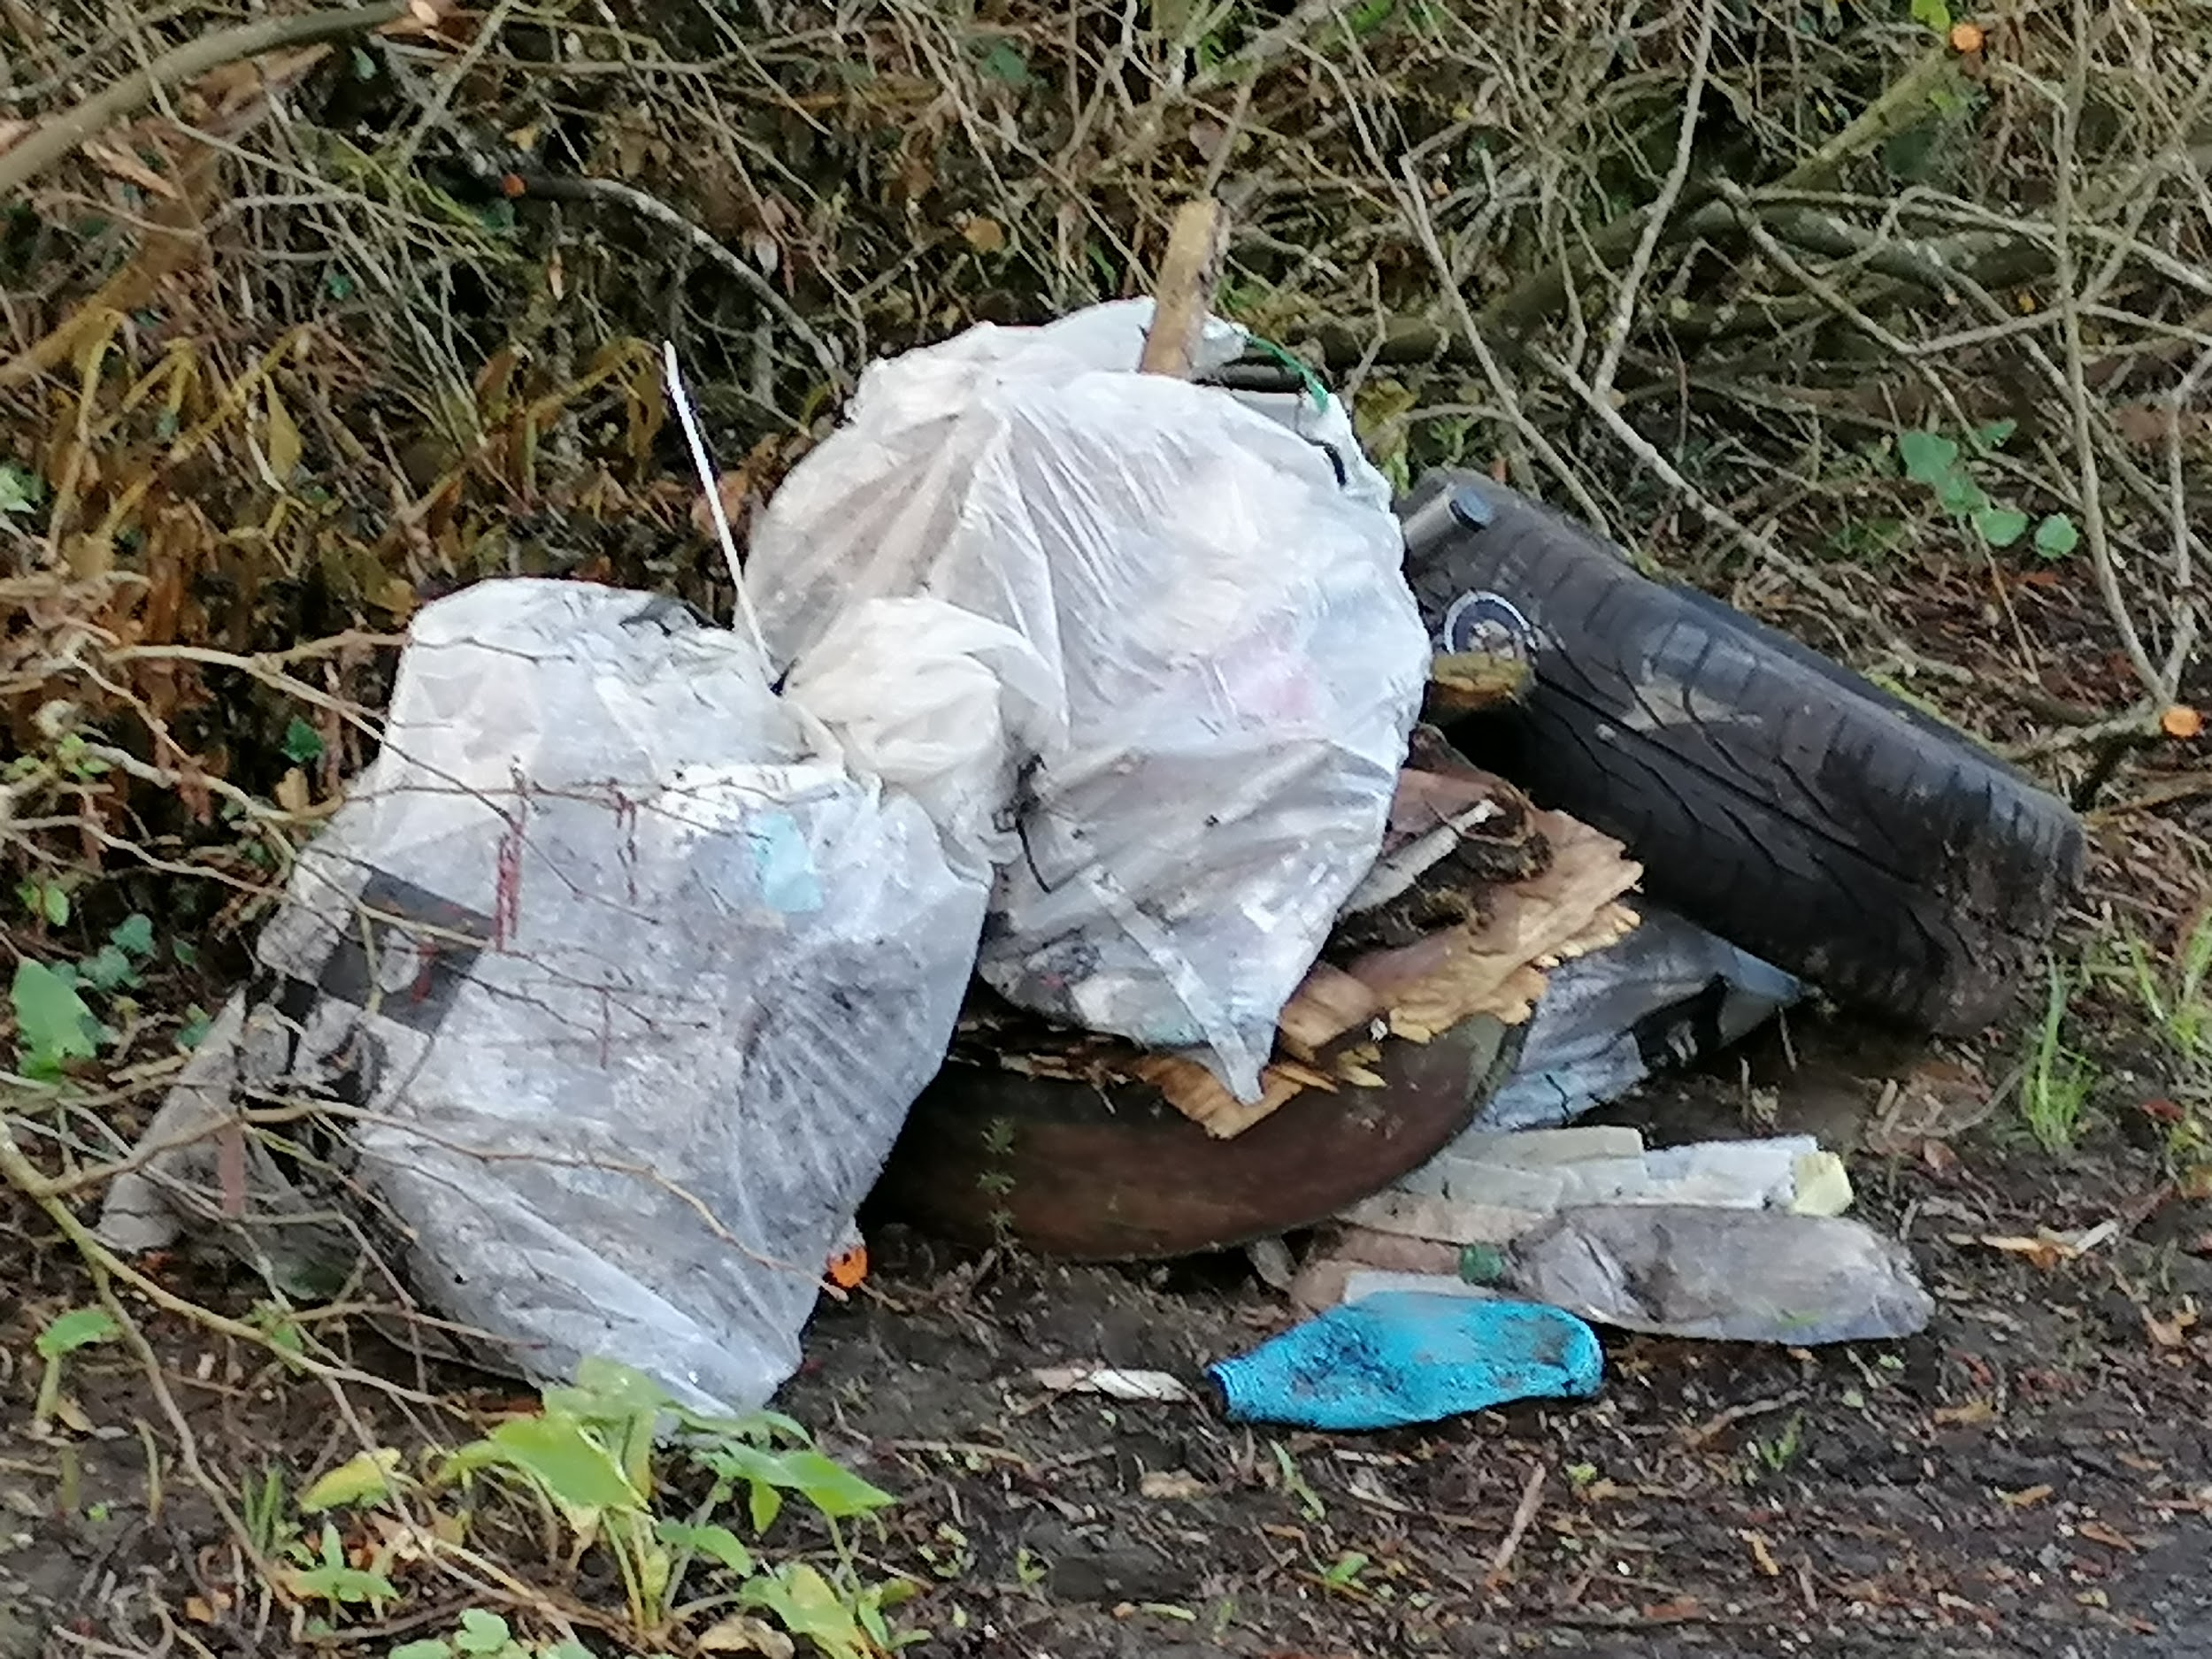
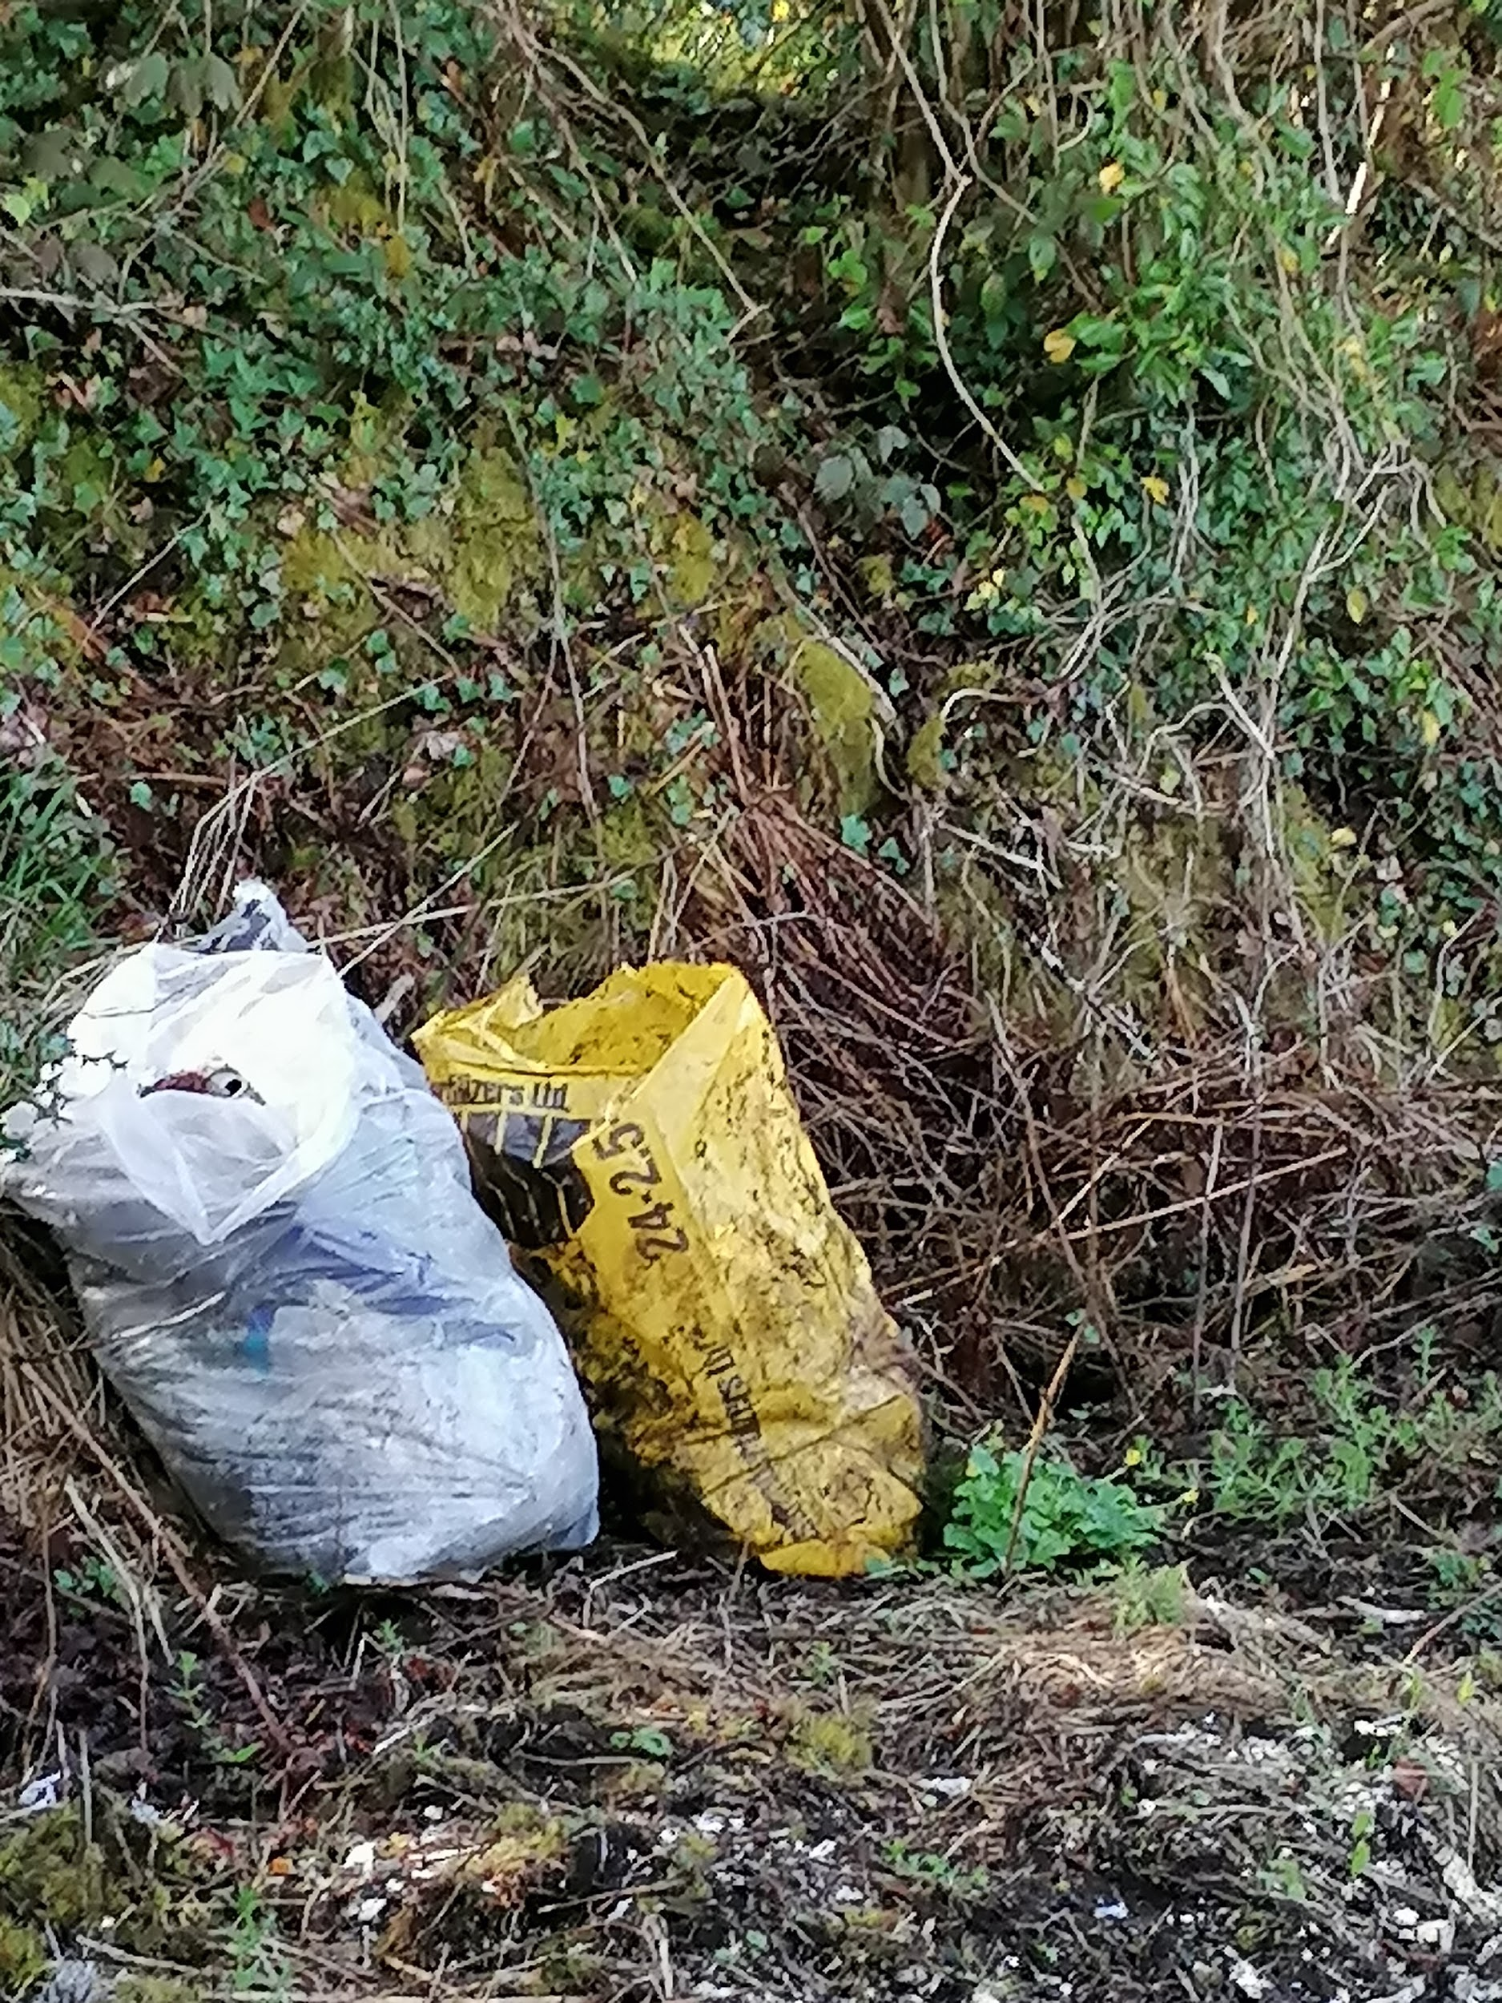

Slide 4
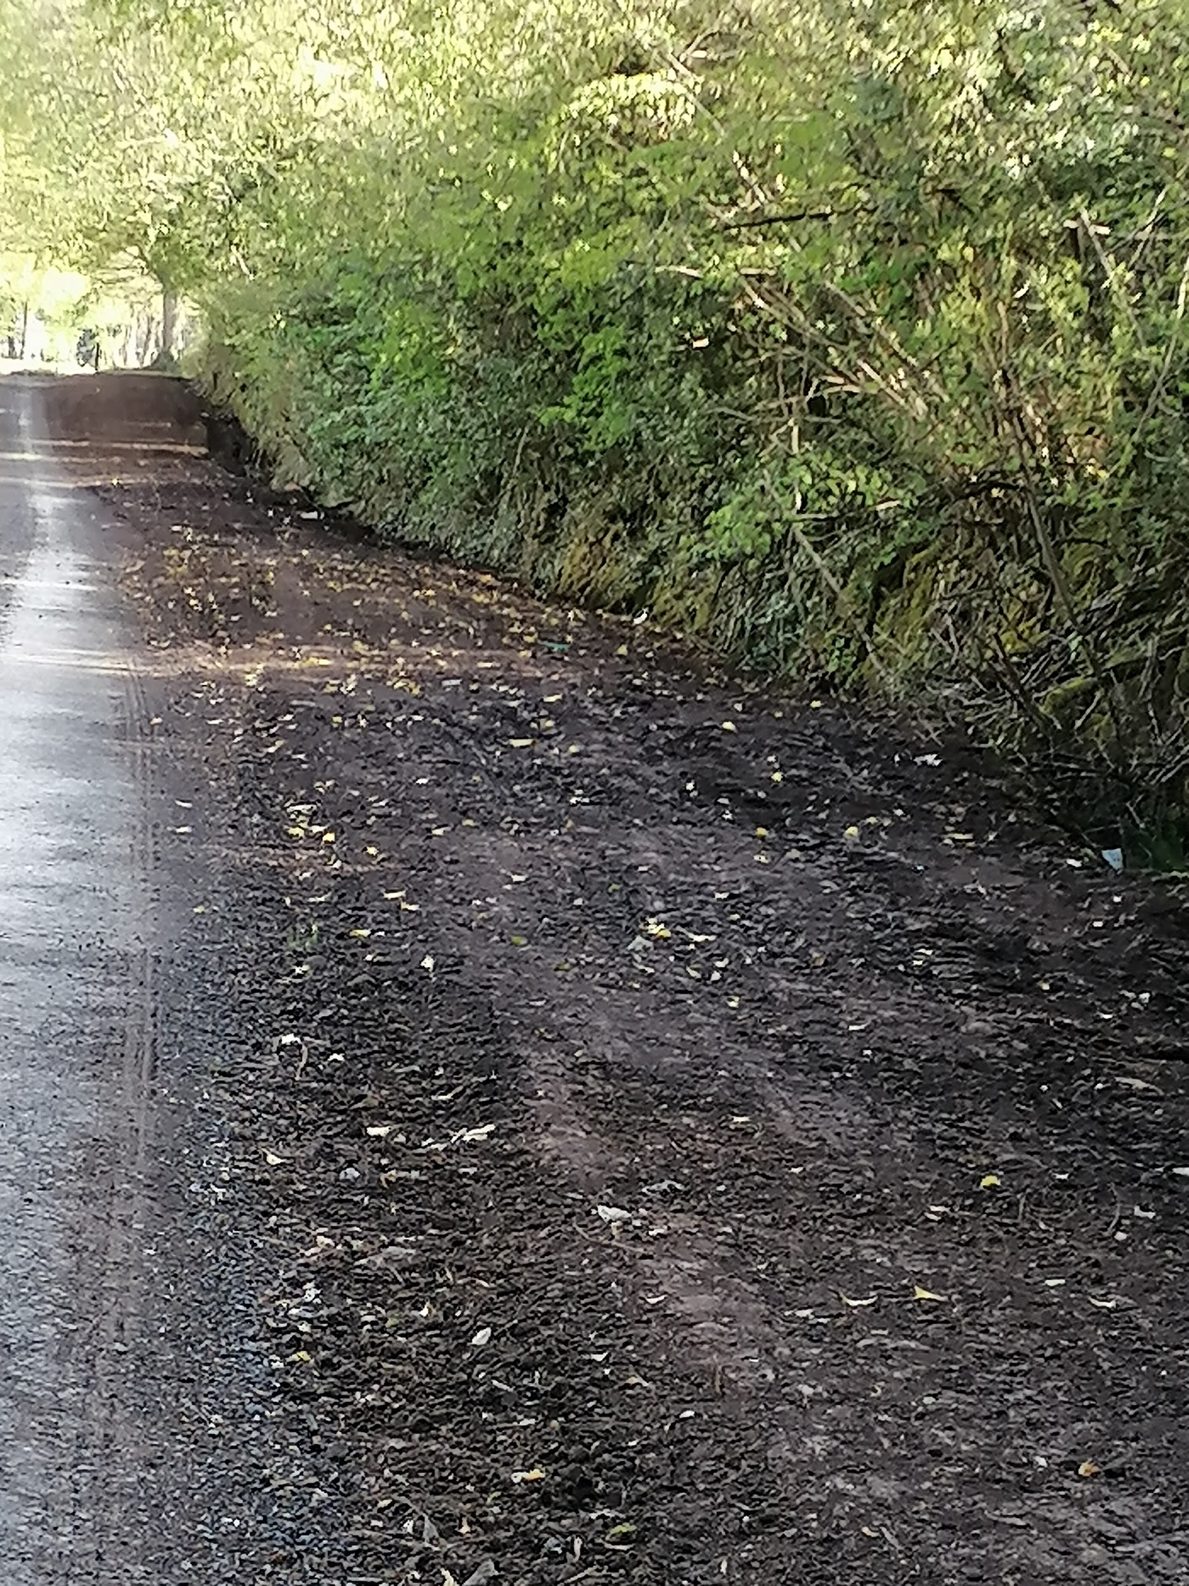
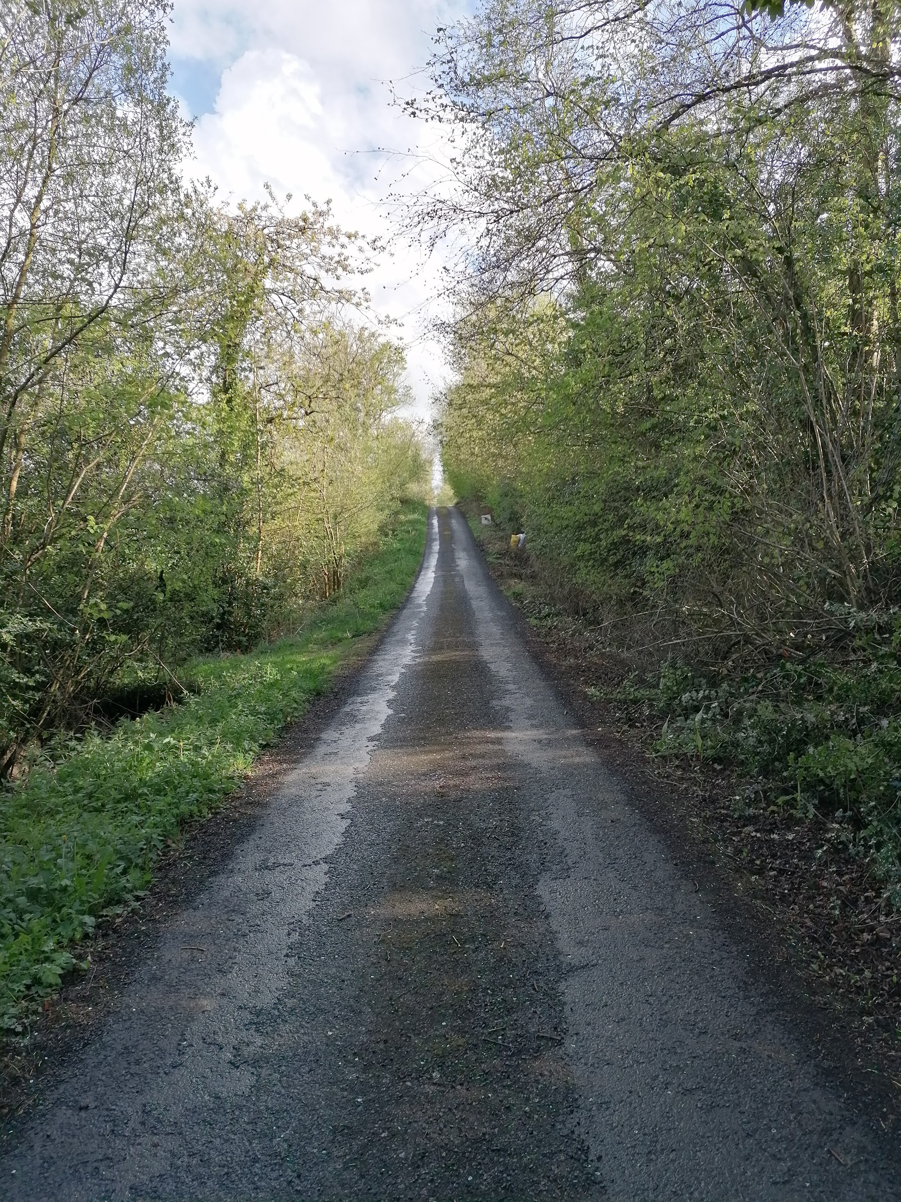
What Happened Next

Slide 5
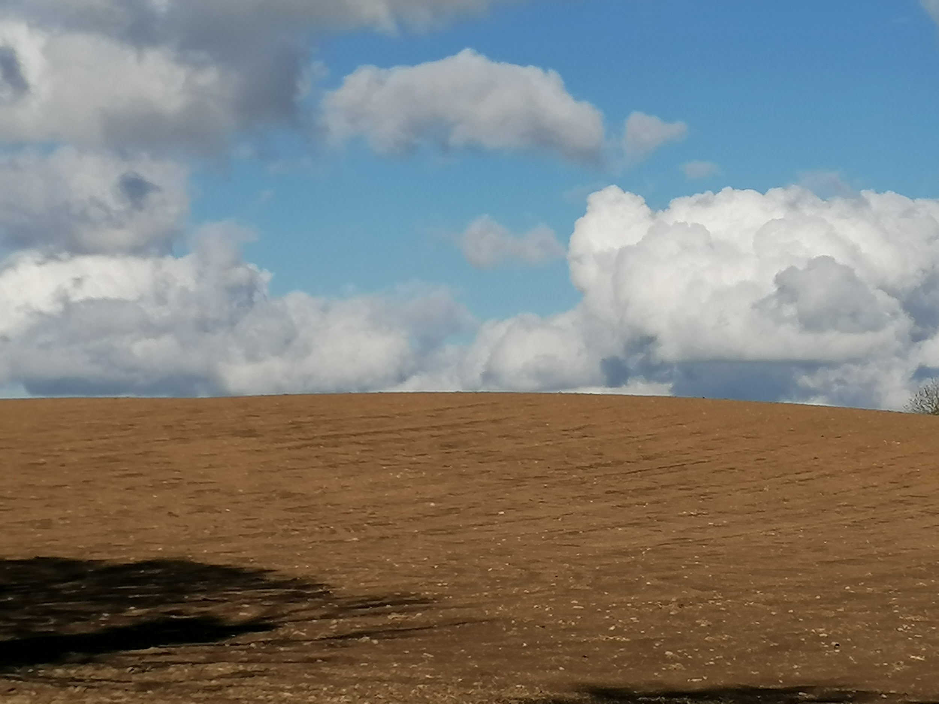
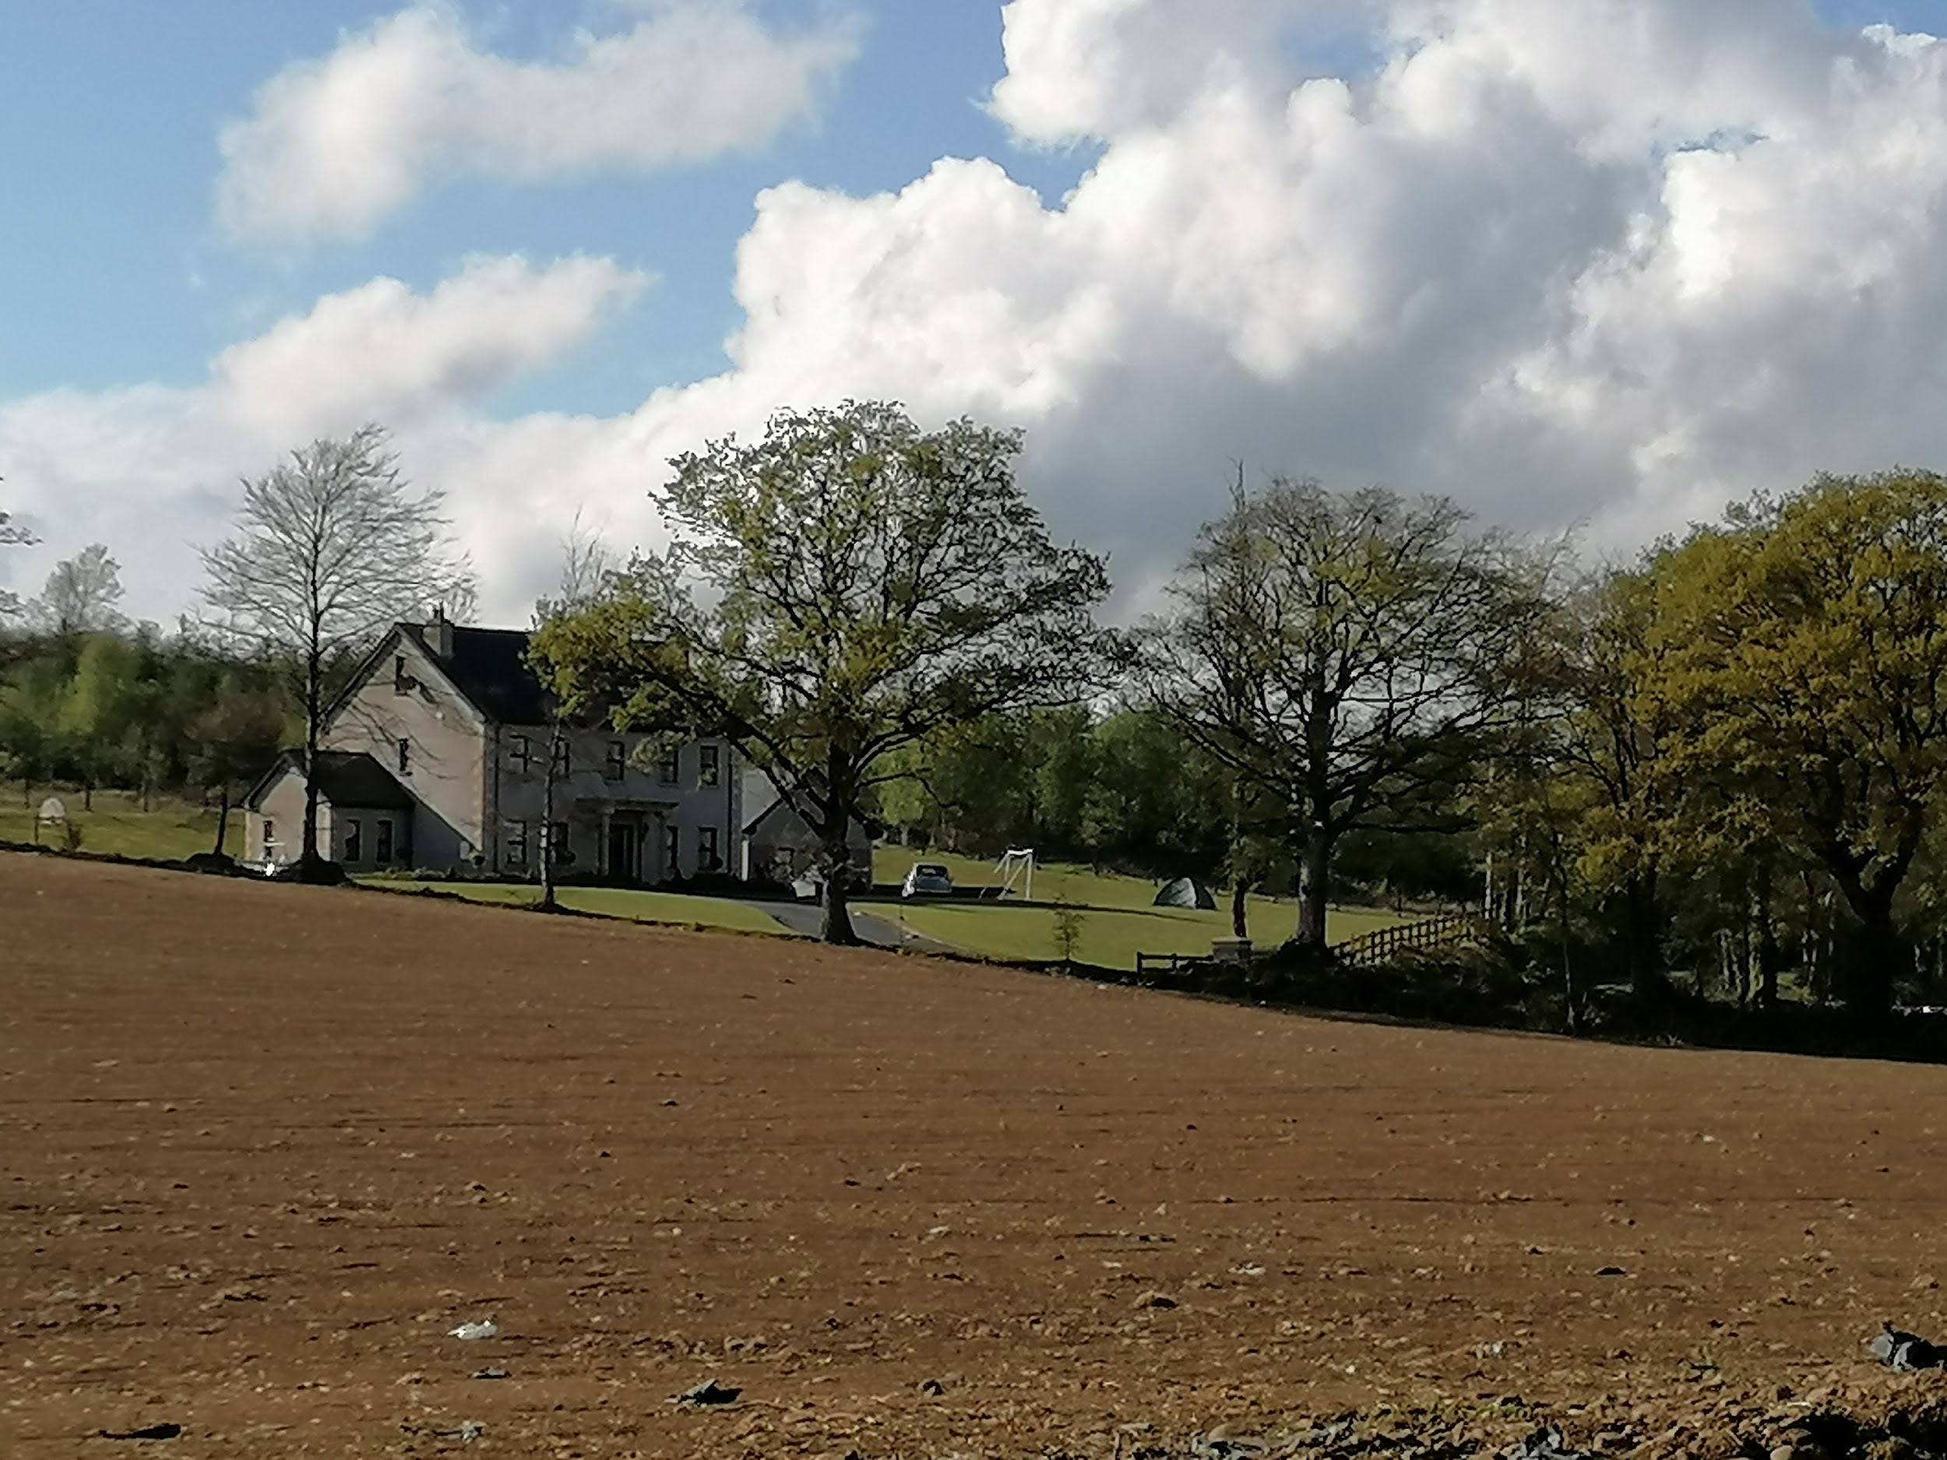
Biodiversity in Action at the O’Reilly’s !
When all the rubbish was collected and bagged we put it in the trailer for the council to collect.
Dad harrowed the ground so we could sow wild flower seeds along the grass verge. Our neighbour also reseeded his land.

Slide 6
Our Den
We built a den in the woods beside our house.
We used branches and twigs for the structure and covered it with moss from the banks. This camouflaged it and also kept the rain out.
We can use the den all summer to keep a watchful eye on wildlife and hopefully not disturb them.

Slide 7
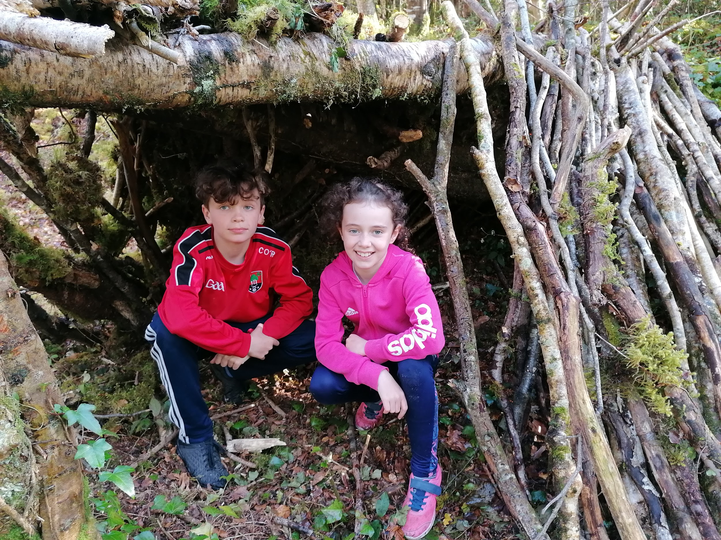
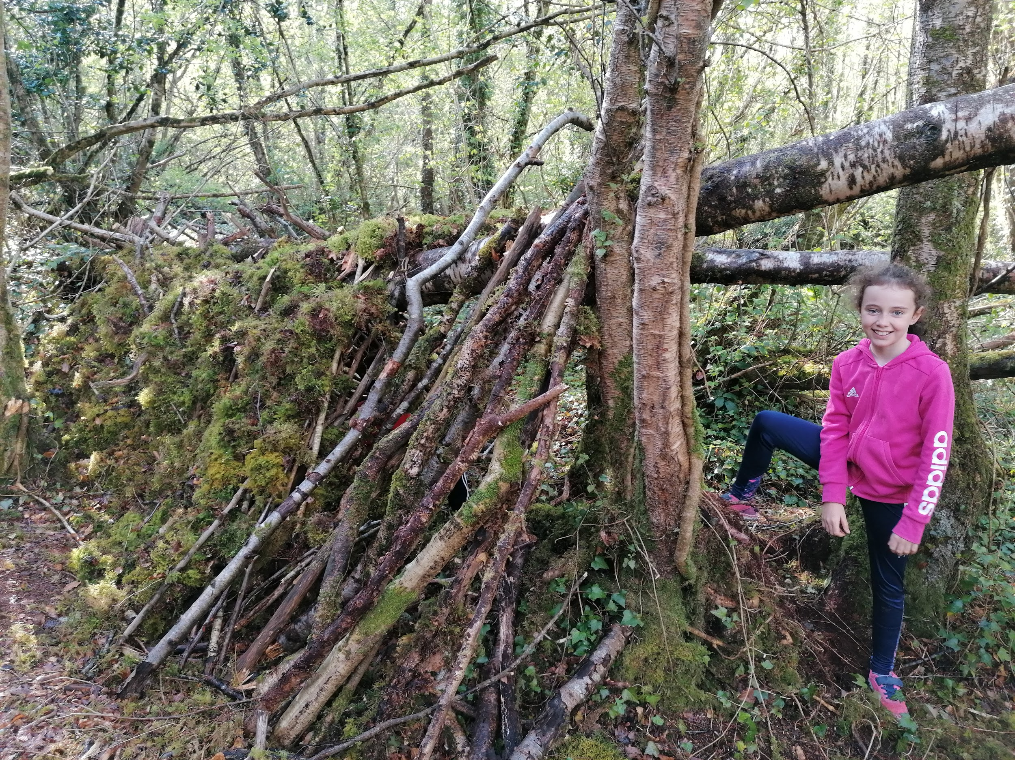
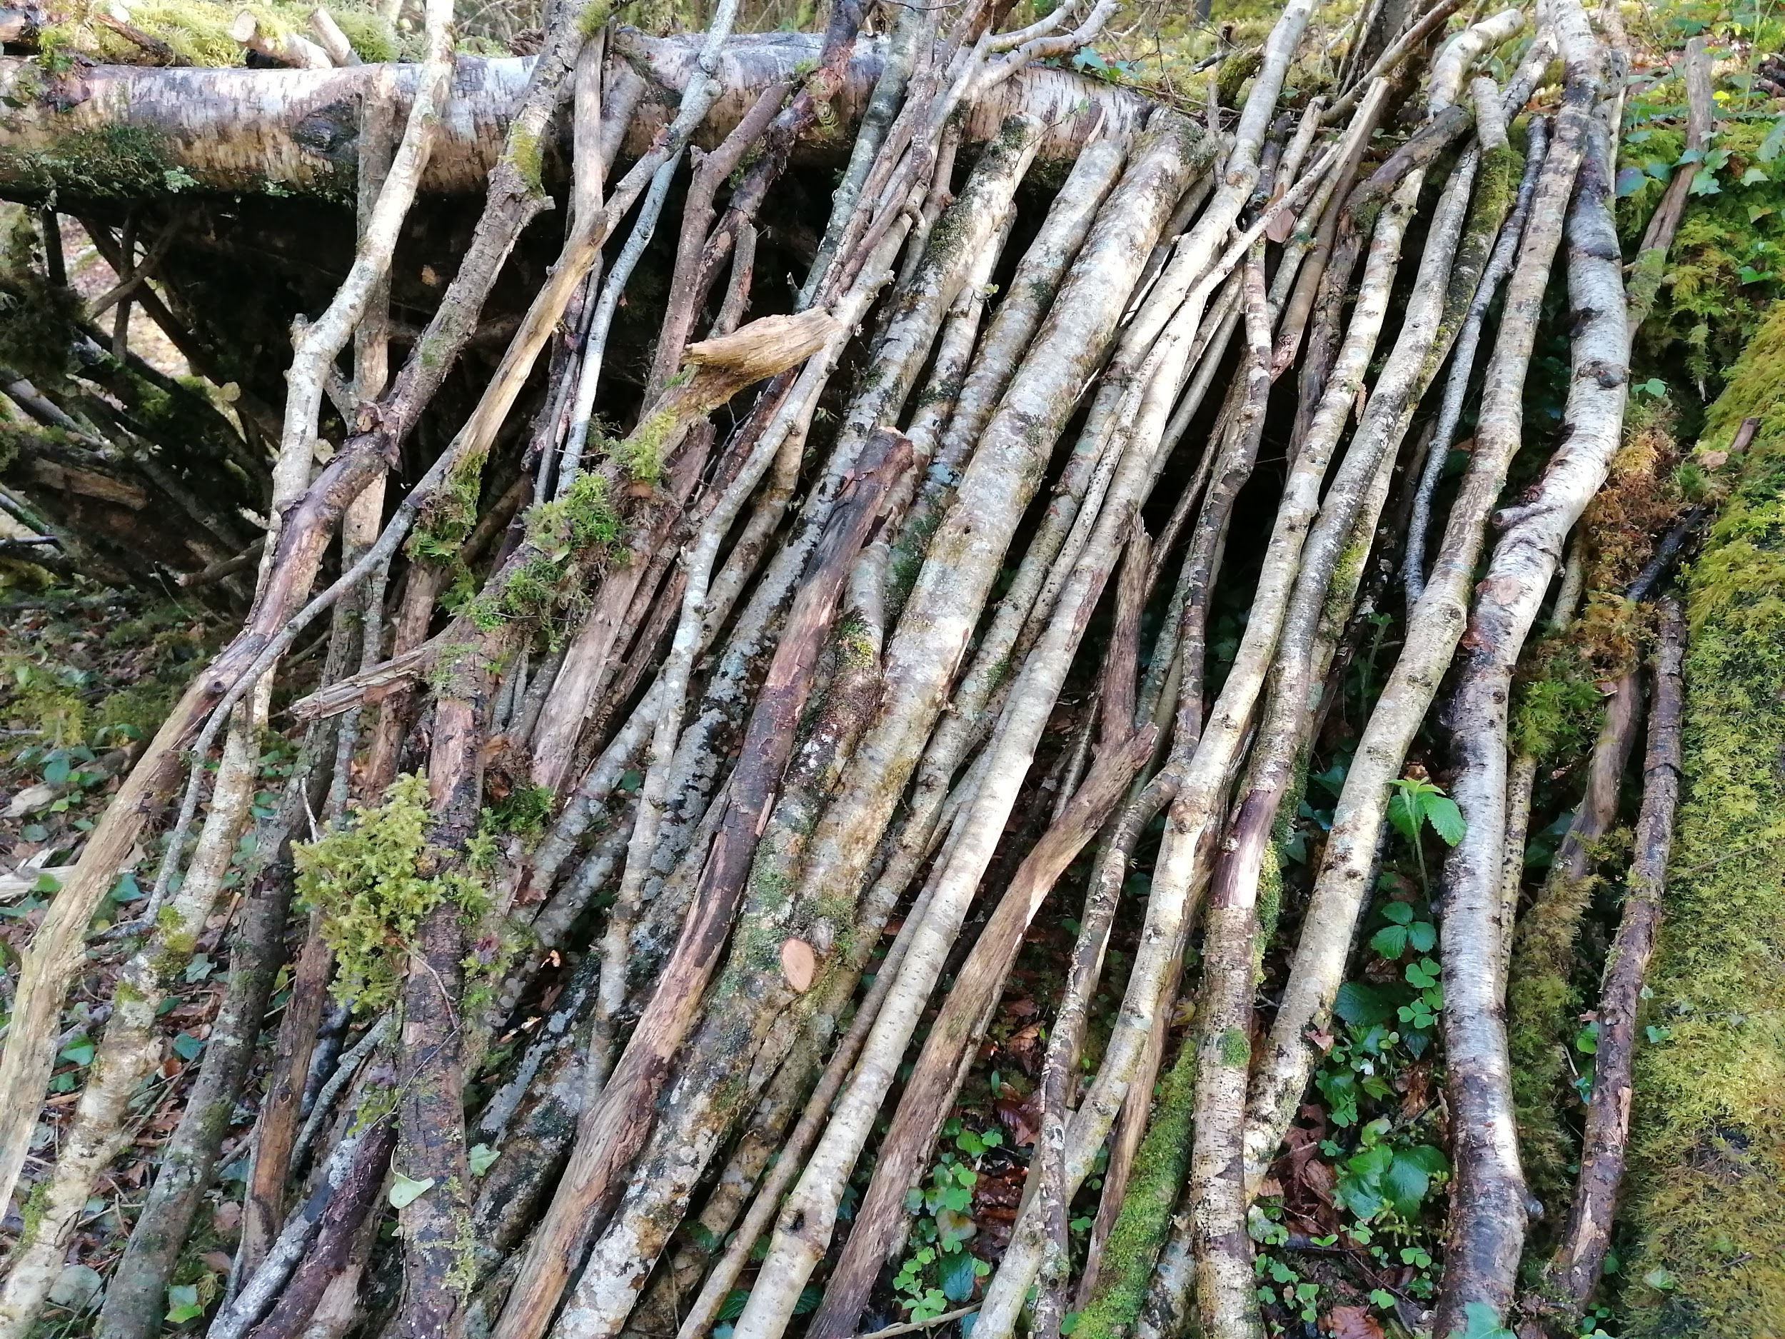
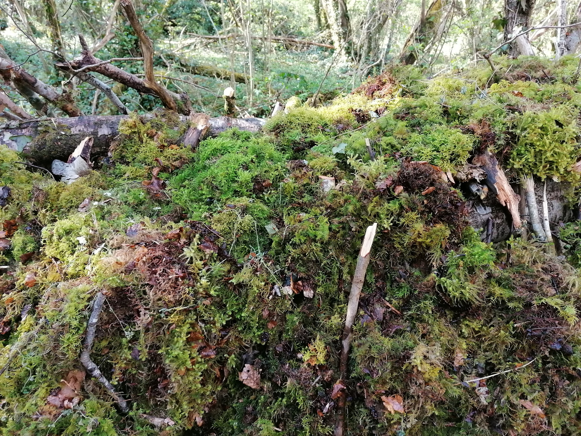

Slide 8
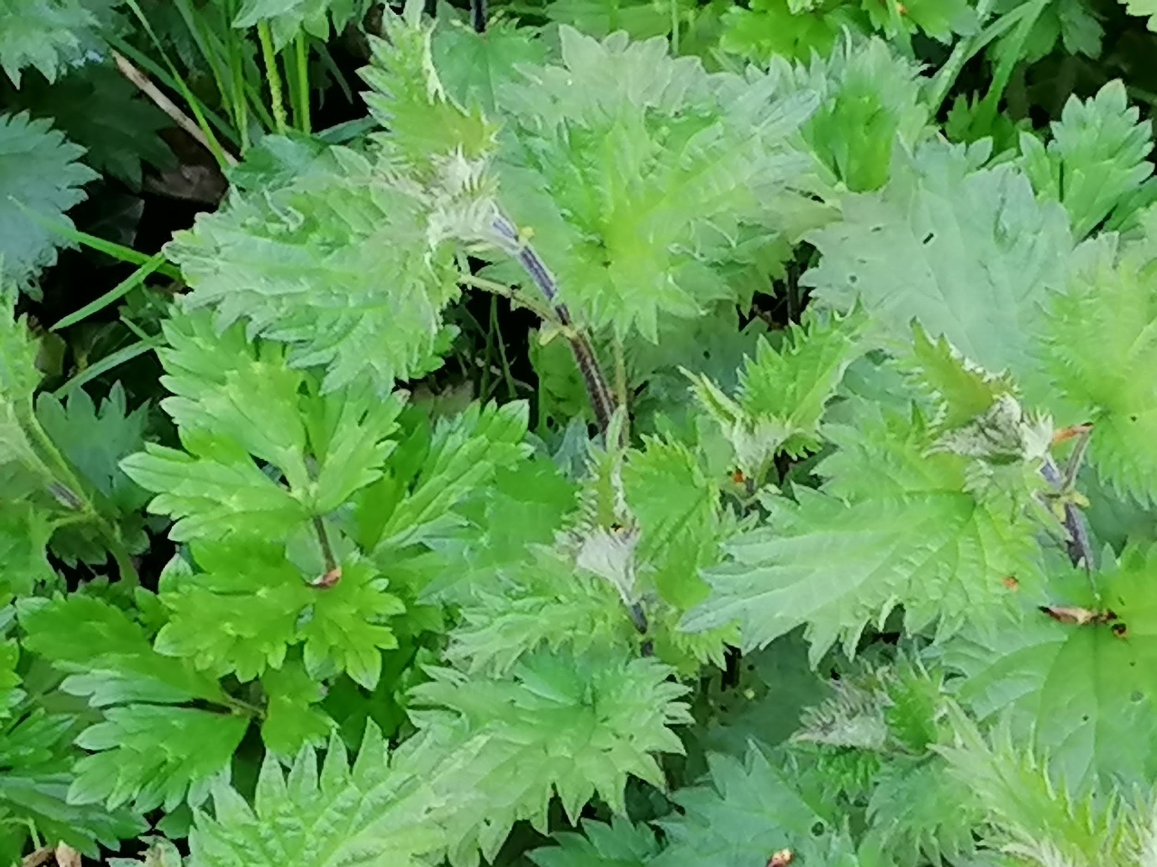
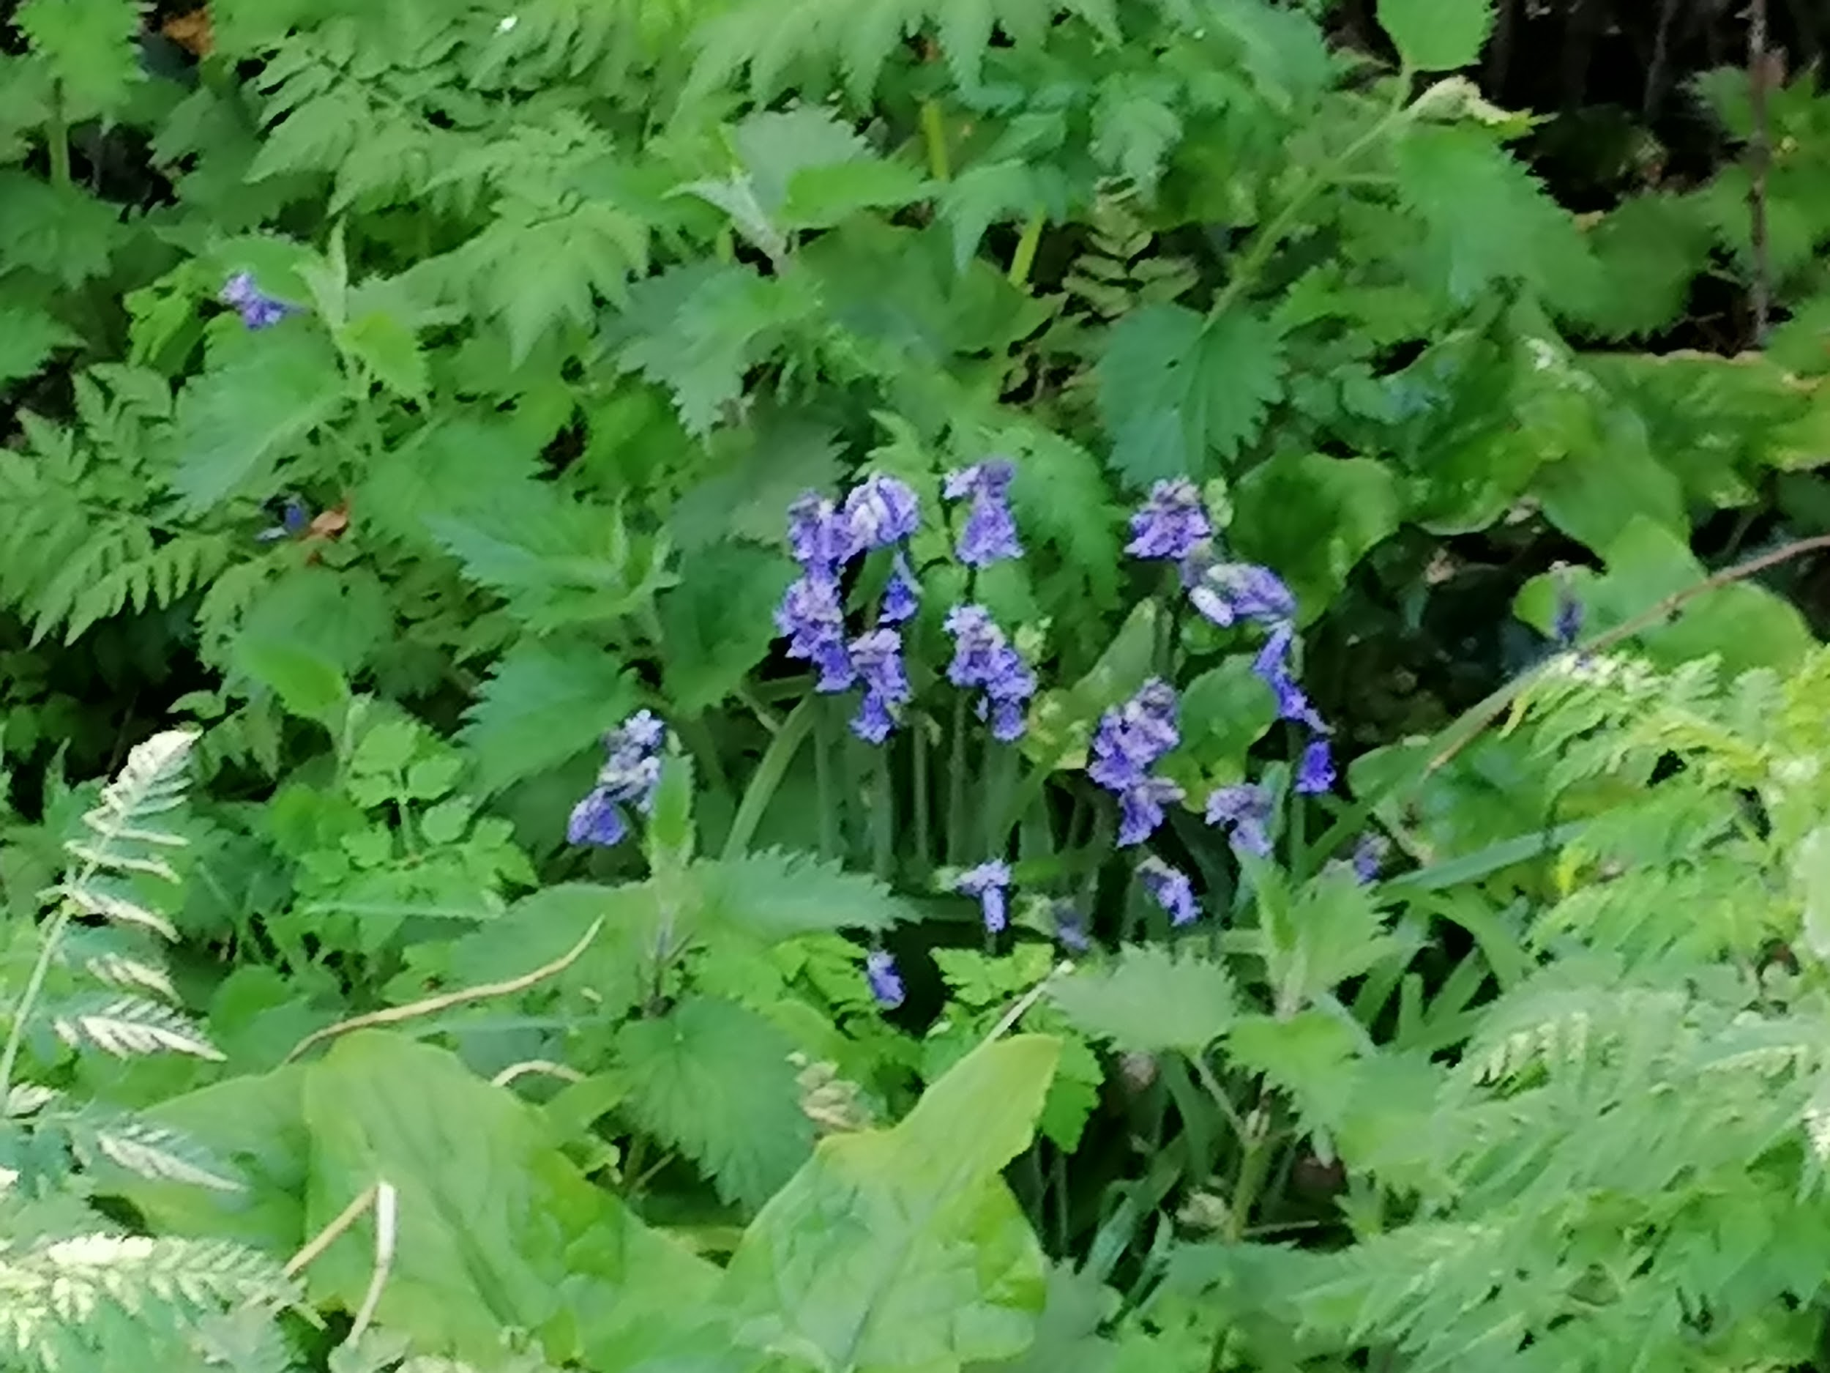
Wild flowers and trees
Here are some pictures of the wild flowers and trees growing on our lane.
Bluebells
Nettles

Slide 9
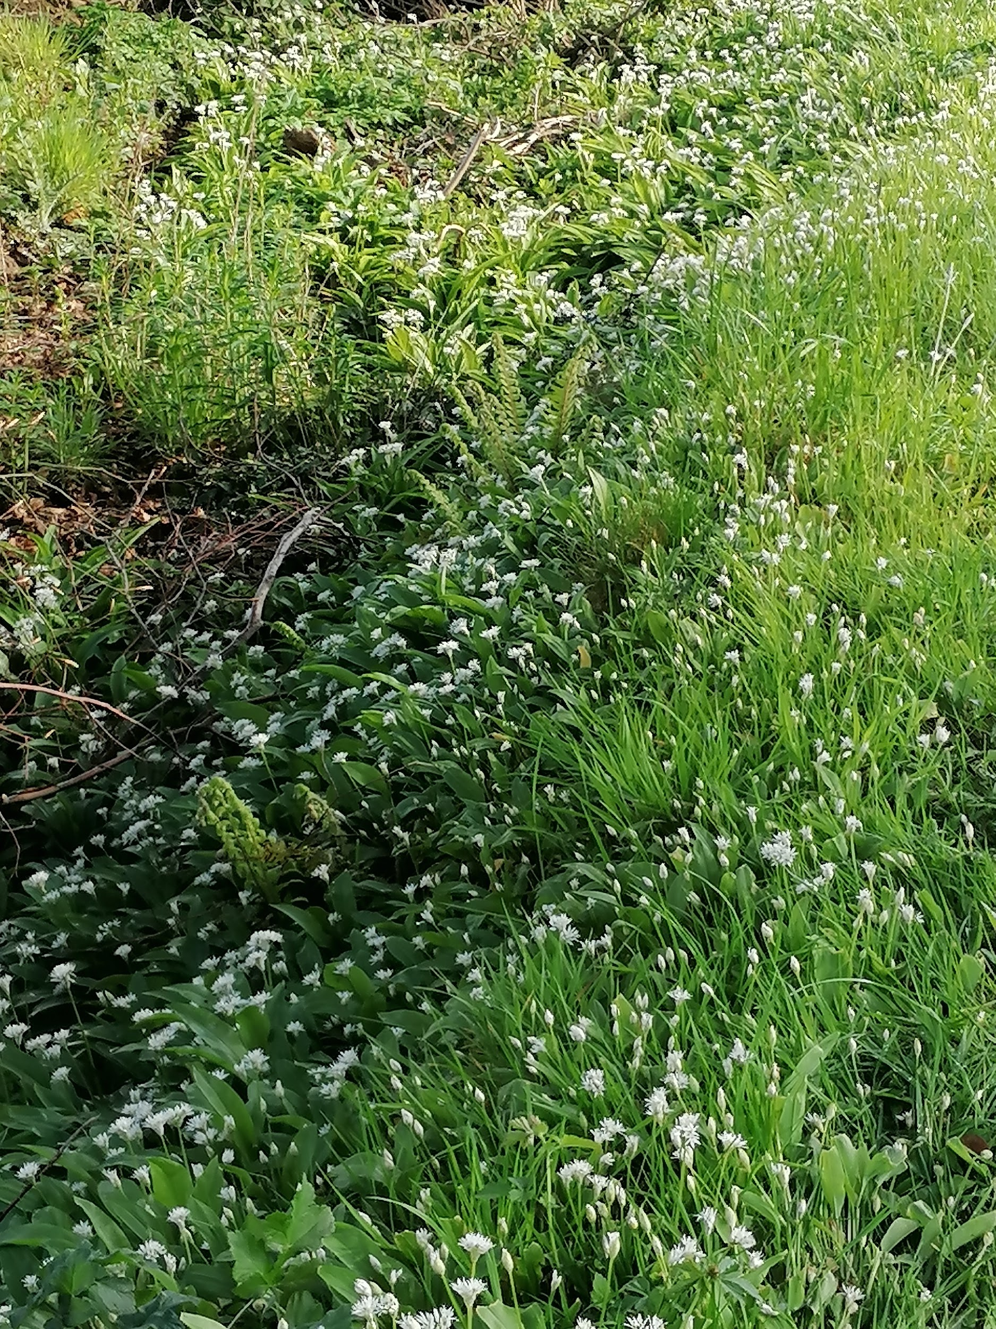
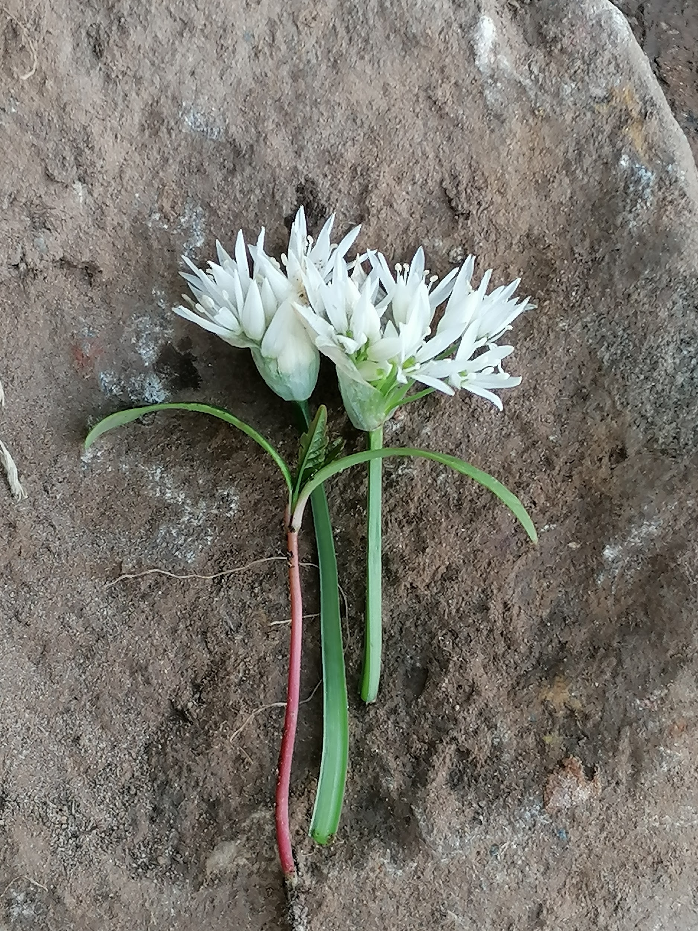
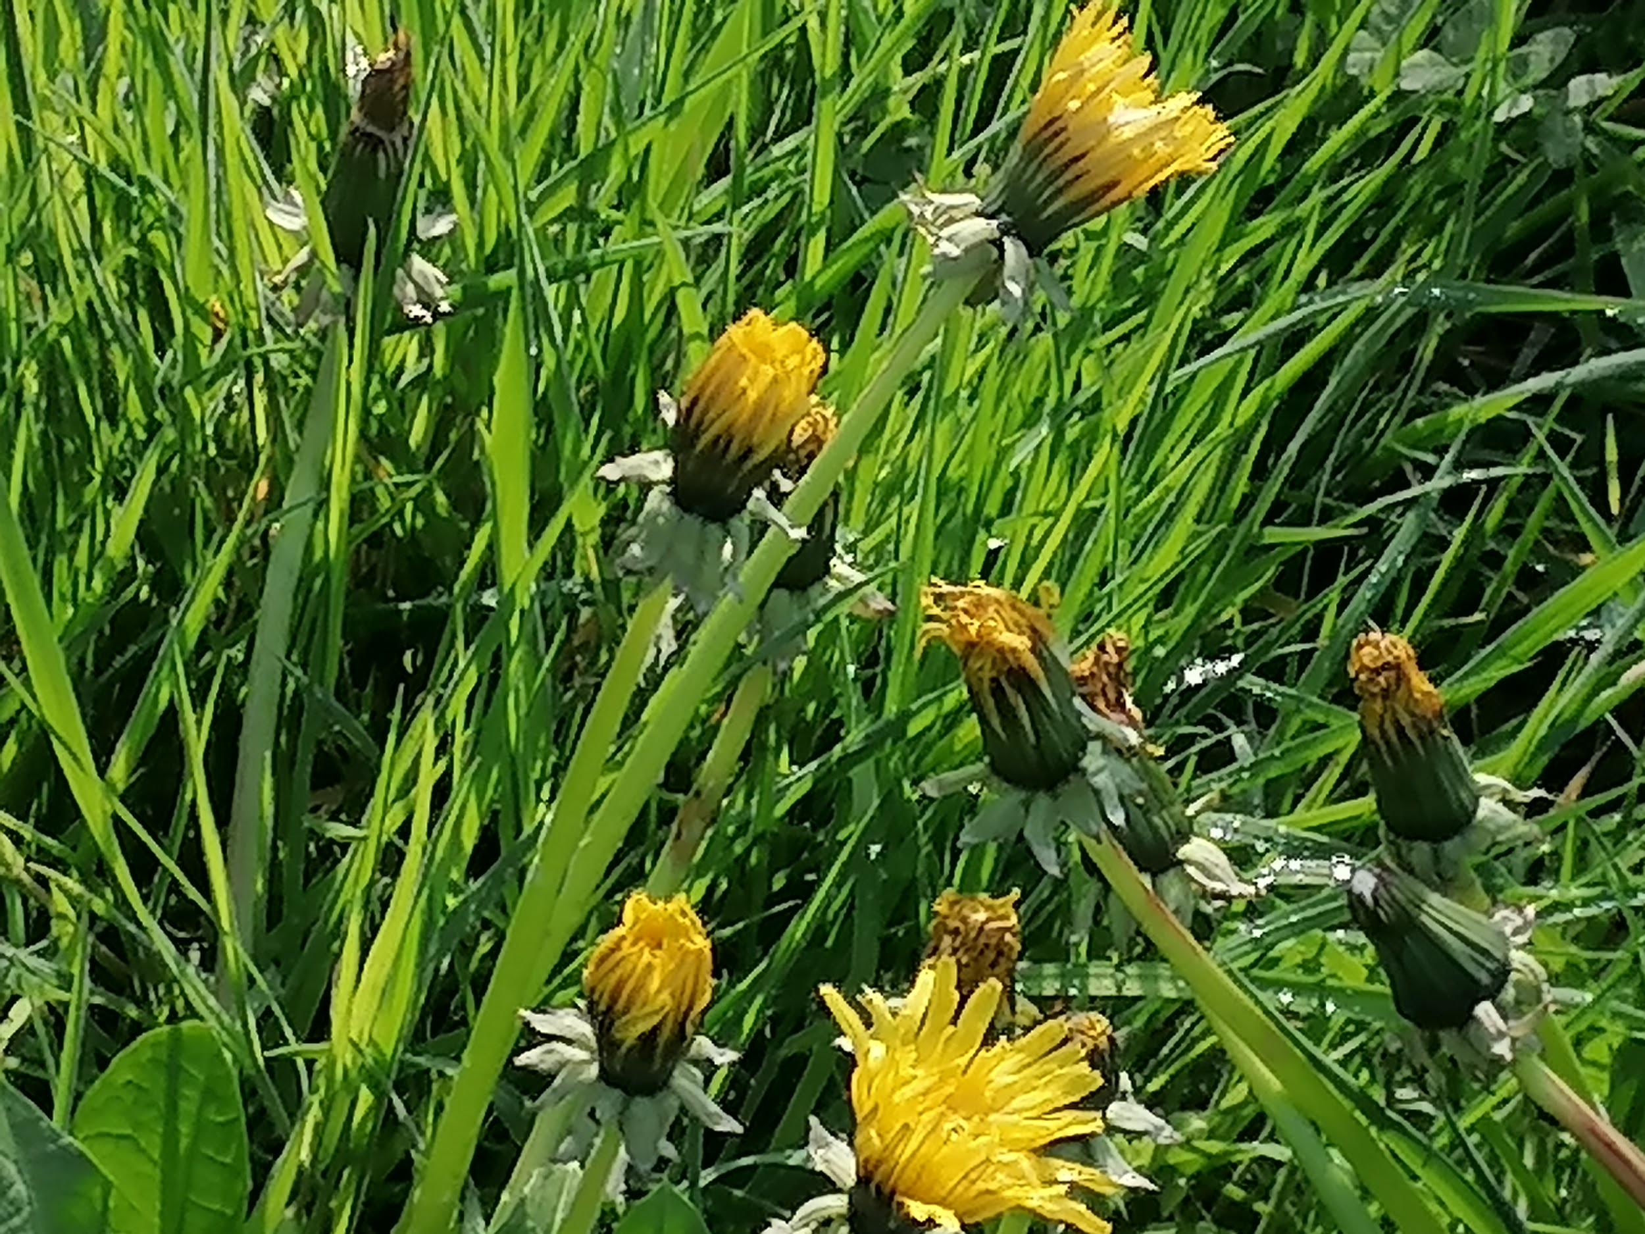
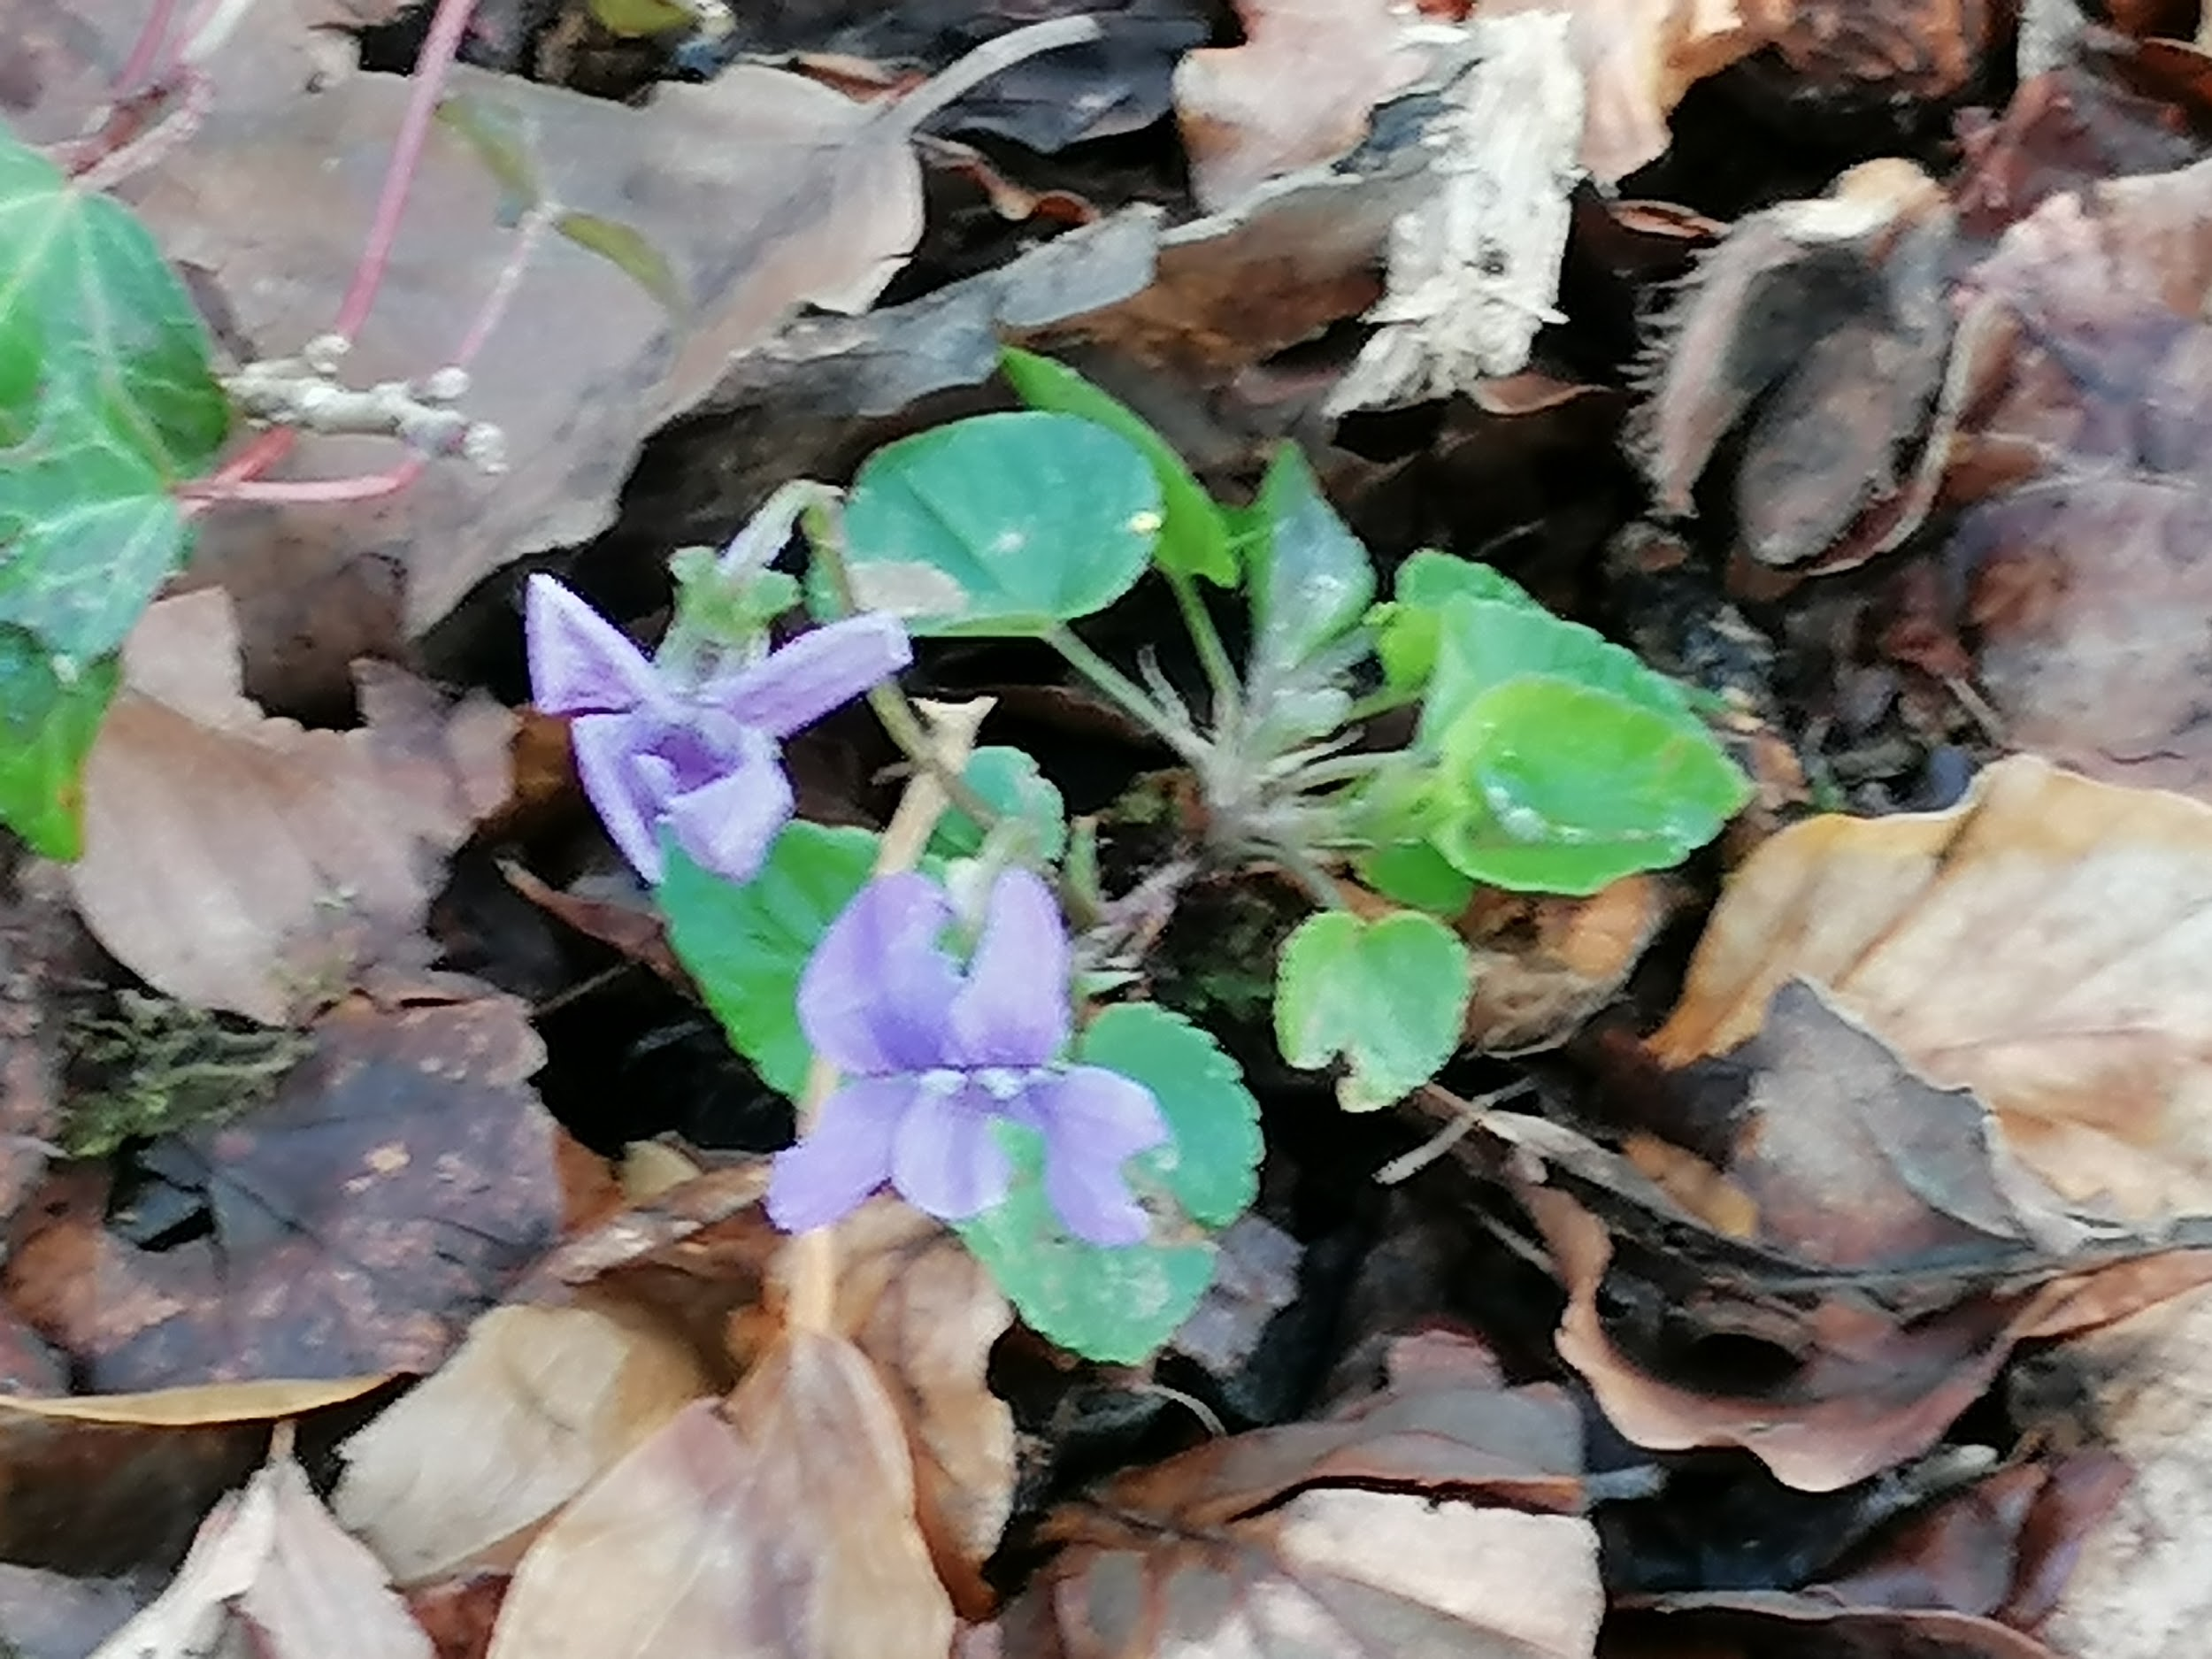
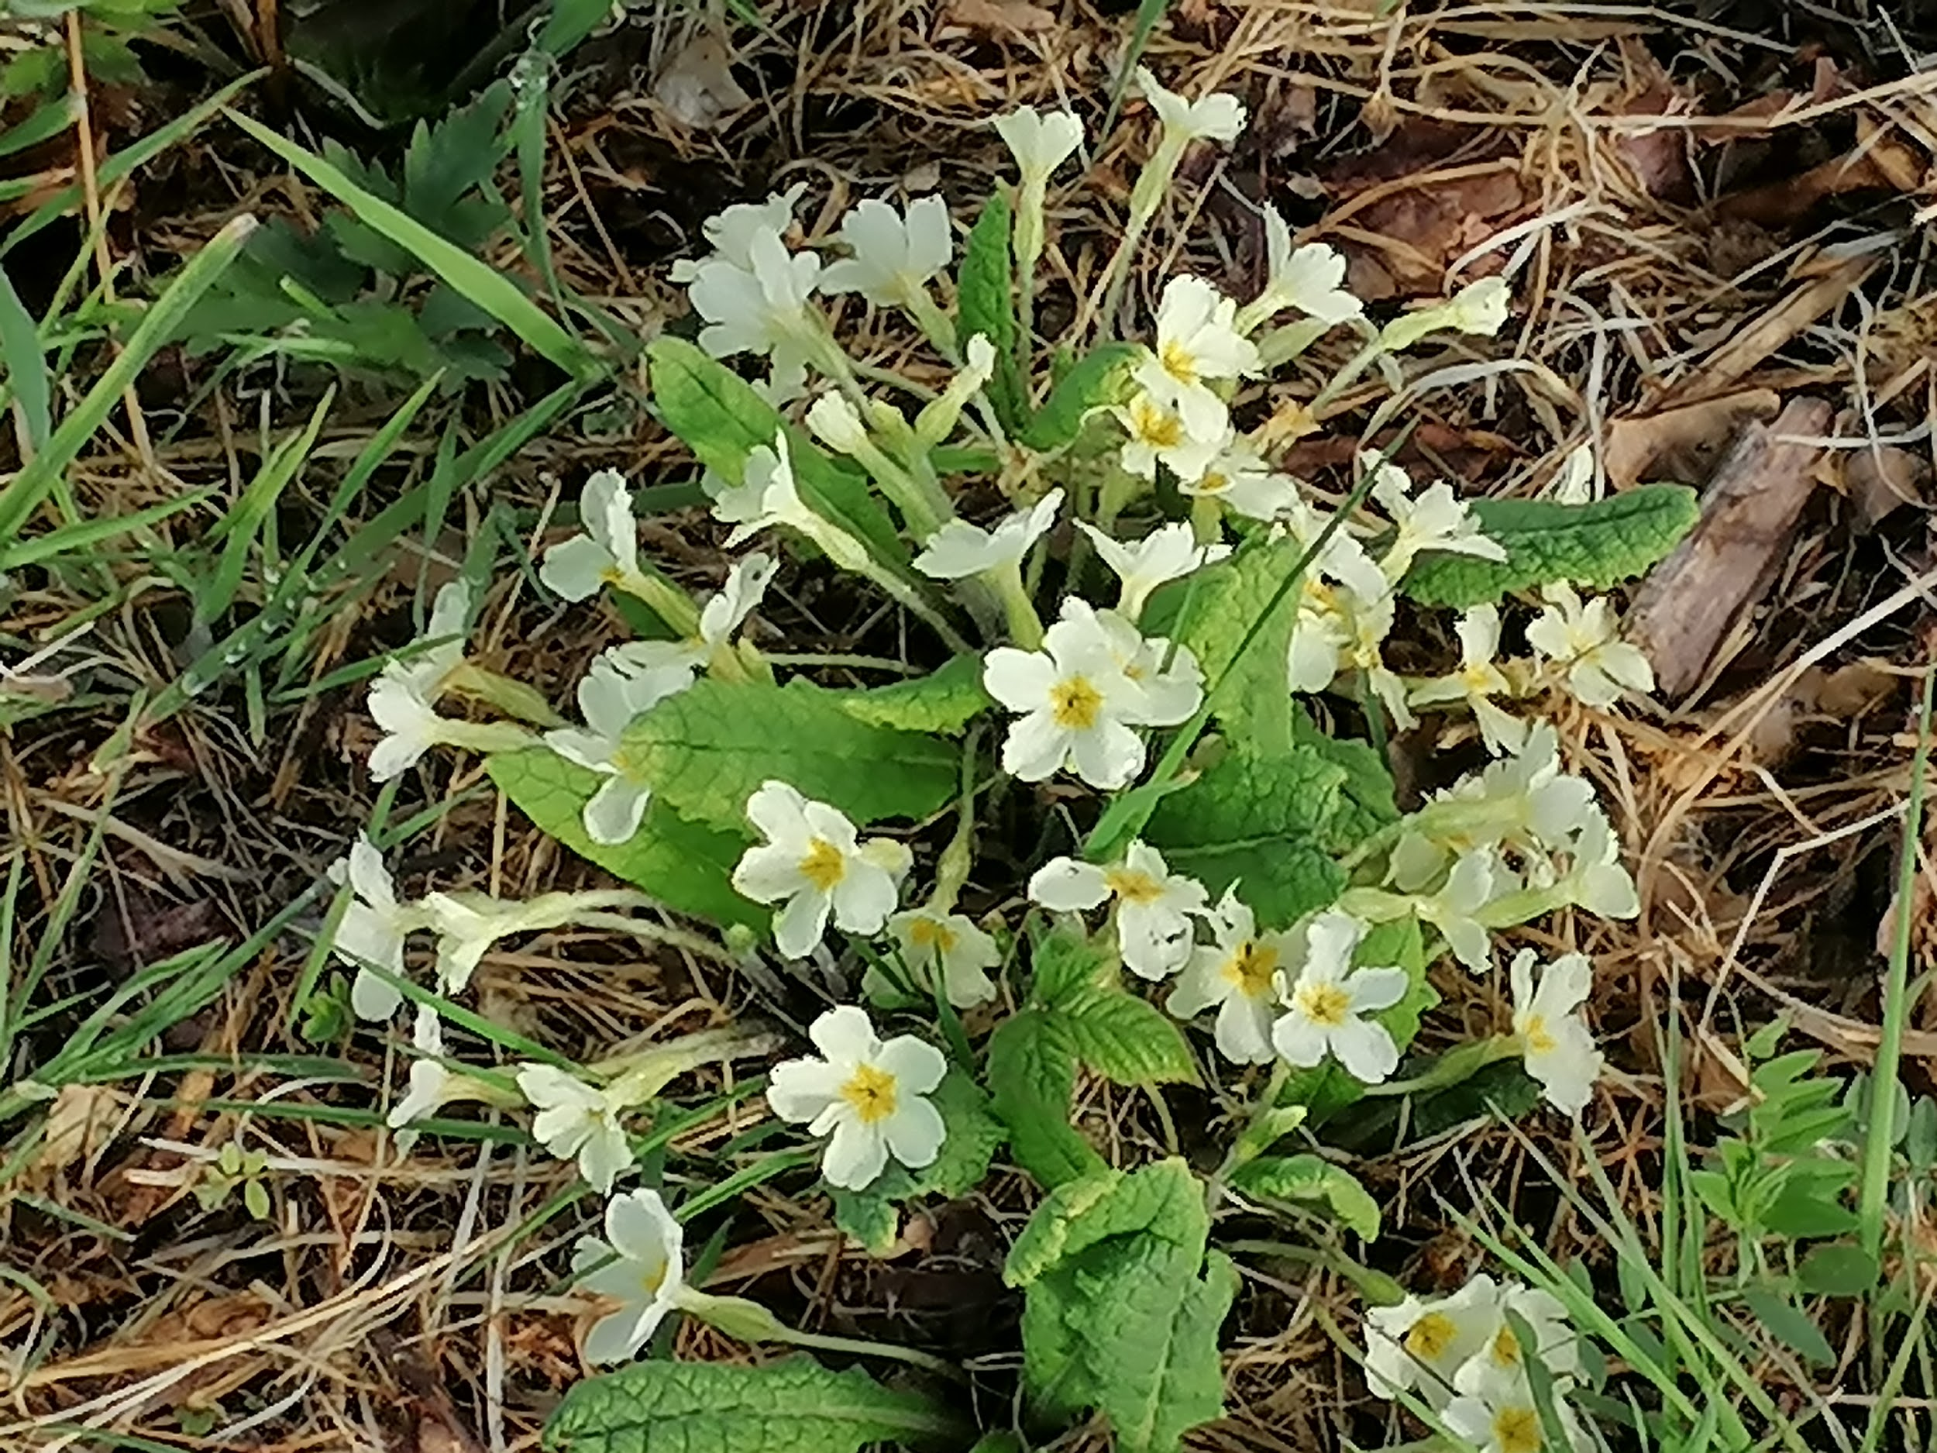
Wild garlic
Dandelions
Violets
Primroses

Slide 10
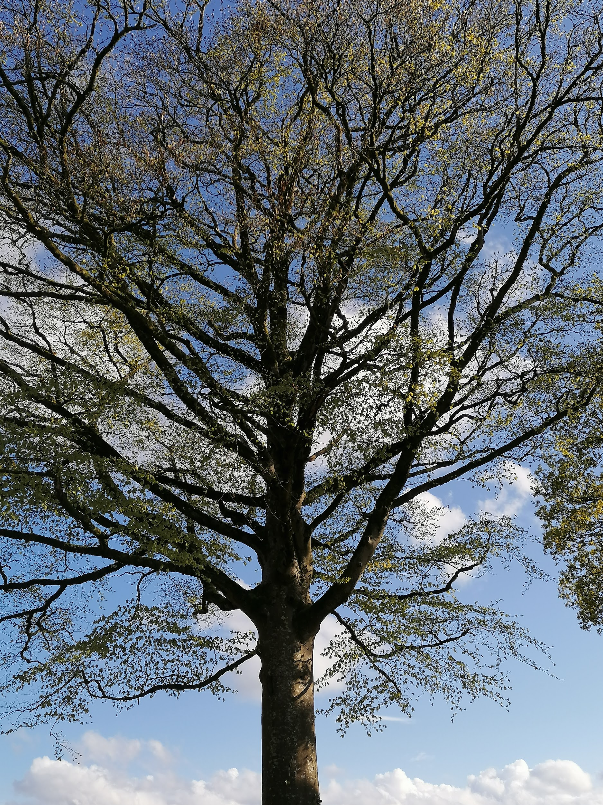
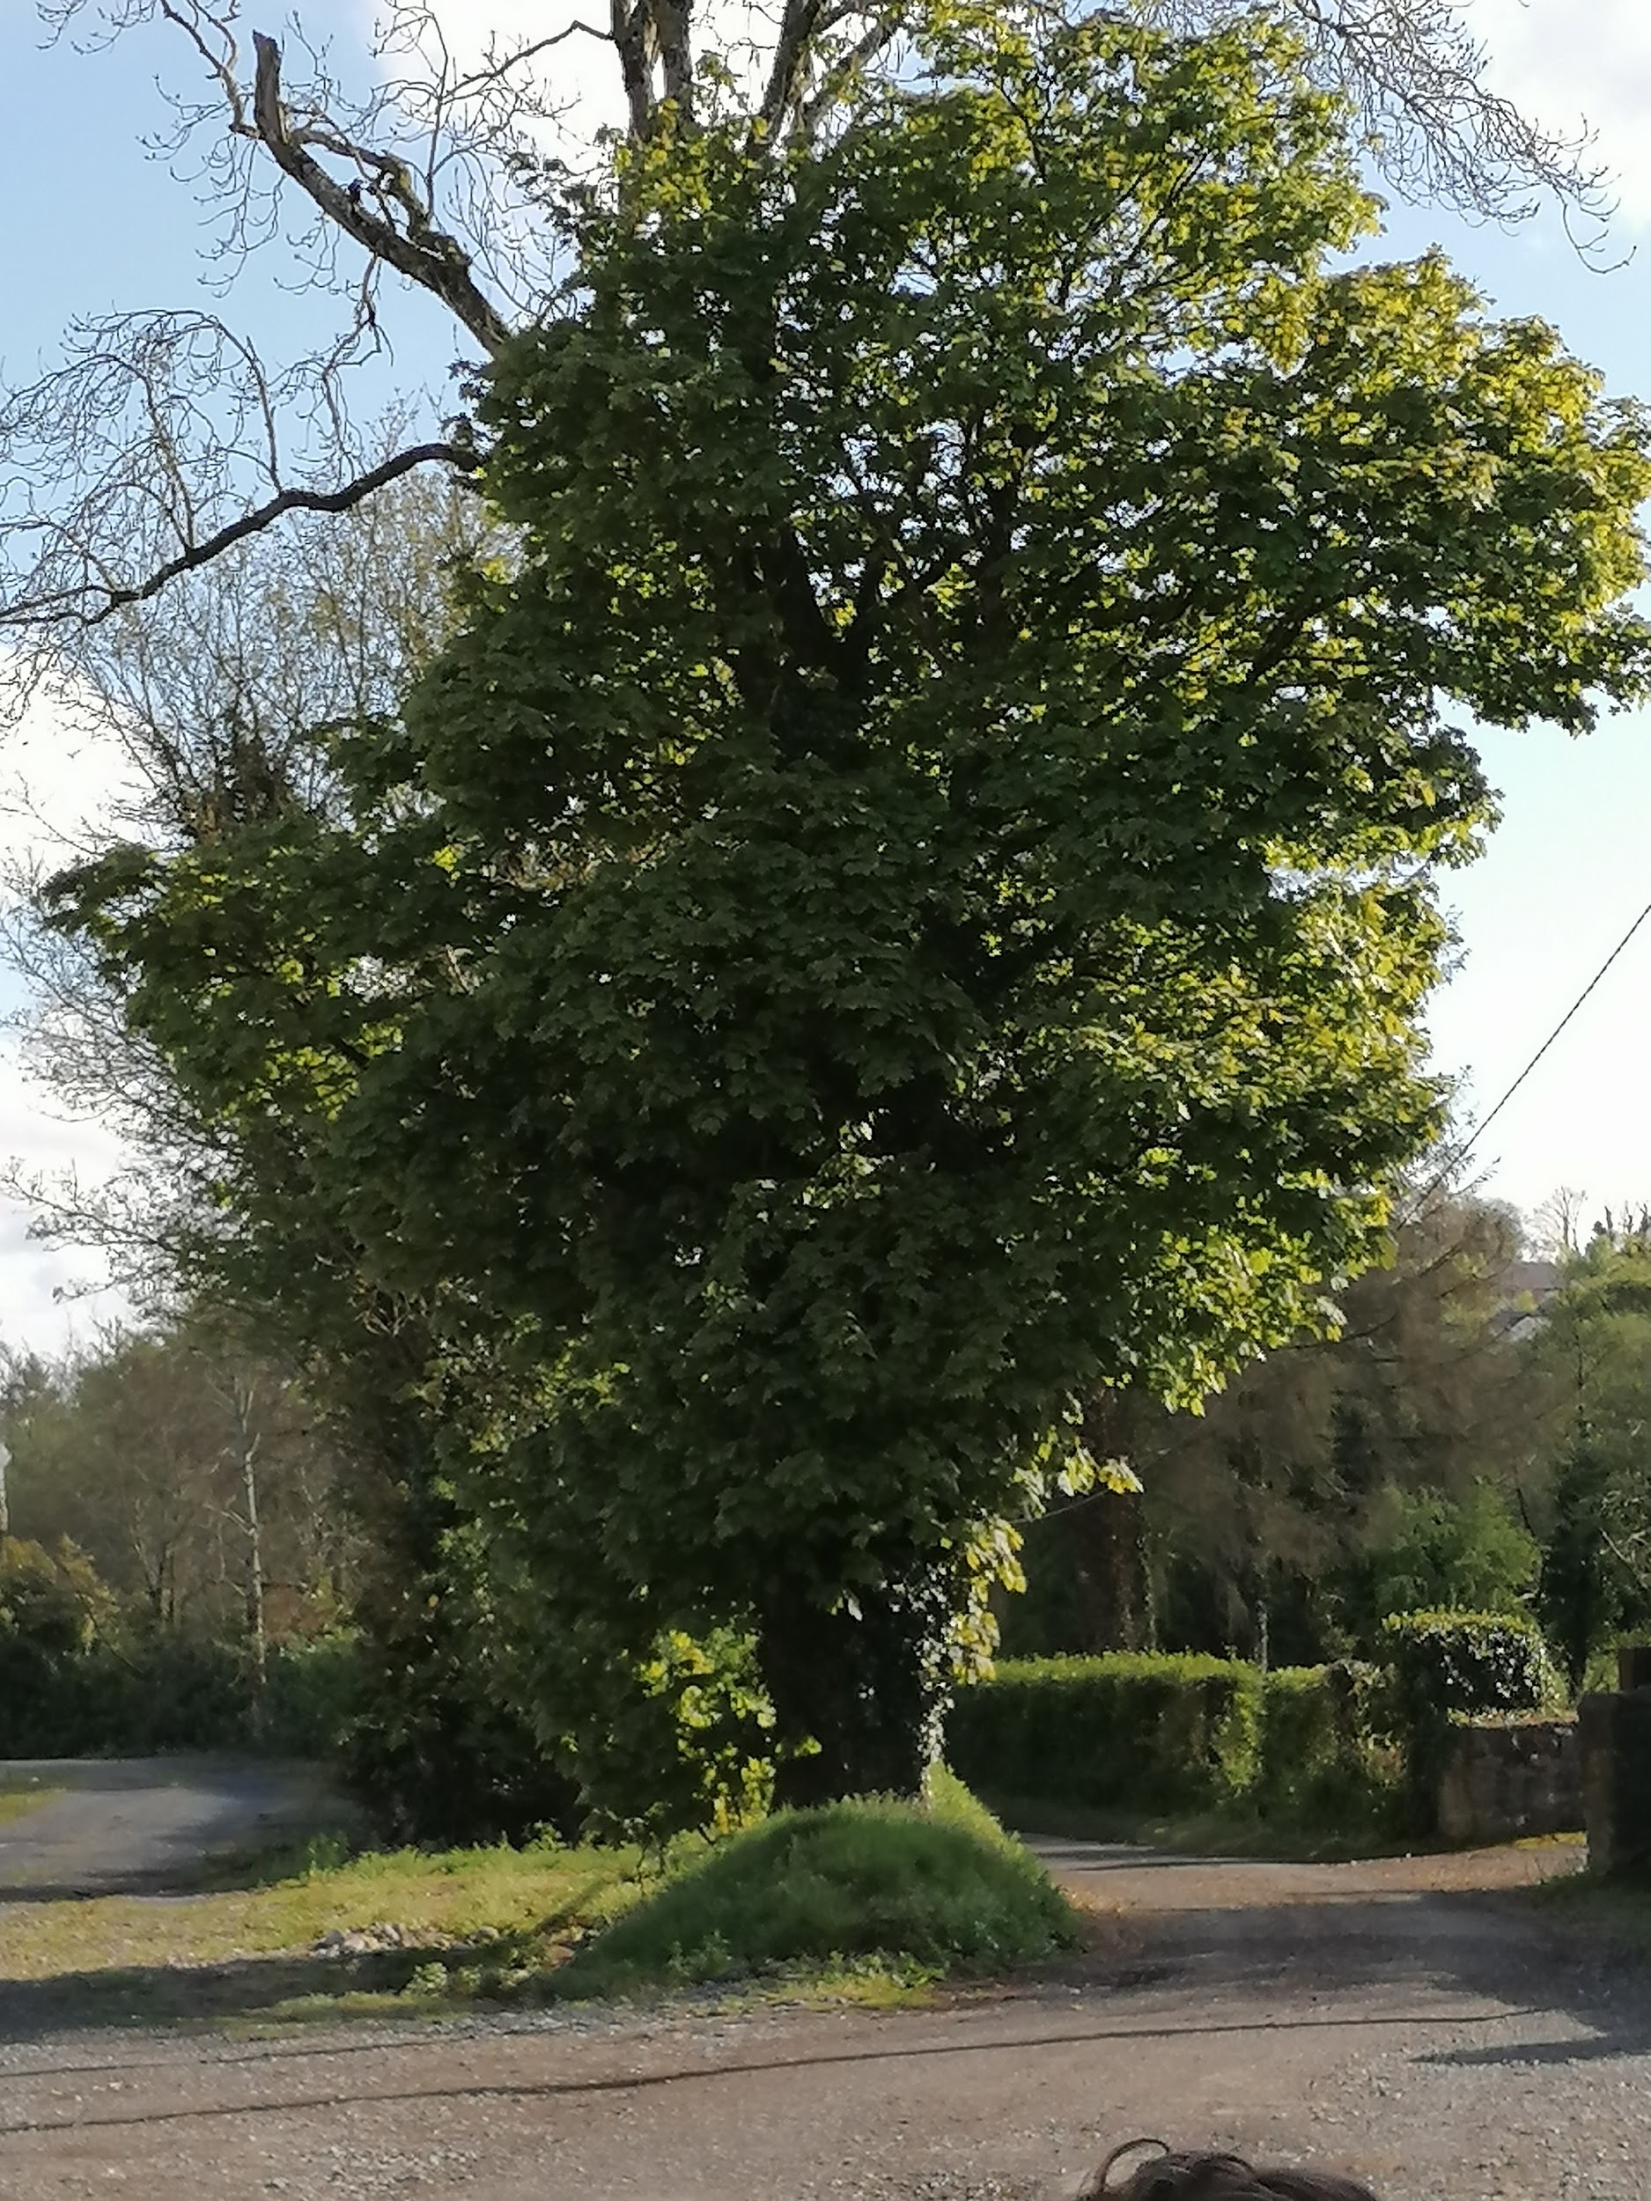
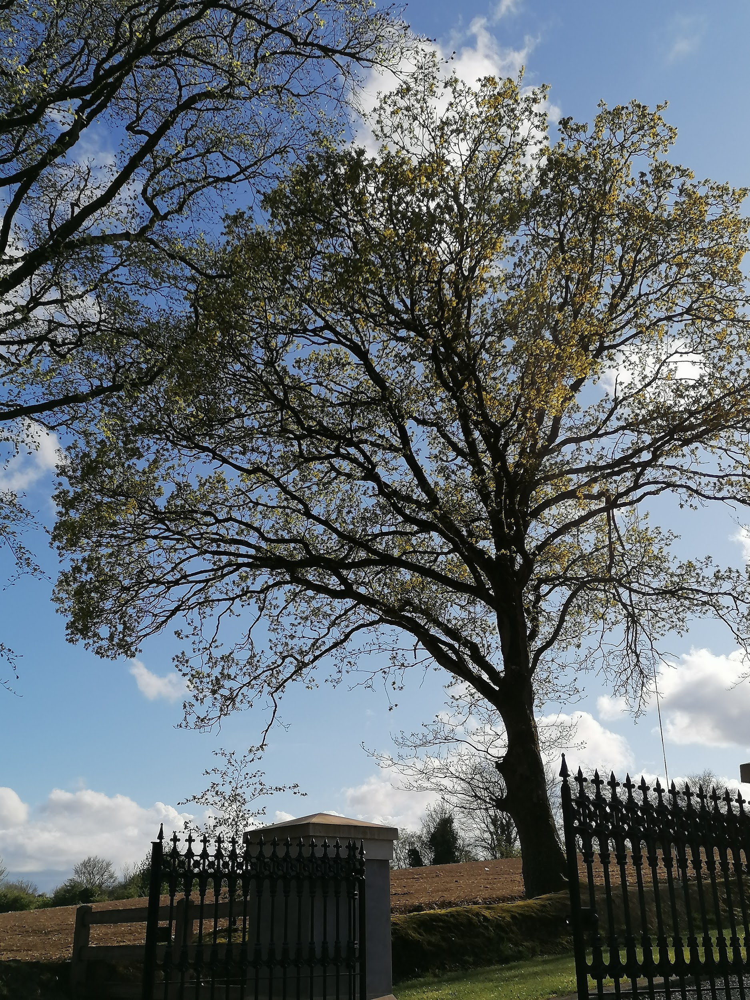
Beach tree
OAK TREE
SYCAMORE TREE

Slide 11
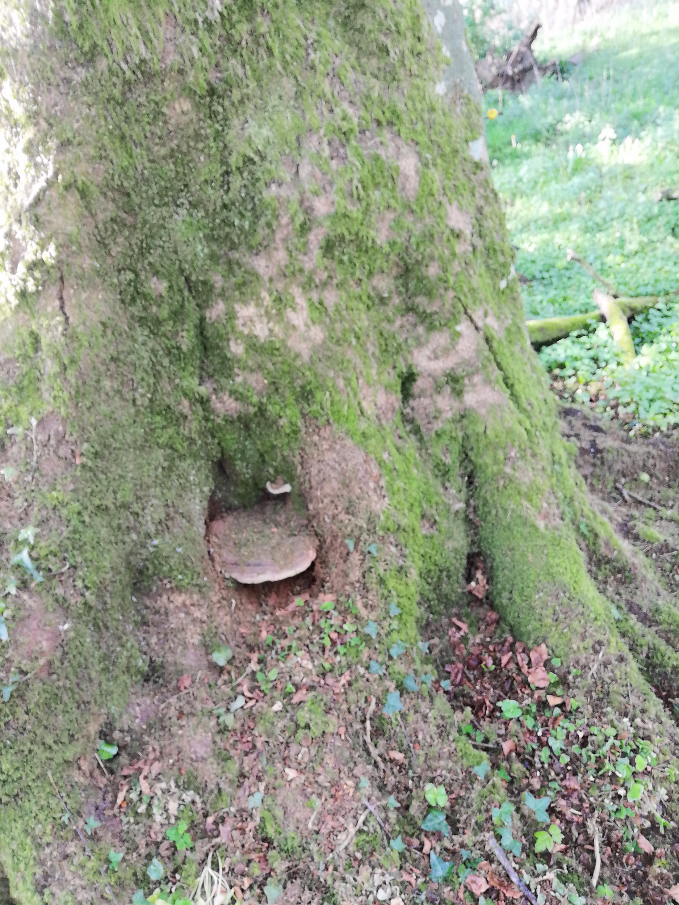

Slide 12
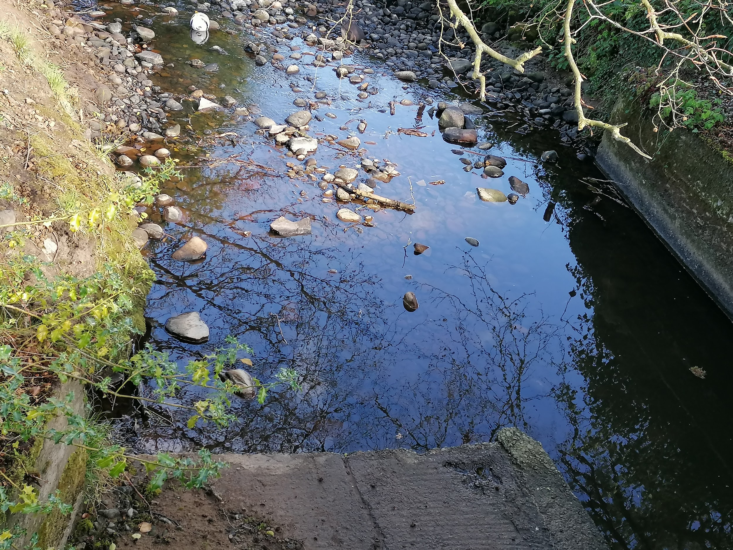
The River
It is great for skimming rocks in it and is very calm, so you can do mindfulness there...
The Shanco Lane river is a clean river that has lots of wild flowers around it like bluebells and many others. It has no plastic in it and it is very peaceful. There are lots of trees around it and because the water is so clear you can see the reflection of the trees in it.

Slide 13
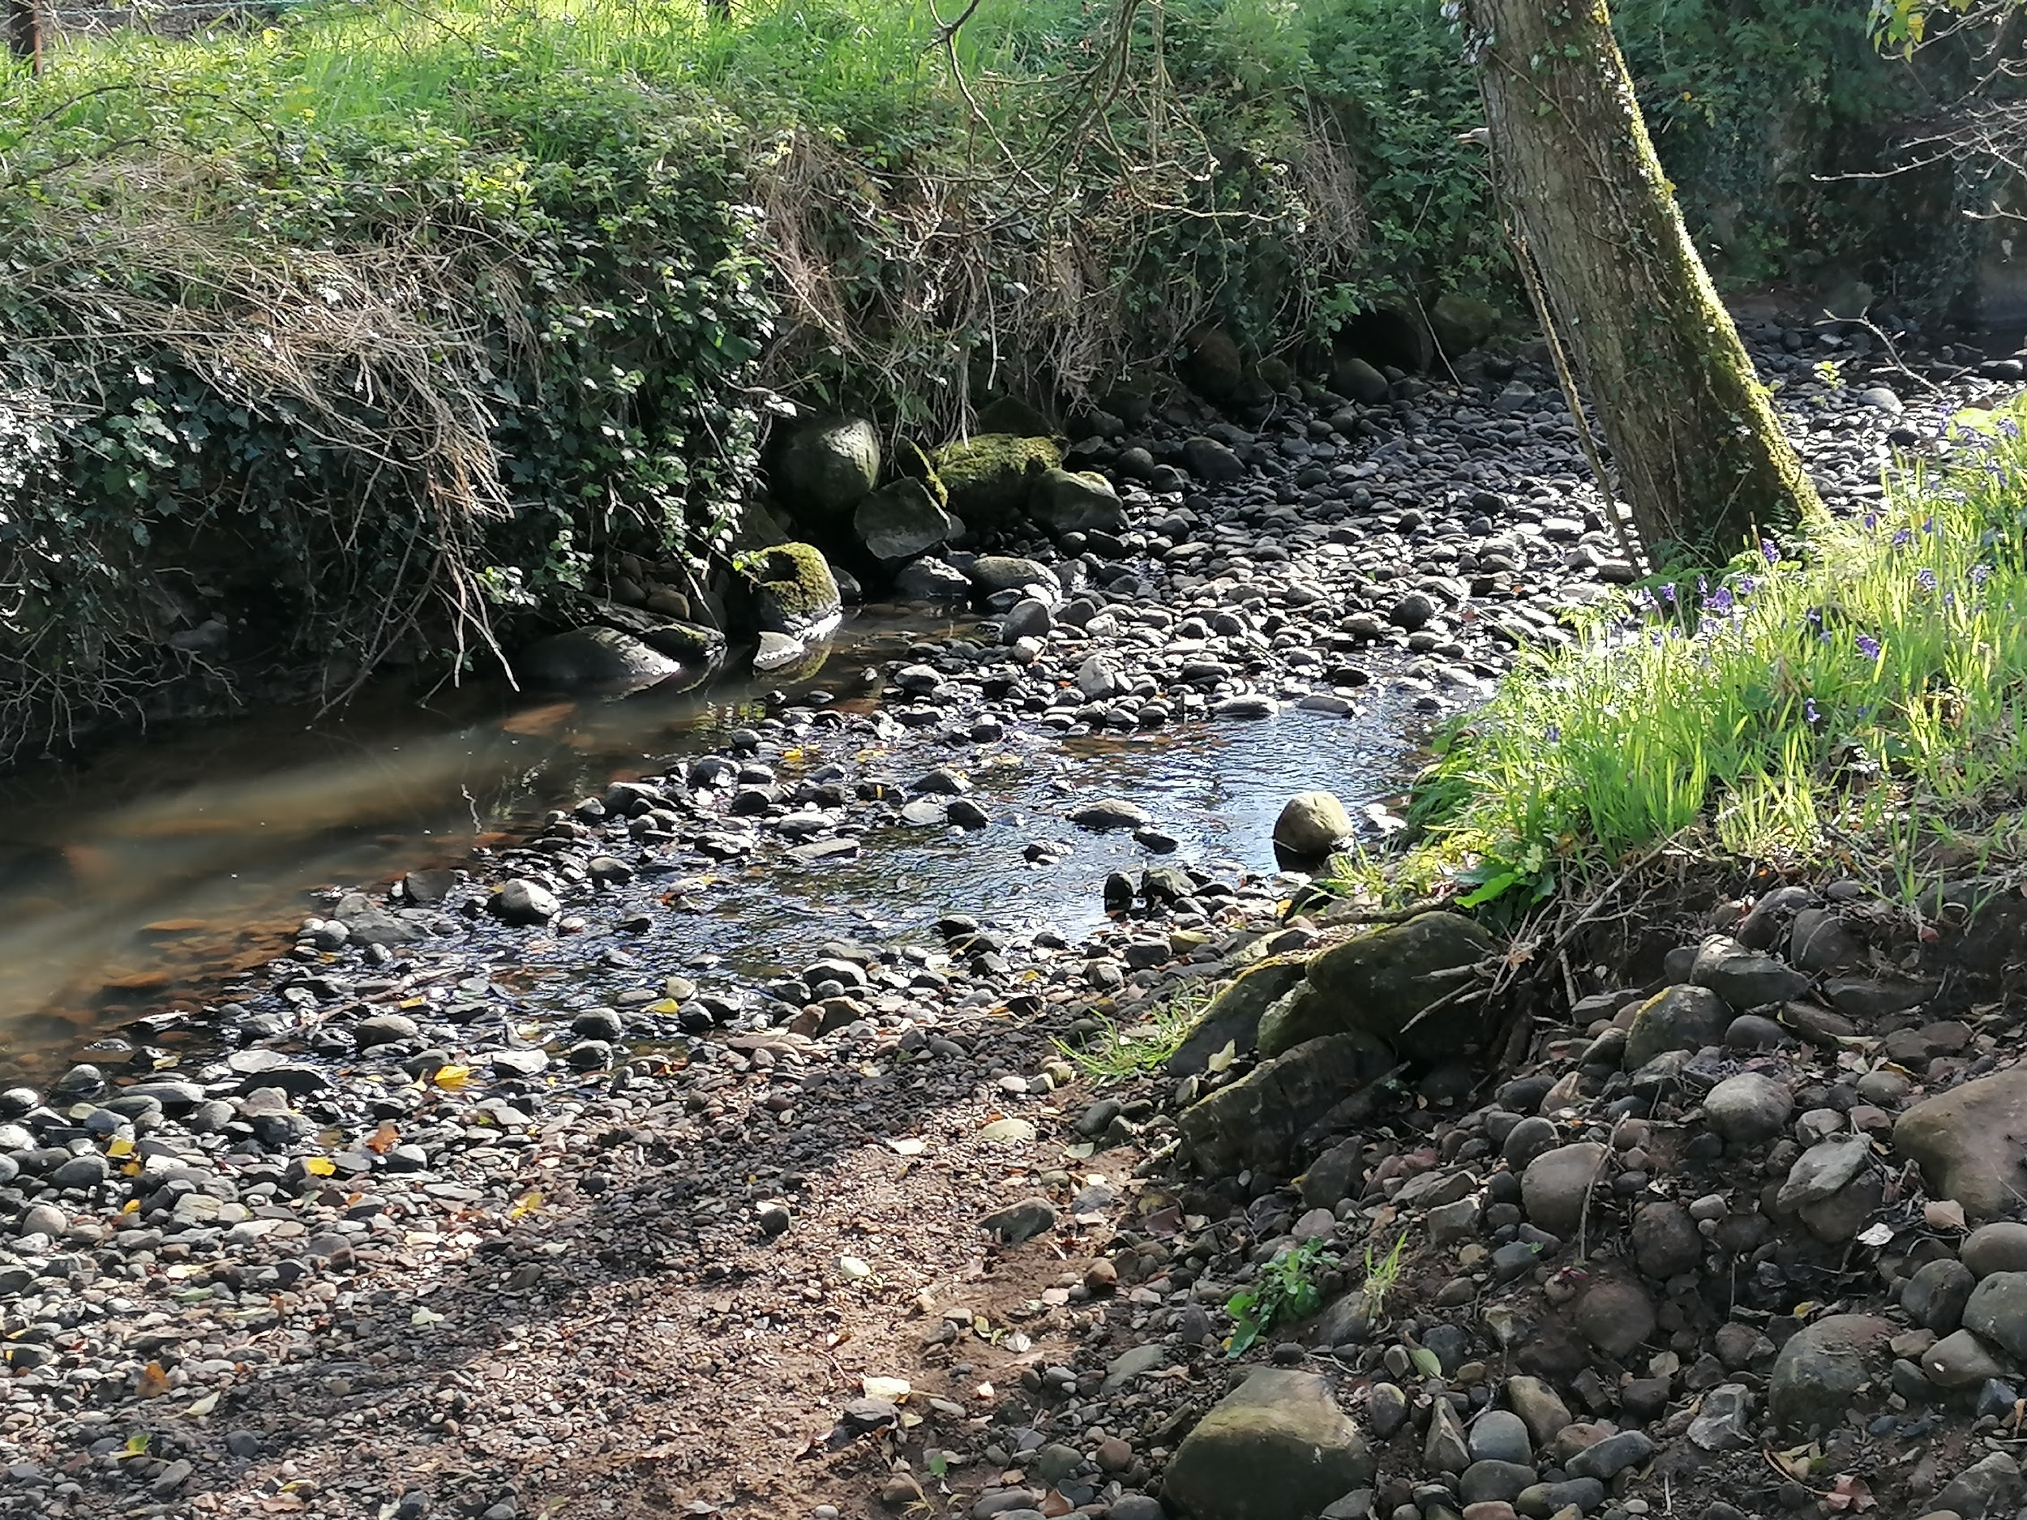
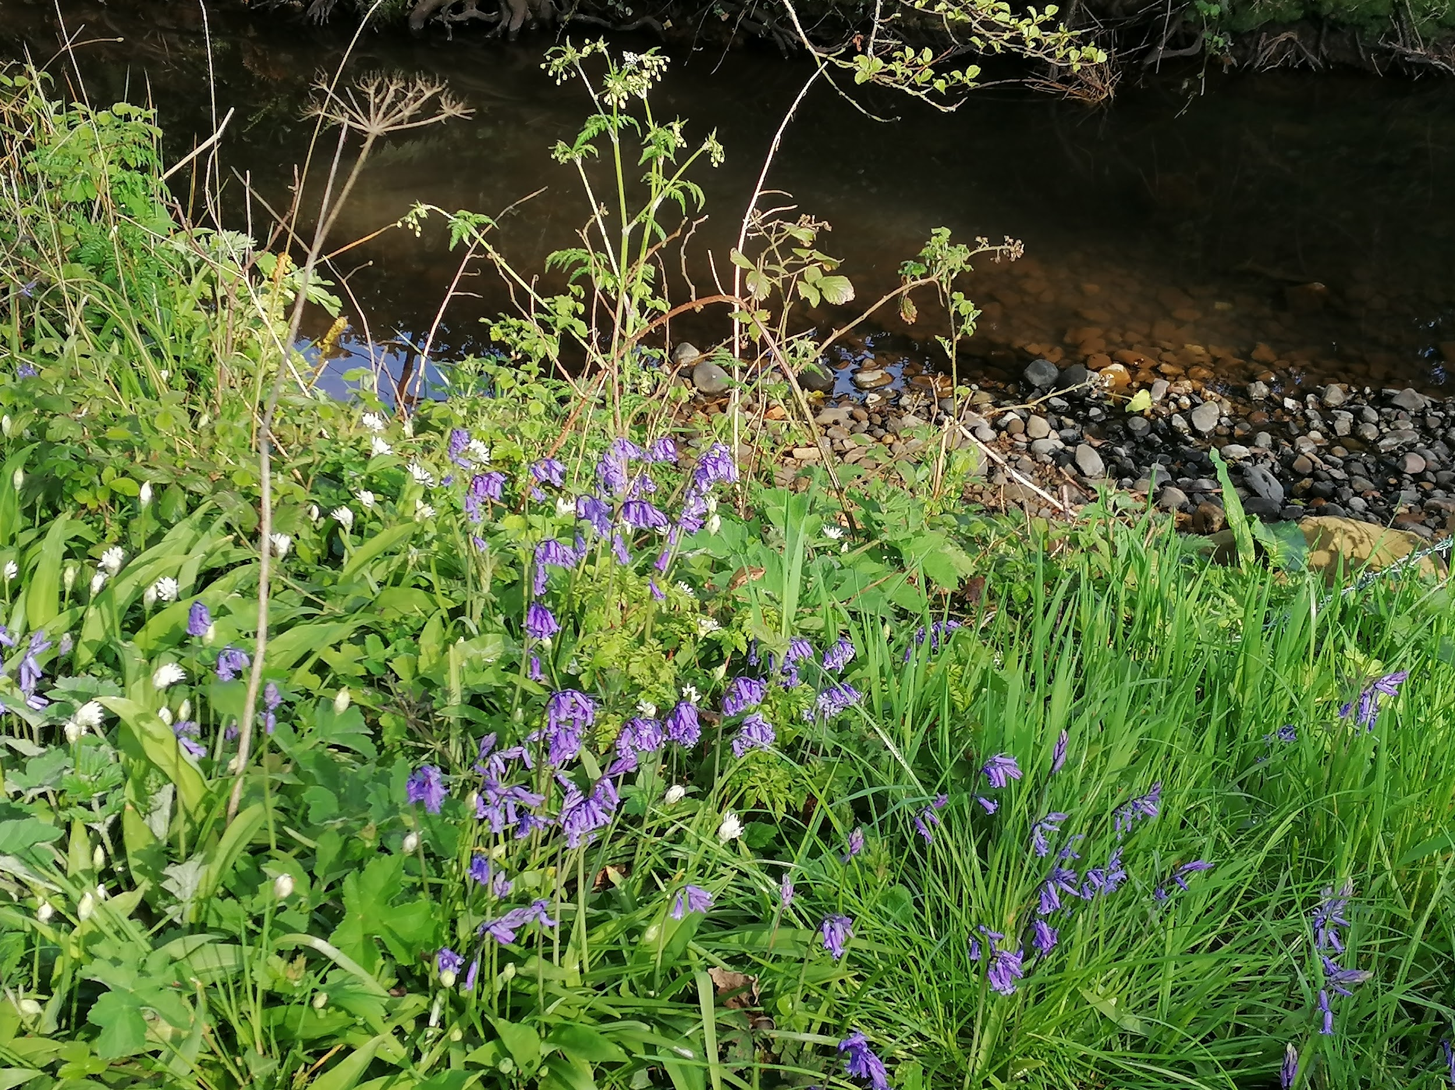
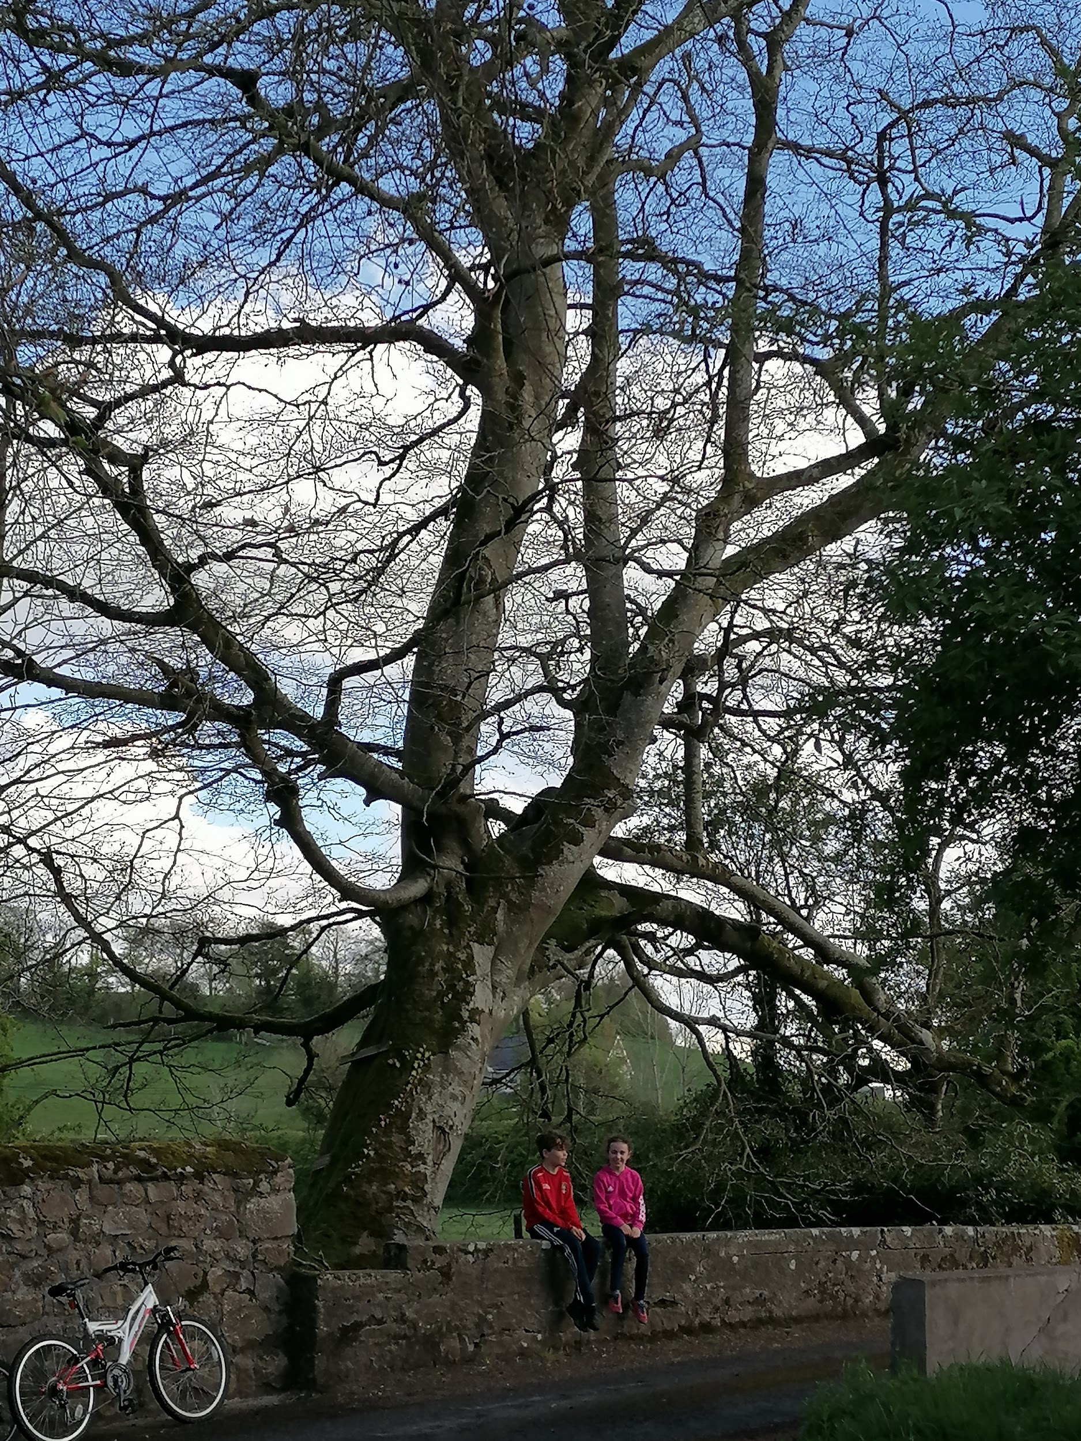
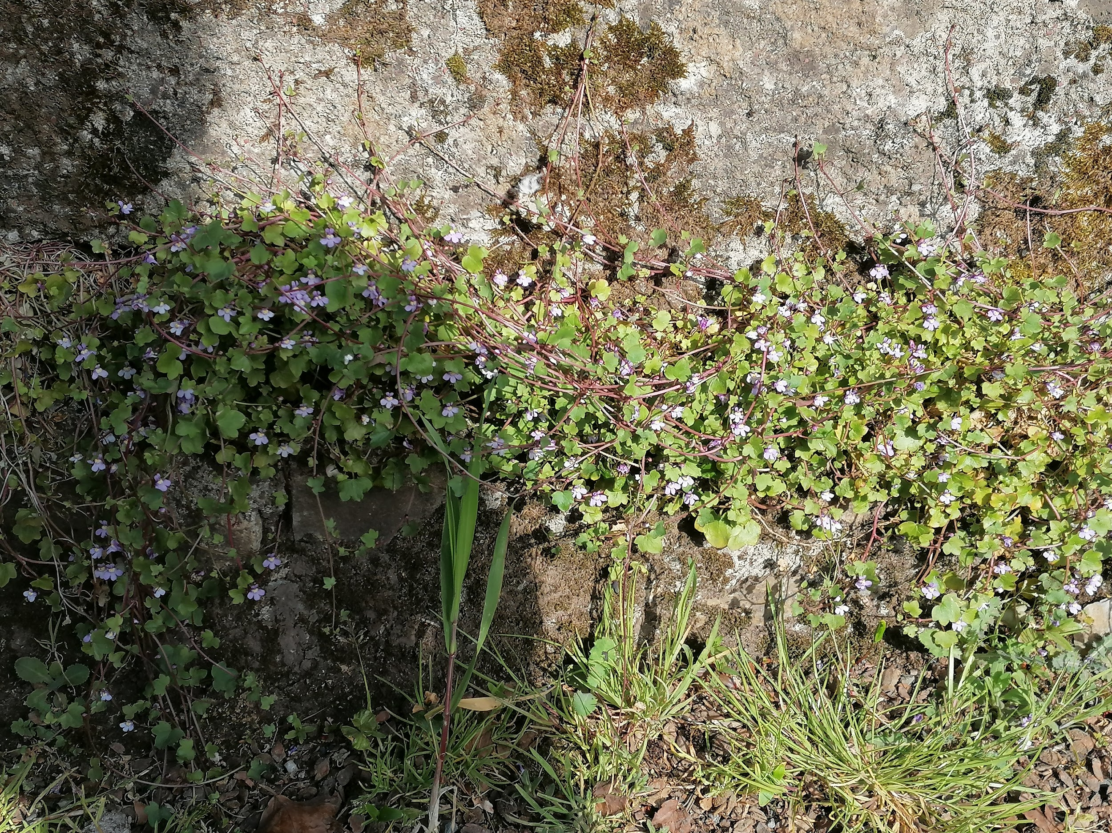
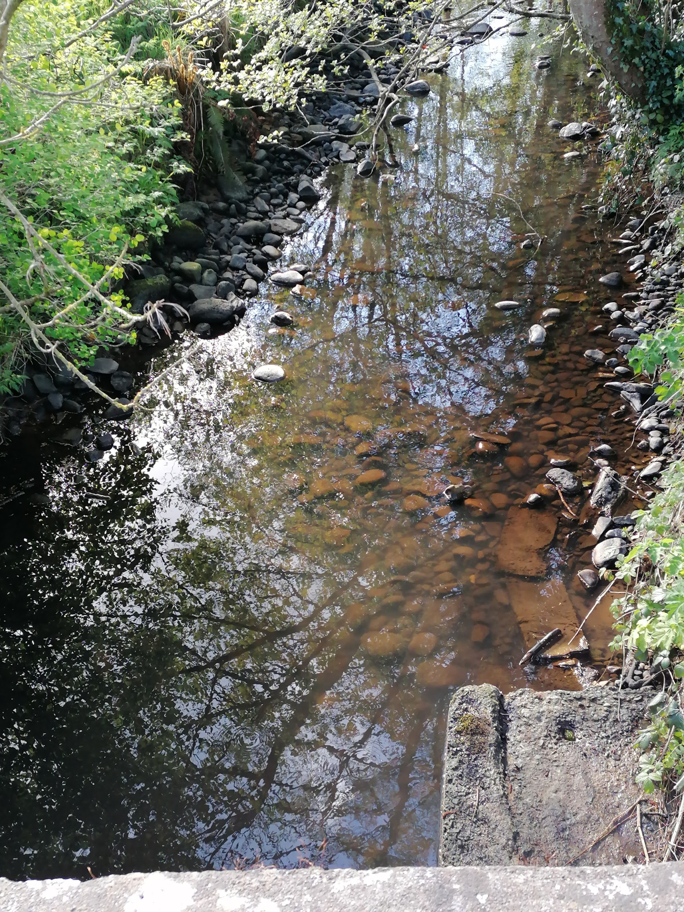
There is a little entrance at the middle of the river for you to take rocks and throw them into the river. It ALSO FLOWS INTO THE BLACKWATER..

Slide 14
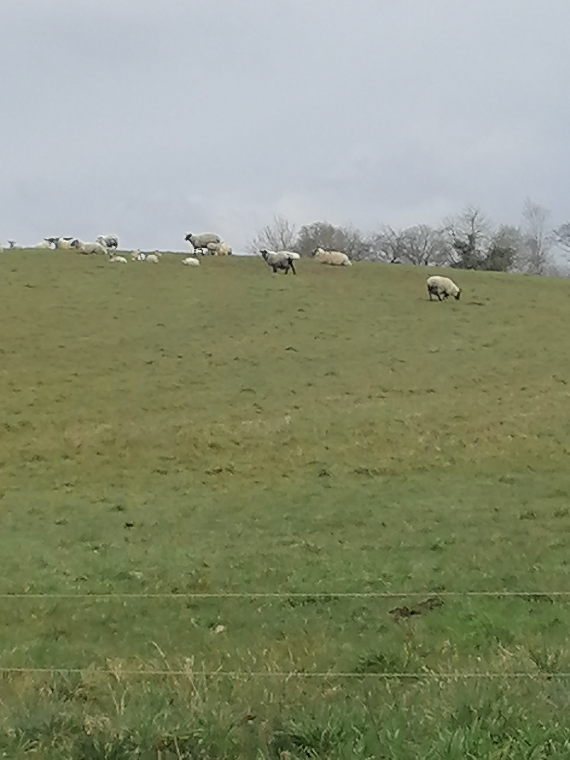
We
Love
The
Animals

Slide 15
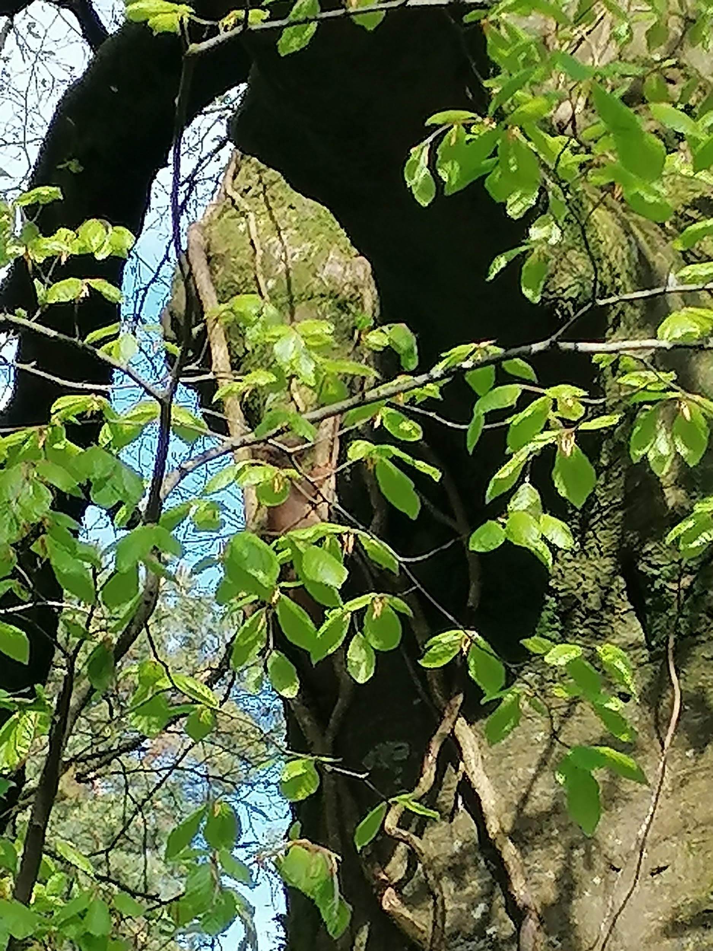
All the animals on Shanco lane
Shanco Lane is known for its wildlife. Here are the animals that you might see if you keep your eyes peeled:
*Jay bird
*Blue tit
*Fox
*Blackbird
*Common pipistrelle bat

Slide 16
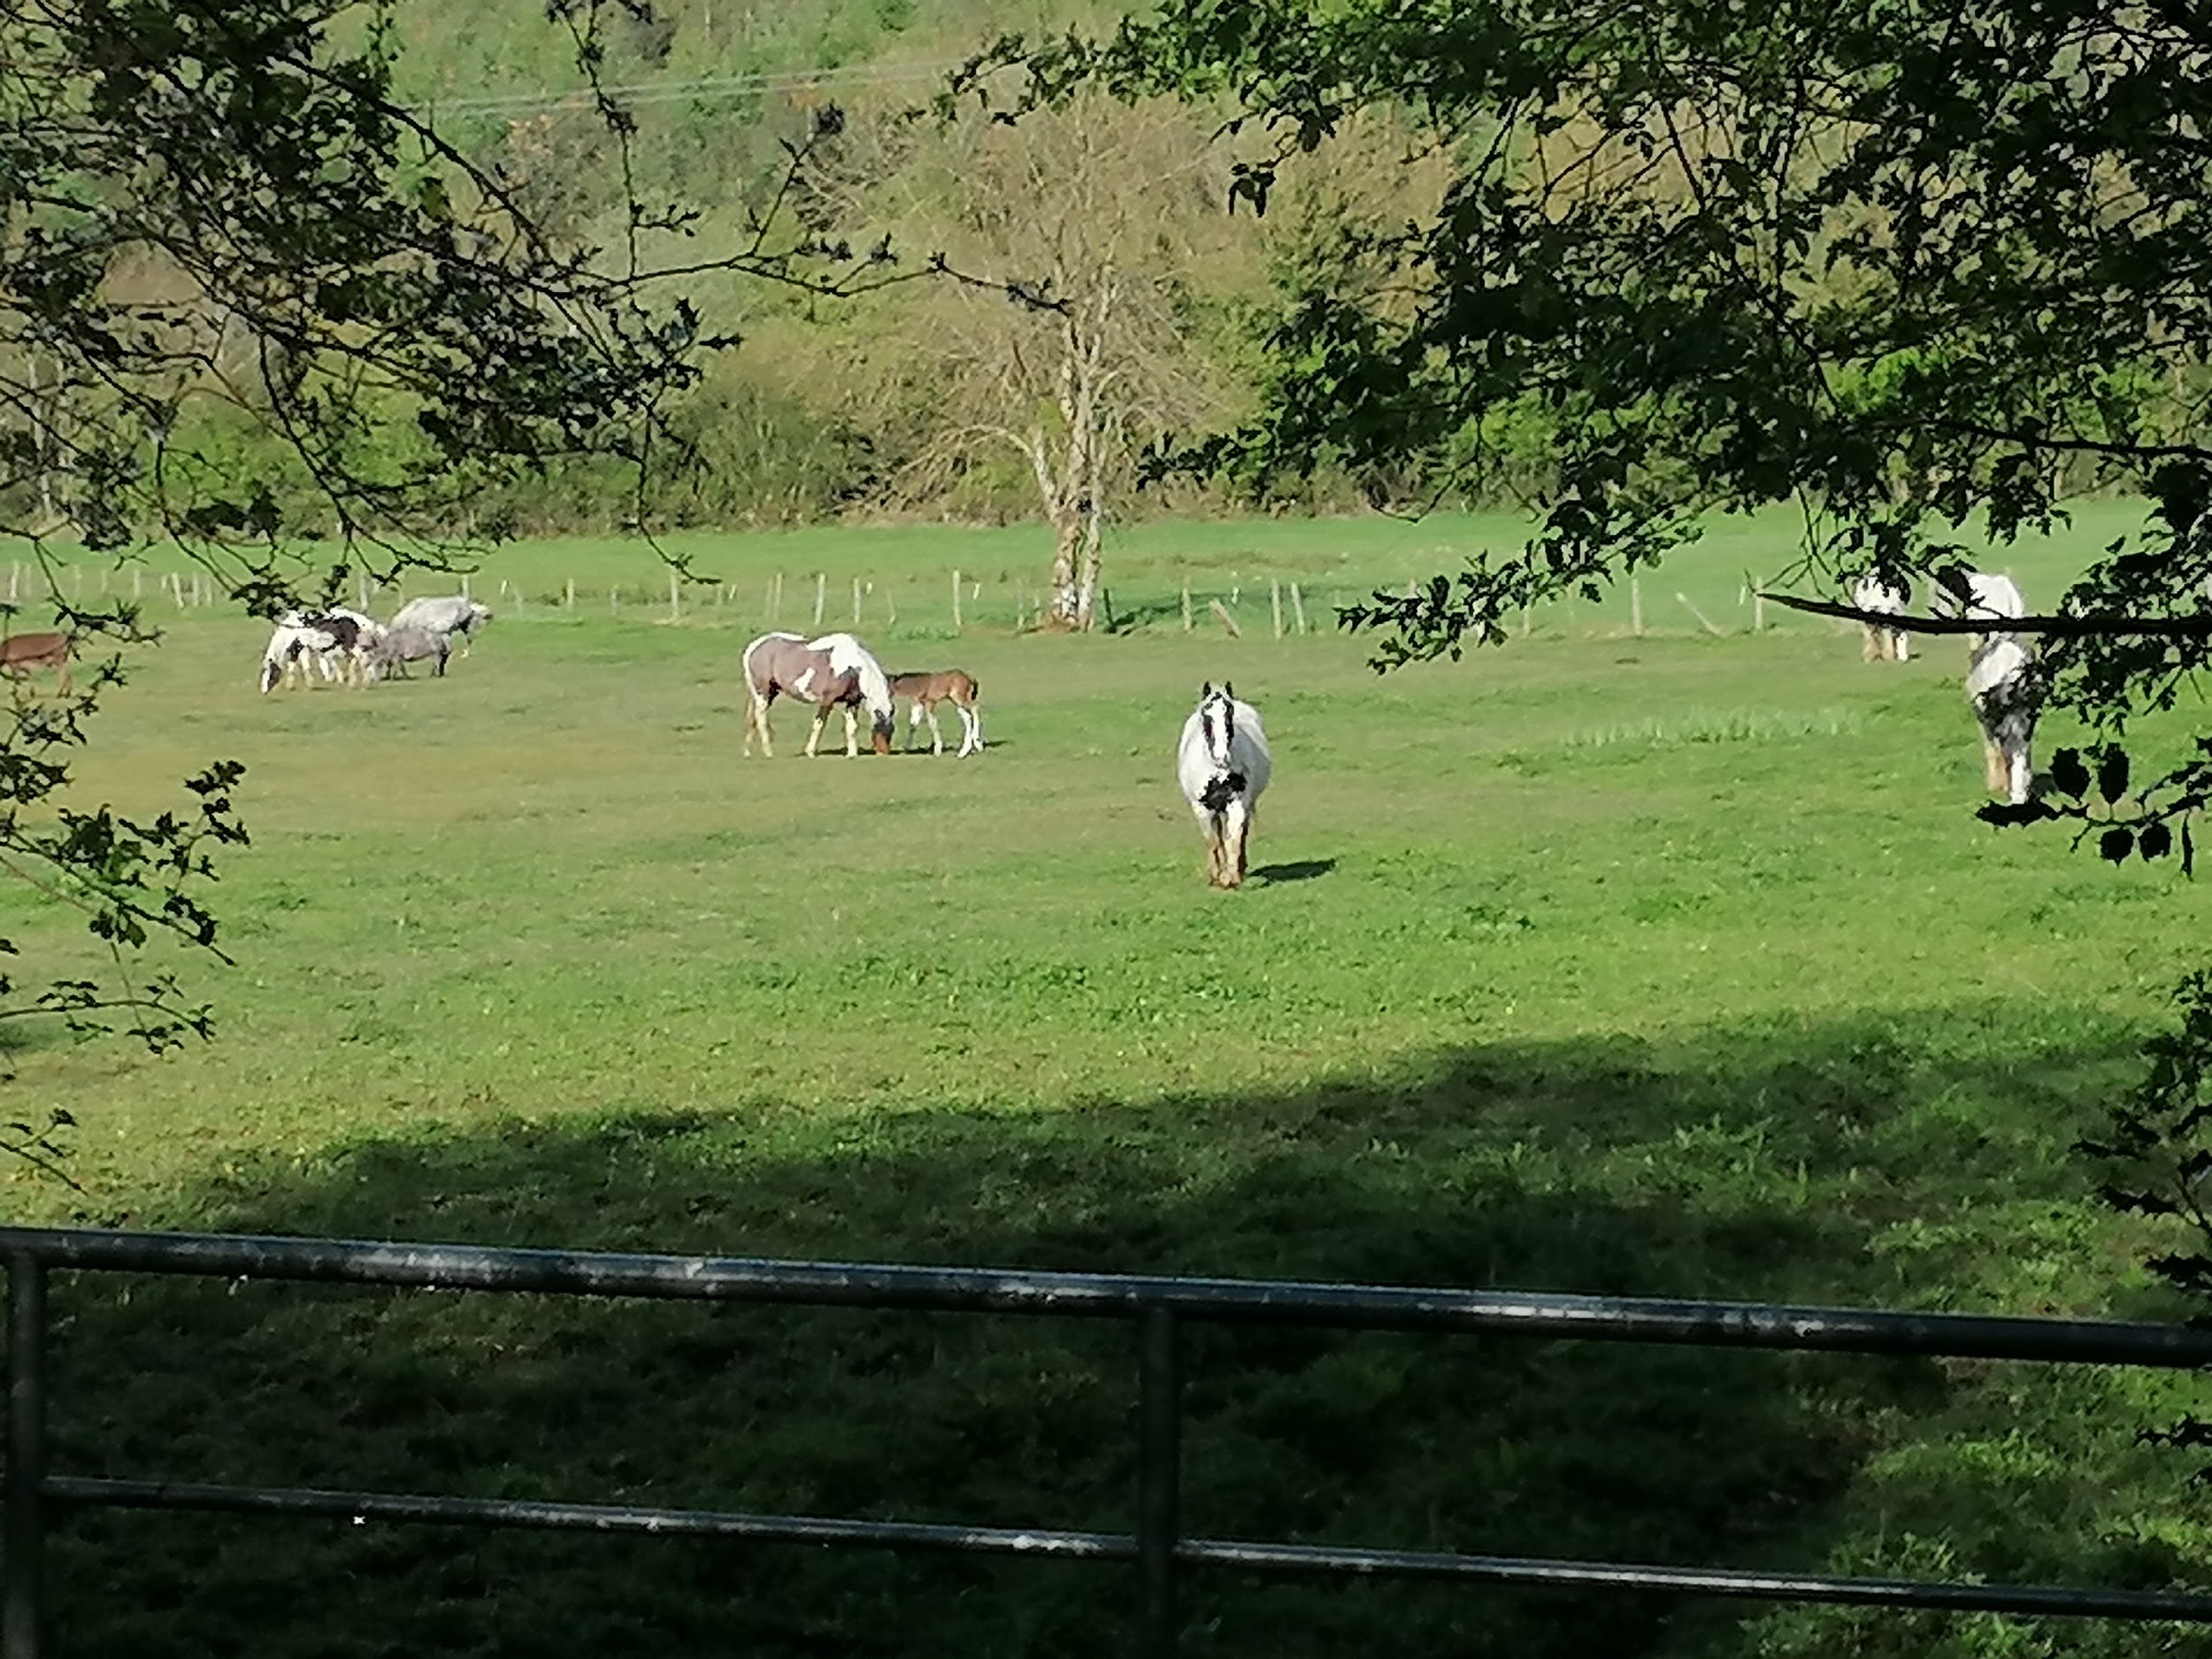
More animals to see
*Red Squirrel
*Pheasant
*Barn Owl
*Pine Martin
*Horse

Slide 17
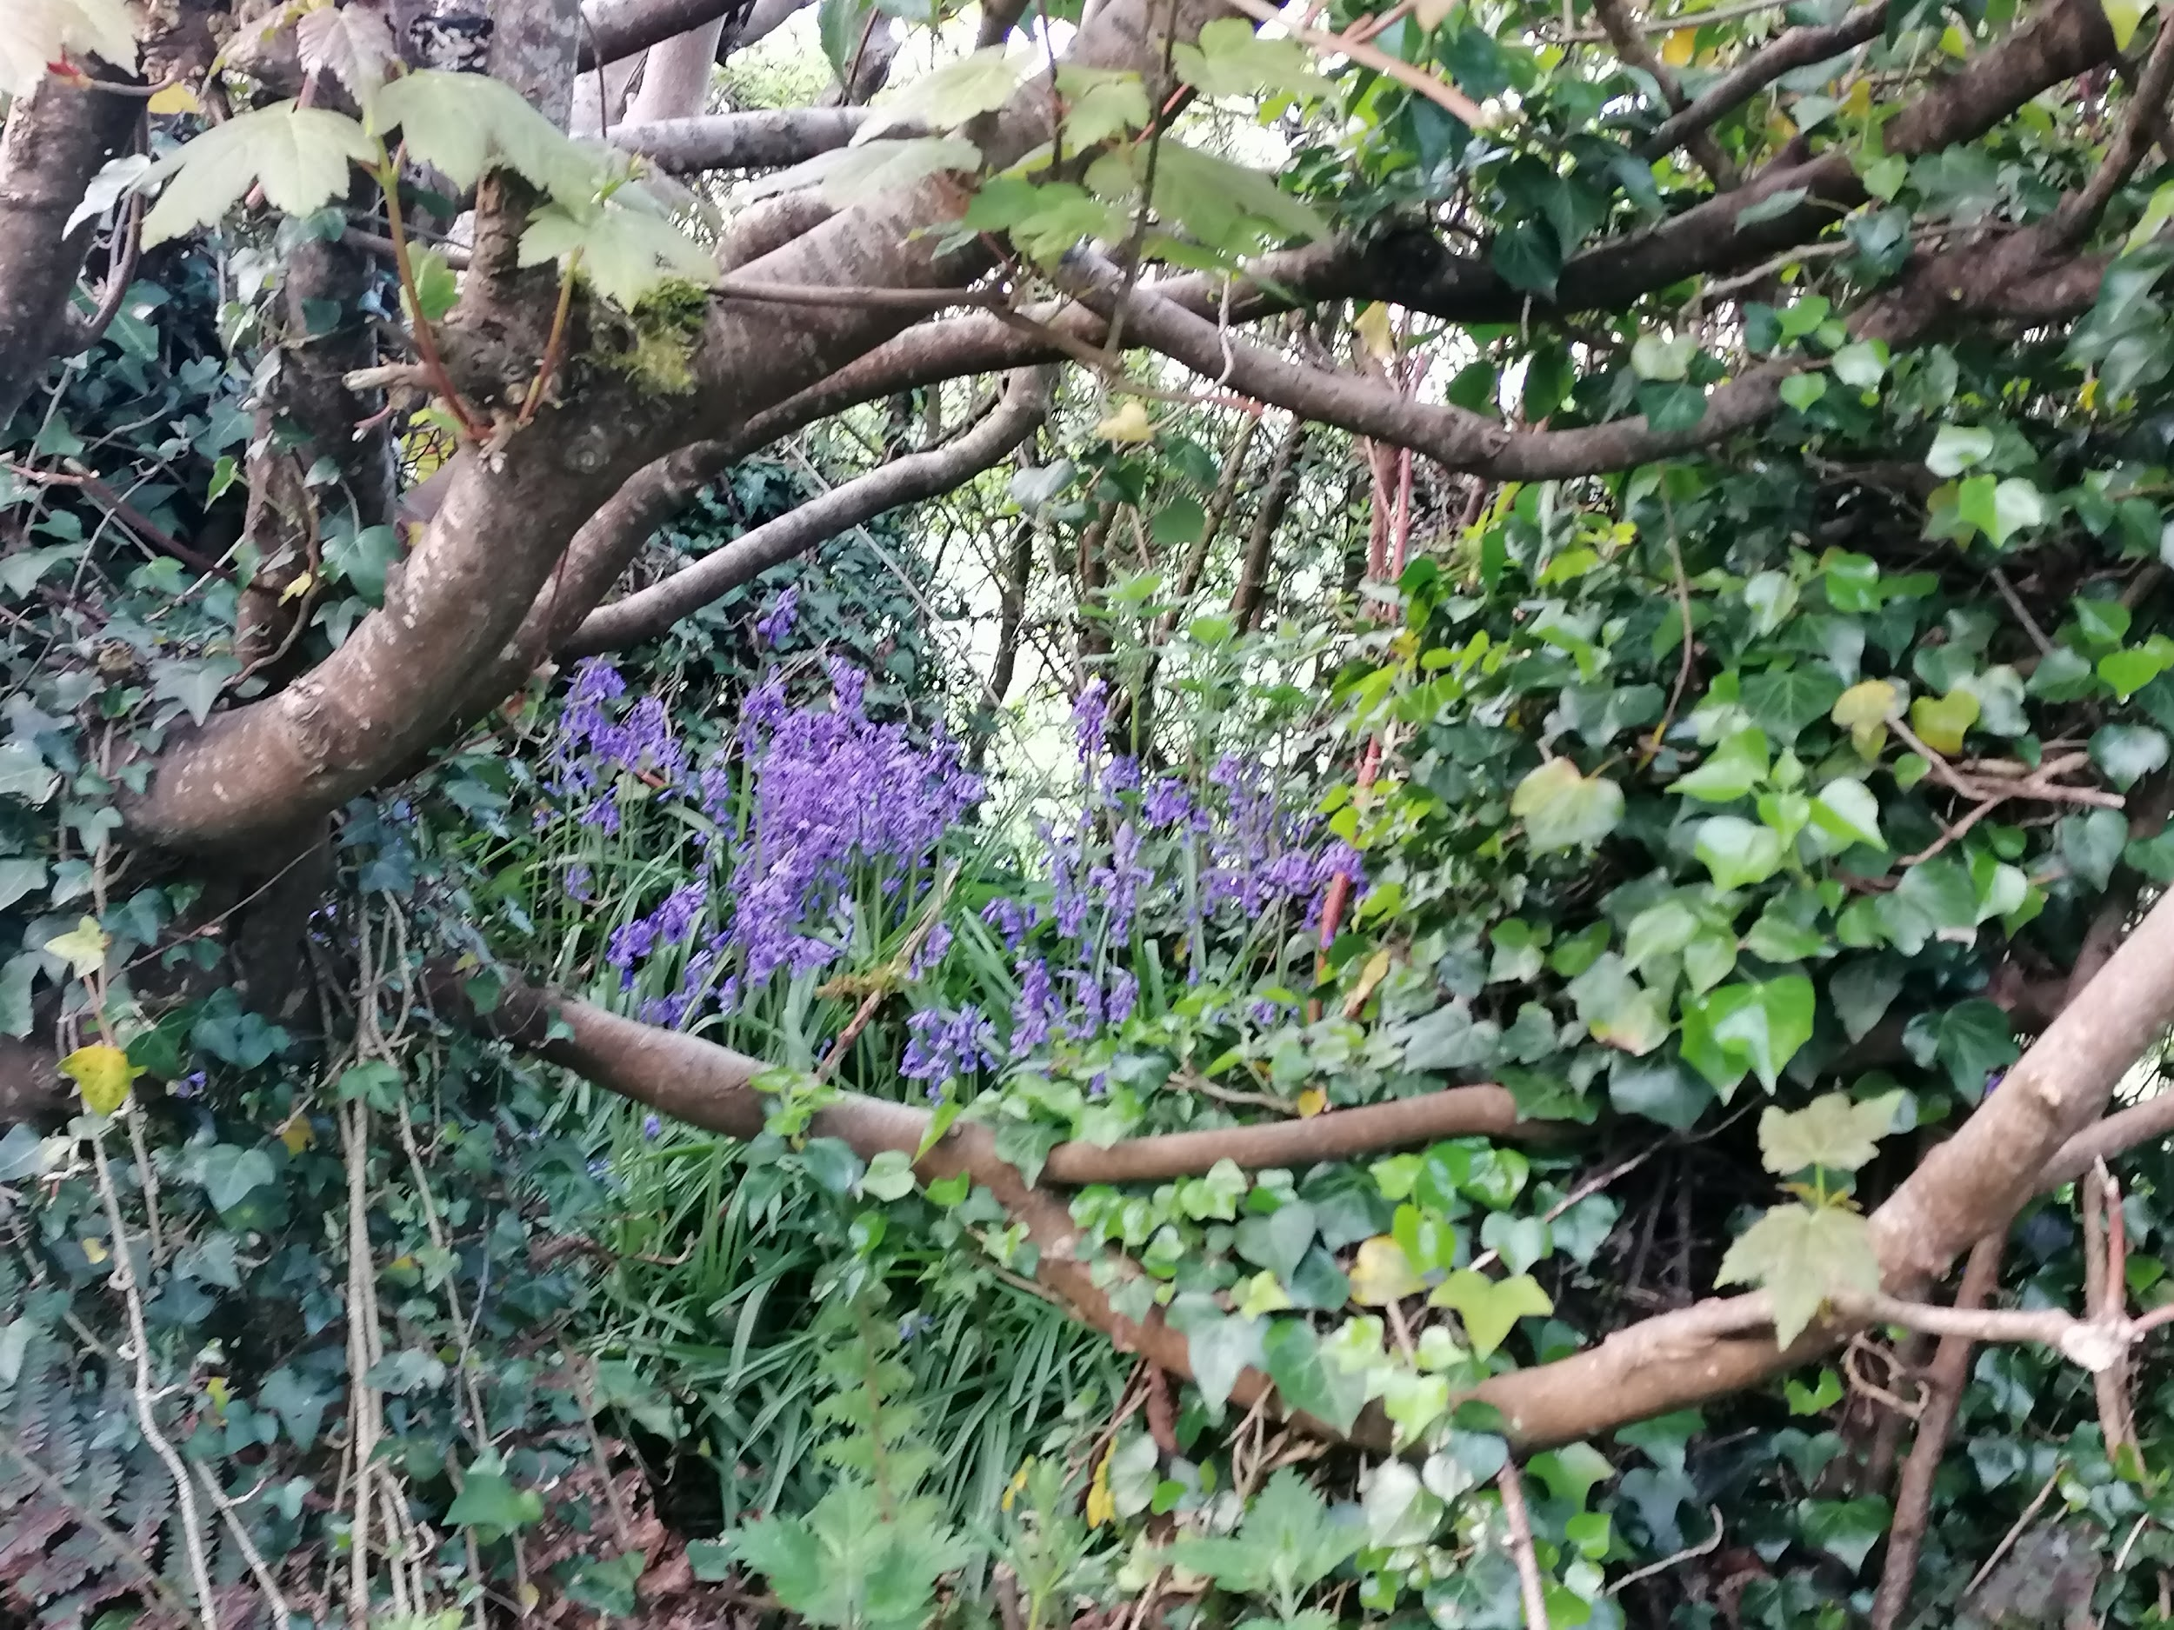
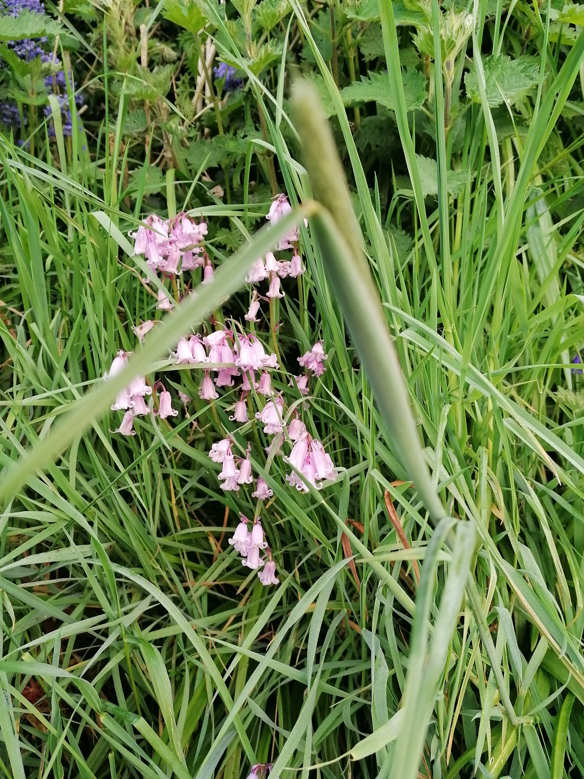
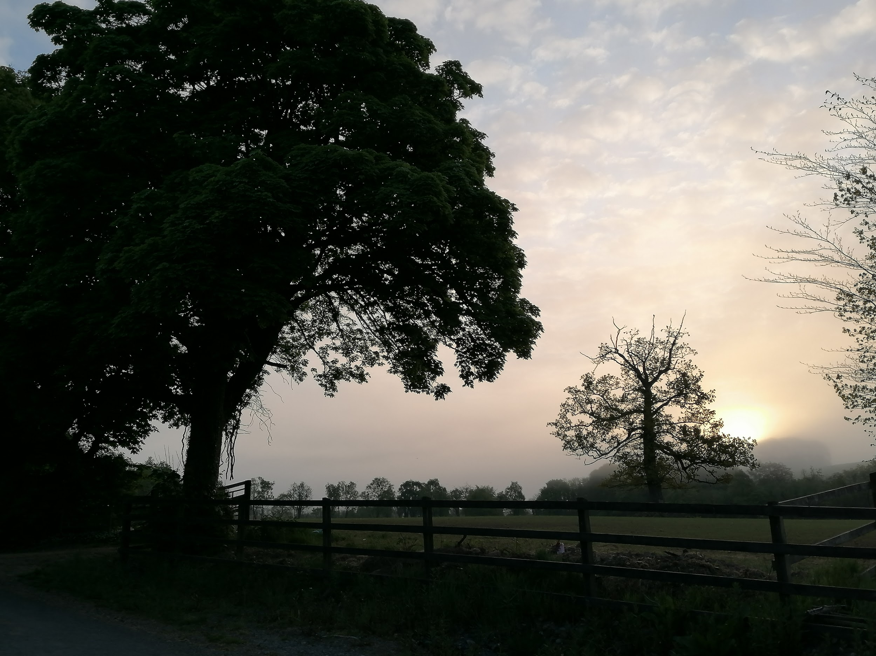
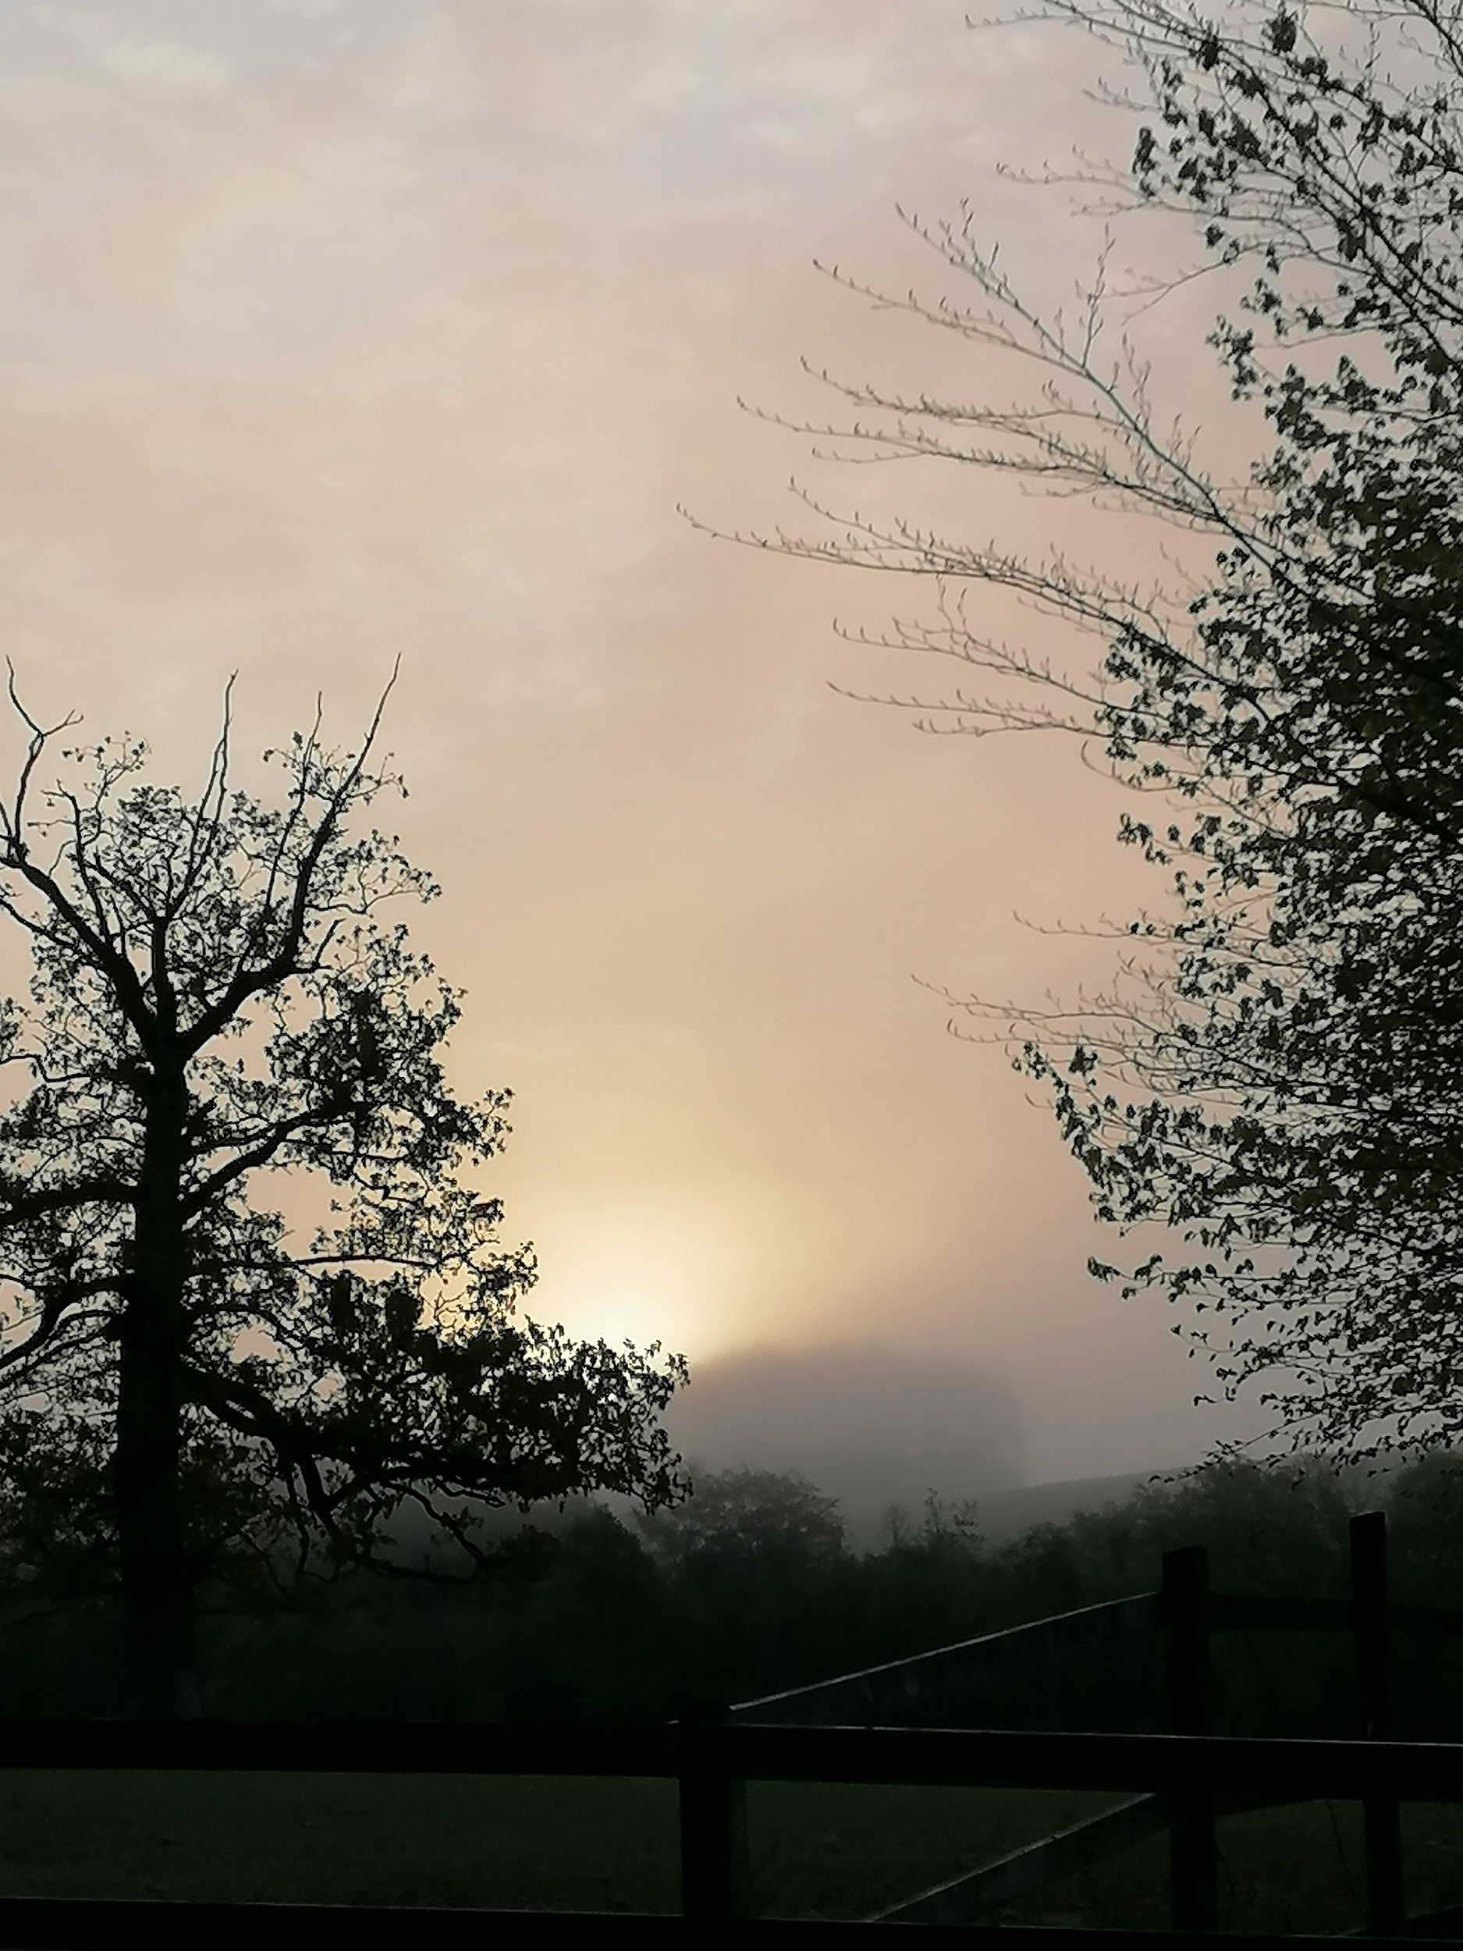
We did darknes
Into light on
May 9th 2020
At 5:00 in the morning!

Slide 18
The end
By Cathal and Eadaoin O Reilly 😊

