Slide 1
Bulgaria
This is my project on Bulgaria.

Slide 2
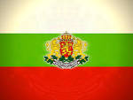
The Bulgarian flag.
The Bulgarian flag is
white, green and red.
In the middle of it there
is a badge.

Slide 3
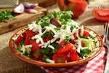
Bulgarian food
In Bulgaria they eat different types of food like kavarma (a meat and onion stew), shopska salata (a salad with white cheese, cucumber, peppers and tomato), bob chorba (a bean and chilli soup), banitza (pastry with white cheese) and kiselo maliko (yoghurt)

Slide 4
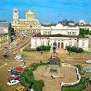
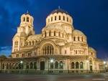
The capital of Bulgaria
Sofia is the capital of Bulgaria. It is also the largest city in the country. Sofia has many different names. When the Romans invaded it a long time ago they called it Serdica. This name came from a tribe of people that settled there.

Slide 5
Bulgarian cars

Slide 6
Bulgarian fashion
In Bulgaria most of the girls wear the same clothes. They wear long dresses with long baggy sleeves.

Slide 7
Tourism in Bulgaria.

Slide 8
Bulgarian language.
hello = здравей
how are you = как сте
I like chips = Харесва ми чипове
What age are you? = каква възраст сте?
My friends are… = моите приятели са ...

Slide 9
The End!
Thank you for reading my Europe project on Bulgaria.
The end.
By Eve

