Slide 1
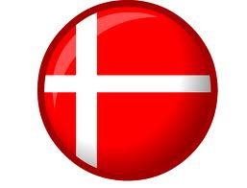
Denmark
By Killian

Slide 2
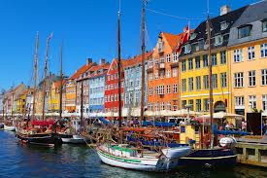
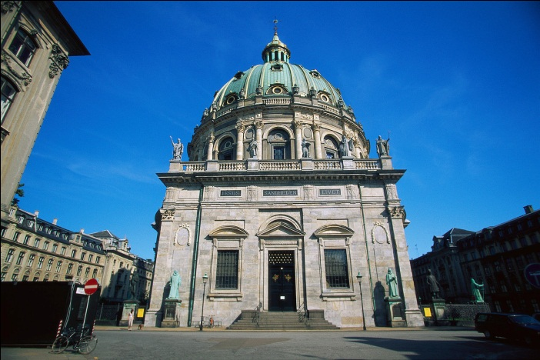
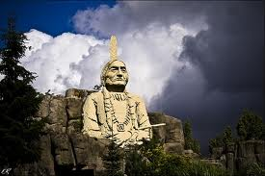
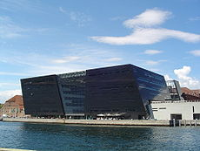
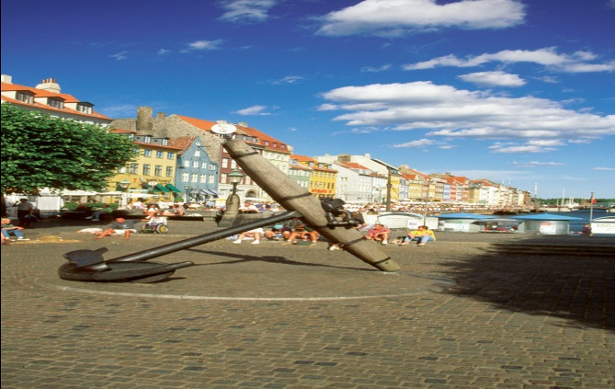
Denmark Information
Capital: Copenhagen
Size: 43,000km
Population: 5.4 million
Language: Danish
National Day: 5th June
It borders Germany.
There’s even
a LEGO land.
Its native
animals are
deer and birds.
Its transport is
bikes and bicycles

Slide 3
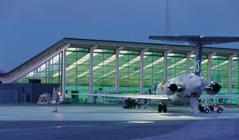
Distance from DUBLIN TO DENMARK
It’s 757.2 miles from Dublin to Denmark. Approximate 1hr and 49mins. 1218.6 kilometres / 657.5 Nautical Miles.
Also here is a
picture of the
Denmark airport.

Slide 4
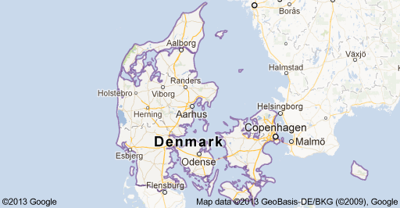
The Map of Denmark

Slide 5
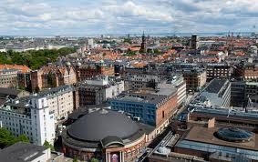
THIS A PICTURE OF THE DENMARKS CAPITAL CITY
This is a picture of Copenhagen.

Slide 6
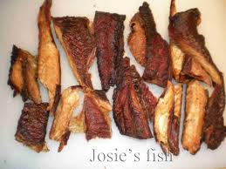
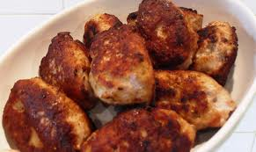
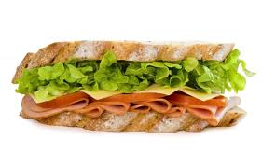
Food
Meatballs (Frikadeller) and Smoked Fish or Sandwiches. Meatballs are the most popular food for the Danish. It looks delicious.

Slide 7
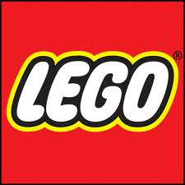
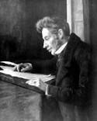
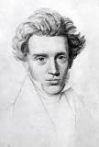
Famous Danes
Ole Kirk Christiansen was the inventor of LEGO.
It’s a very popular creation and is sold world wide.
Hans Christian Anderson was a famous author. He
wrote the Ugly Duckling and The little match girl.
Soren Kierkegaard is a famous Philosopher.

Slide 8
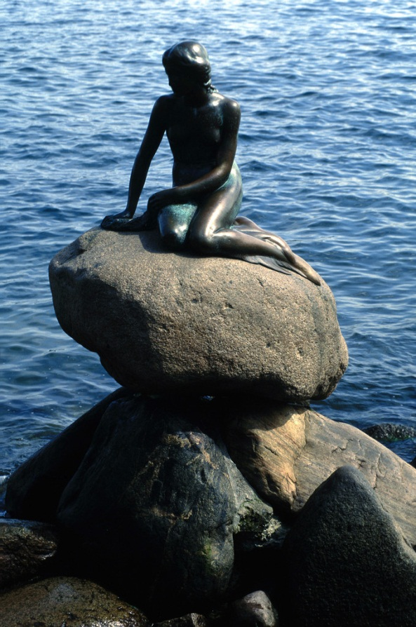
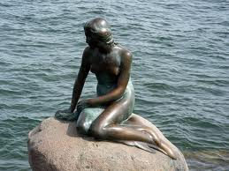
The Little Mermaid
This mermaid owes its fame to Hans Christian Anderson fairy tale on which the sculpture was based. She sits on a rock in Churchill Park in Copenhagen harbour. The sculptor Edward Eriksen, used his wife as the model.

Slide 9
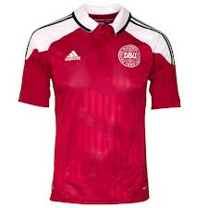
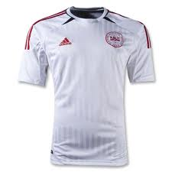
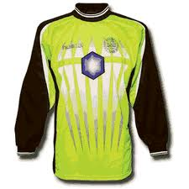
Football
The colours of the football team is red and white as you see below.

Slide 10
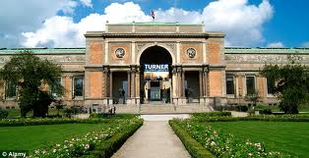
Denmark holiday Destination
There is a museum to go and have a look around. Most of the people have been there have rated it excellent. Other people have rated mostly between average to very good. There is also a National Gallery of Denmark. You can stay as long as you can.

Slide 11
