Slide 1
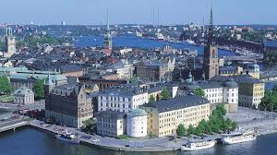
ESTONIA
The capital of Estonia is Tallinn. The size is 45,000km. The population of Estonia is 1.3 million. They speak Estonian and their National Day is on the 24th of February. Estonia is also a very icy country.

Slide 2
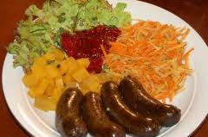
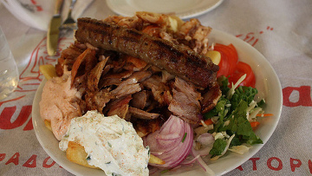
ESTONIA’S FOOD
Classic Estonian dishes includes verivorst (blood sausages), leib (black bread) and kartulid(potatoes). Estonian food sound disgusting but Estonians like them so they must be nice.

Slide 3
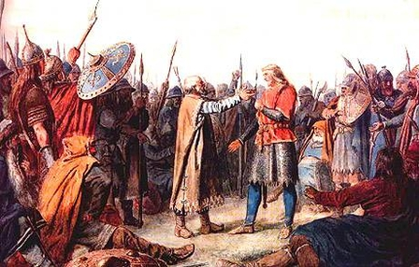
History
Throughout the centuries the land experienced a number of invasions.
Vikings arrived in the AD 800s followed by Danes, Swedes and Russians.
The Estonians were able to withstand most of the invasions until the 1200s. At that time German crusader knights, aided by the Danes, conquered the area. They wanted to convert the Estonians to Christianity. Denmark took control of northern Estonia, and Germany ruled southern Estonia as well as Latvia.
In 1346 the Danes sold their n land to Germany. The Estonians lived as peasants under the control of German landowners. In the 1500s German power declined in Estonian. The land was divided again, this time between Sweden and Poland. By 1629 Sweden had won all Estonian lands.

Slide 4
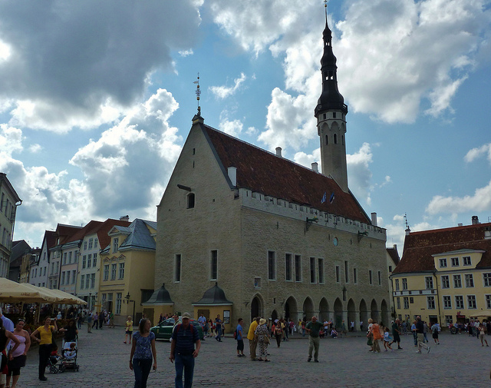
The Town Hall
This Town Hall was built is thought to date from the early 13th century.
Its Gothic architecture has been well preserved.
It is currently open to the public and is some times used for receptions

Slide 5
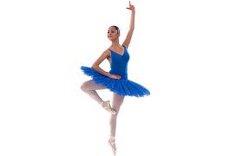
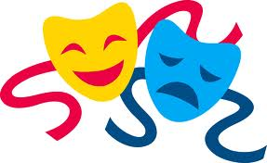
Did you know ?
Did you know 1999 saw the signing of an agreement of cultural exchanges between Ireland and Estonia. This has resulted in exchange visits of theatre, musical and dance groups from both countries.
Did you know about half of Estonia is related to the people of Finland. The Estonian language is a lot like Finnish. Russians make up more than one quarter of Estonia as well.
Humans may have lived in Estonia from as far back as 7500 BC. That’s about 9513 years ago.

Slide 6
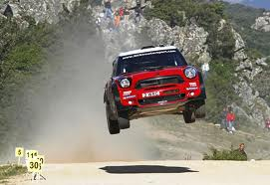
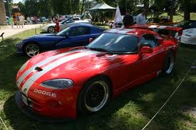
Estonian race cars
Estonian race cars look pretty cool and some time I would like to see a race in Estonia.
From most of the cars I saw I think they are al red.

Slide 7
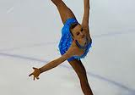
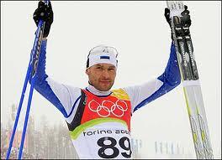
Estonian sport
There is a lot of Estonian sport like ice skating, skiing, soccer and a lot more.
The Estonian football league system is a series of interconnected leagues for club football Estonia. Reserve teams play in the same league pyramid as their feeder clubs.

Slide 8
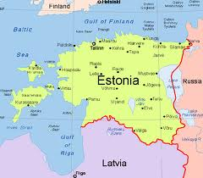
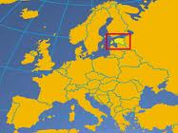
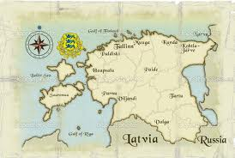
Maps of Estonia
Distance from Estonia to Ireland is 1233 kilometres. Approximate flight duration time from Estonia to Ireland is two hours forty five minutes.

Slide 9
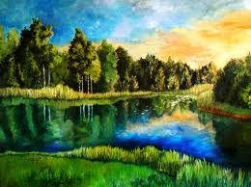
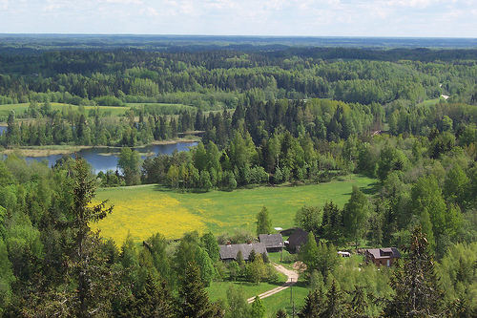
Landscape of Estonia
Estonia is a very nice country I would like to see.
For such a small country, the diversity of Estonia’s landscape is unique in Europe.
It’s a place where sea meets land, bogs alternative with forest’s, meadows rivers, lakes and heritage landscapes.
All this provides different habitats for birds and animals.

Slide 10
Myths and legends
According to the legend the church was meant to be built on a sacred place of the Estonians. They did not like it. Every morning the walls that had been built the last day had crumbled. It lasted for a long time. Then they went to a man for advice he replied. “The walls of the church will remain up if you immure an innocent girl inside the walls in kneeling position”. The congregation chose a girl named Mary. The mason made a hole where to fit Mary in a kneeling position and the hole was closed with a large curb. The second hole was made to give her bread and water to keep her alive. Afterwards they closed that hole to and the walls stayed up. Mary was immured in the wall of the church in kneeling position and the place was called Põlva.

Slide 11
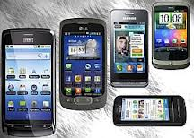
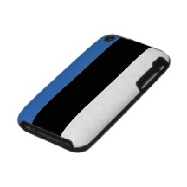
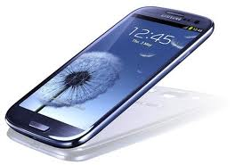
What Estonia is famous for
Estonia is famous for the exporting of food products, metal products, chemical products and electronic products such as mobile phones.

Slide 12
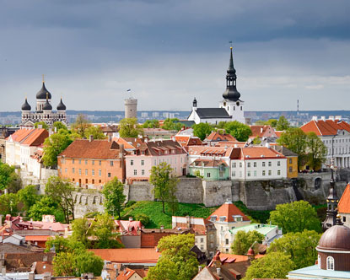
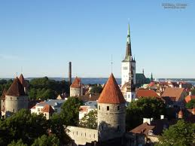
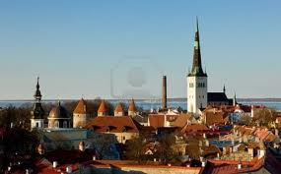
Images of Estonia

