Slide 1
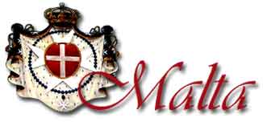
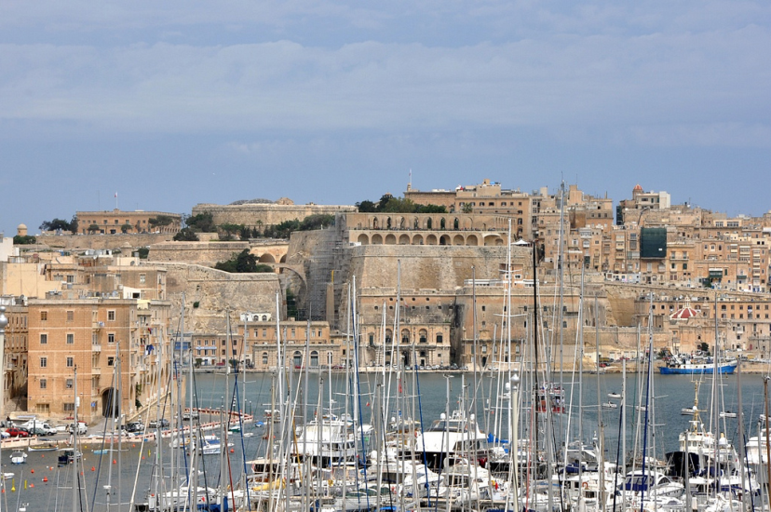
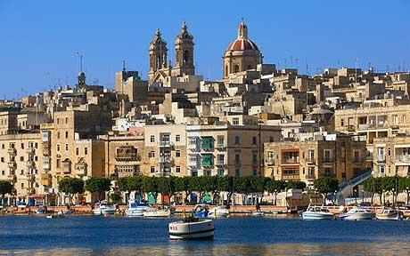
Capital city: Valletta
Population:0.4million
Languages : Maltese , English
Size: 316 km sq
National day: 8th September

Slide 2
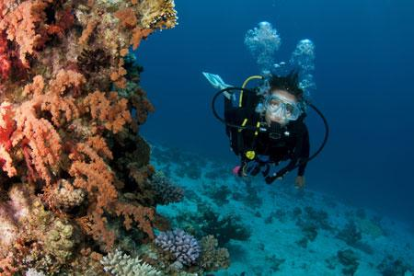
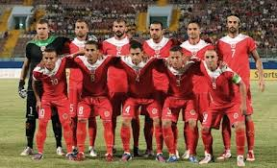
SPORTS
In Malta sports reflect the fun loving attitude of the local people.
They work hard all week long to earn money for their bread and butter but at the weekend they like to enjoy themselves.
In Malta they like are football, cricket, rugby, hockey, scuba diving, netball and sports like cycling and long distance walking.
Malta is surrounded with sea so boating is another form of sports they enjoy.

Slide 3
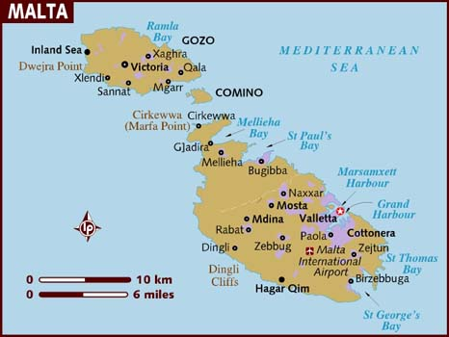
Where is malta?
The Independent Republic of Malta consists of a group of islands in the Mediterranean Sea.
Malta occupies an area of 316 square kilometres (122 square miles). It is located 93 kilometres (58 miles) south of Sicily. The country consists of five islands – Malta, Gozo, Comino, Cominotto and Filfla. Of these the last two are uninhabited – that is no one lives on them. Malta is the largest of the islands, making up about 78 per cent of the Republic's land area.

Slide 4
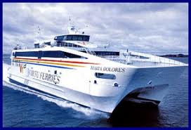
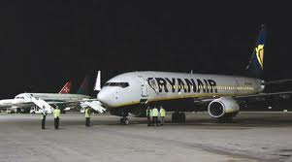
How to get to Malta
Malta floats in crystal blue-green waters 60 miles south of Sicily and 200 miles from north Africa.
The capital city, Valletta, has one of the finest natural harbours in the world.

Slide 5
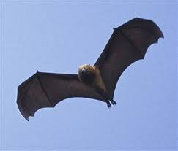
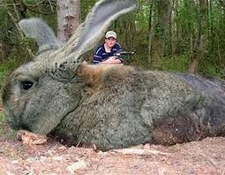
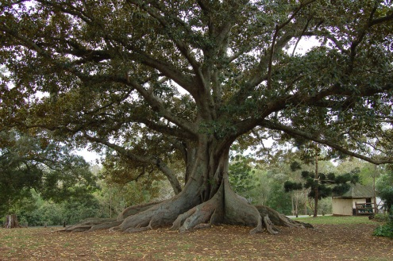
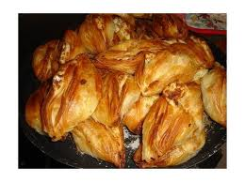
FOOD
There is little wild vegetation in Malta. The forest cover includes a variety of trees, including carob, fig and chaste. The animals to be found in Malta include the hedgehog, the least weasel, water and white-toothed shrews, and the pipistrelle and other bats. Rats, mice and some rabbits also are found. Birds include the spectacled and Sardinian warblers, Manx and Cory's shearwaters, and the blue rock thrush.
Wheat, barley, corn (maize), potatoes and citrus fruits are grown on small farms on terraced hillsides. Farming accounts for a very small part of the country's earnings.
Malta imports most of its food.

Slide 6
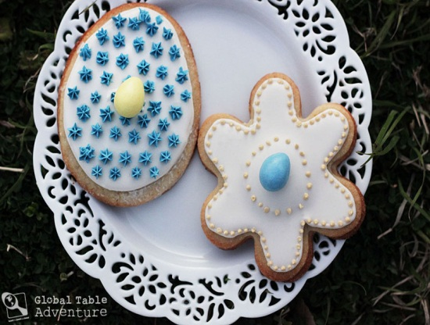
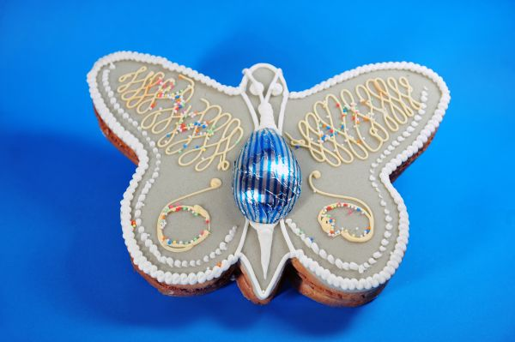
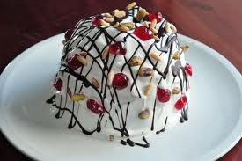
Treats and sweets from malta
Maltese desserts, like others from around the Mediterranean, tend not to have a lot of chocolate, and often include fresh ricotta, and dried fruit. They have ingredients like orange-blossom water, honey, nuts and dates, aniseed, and sesame seed make for a truly delicious dessert.
The Maltese do have a sweet tooth, and that means sweets aren’t just for after a meal. You can find a great deal of delicious confections to snack on, at any time of the day.

Slide 7
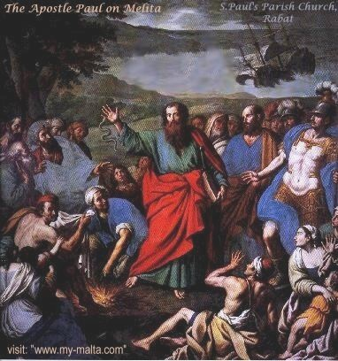
Myths and legends
Malta is an ancient island with perhaps the oldest free standing "temples" on earth. These buildings are even older than the Pyramids and Stonehenge. But the number of Temples for such a small island is staggering.
It is comprised of a few islands but only two are large enough to support any amount of people - Malta and Gozo.
In AD 60, the Apostle Paul, an early follower of Christianity, was shipwrecked in a bay of the island. The bay now bears his name. It is believed that he converted the inhabitants to Christianity.

Slide 8
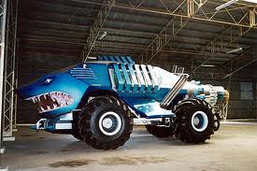
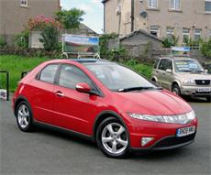
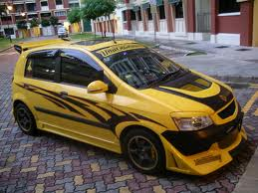
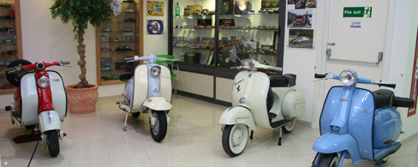
cars
Every vehicle being driven in Malta must be insured, must be tested regularly for roadworthiness in an approved testing station, must have registration plates affixed to the front and back of the vehicle, and must have a valid road licence affixed to the left side of the front windscreen.
There is also a classic car museum in Malta. As well as having a lot of old cars it also has old motorbikes.
The Hyundai Getz is a very popular car in Malta.

