Slide 1
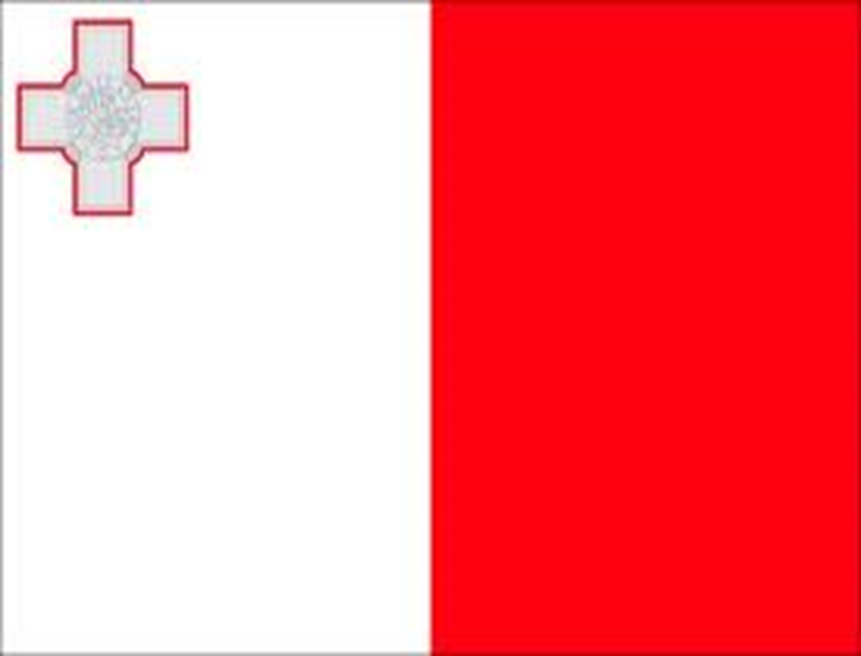
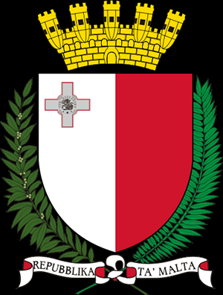
Malta
Hi my name is Odhrán mc Carron and here is my project which is about Malta☺!☺!☺!

Slide 2
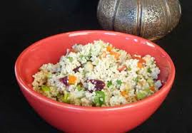
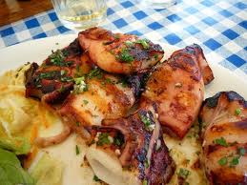
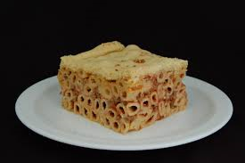
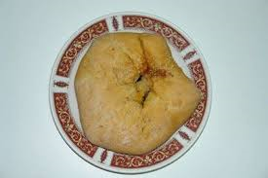
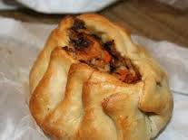
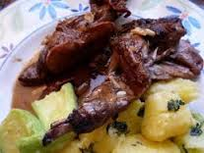
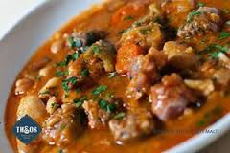
The food in Malta
The food that they eat would seem strange to me and you but it is actually nice to them. Here are some names of food they eat Kusksu {vegetable soup with small pasta beads called kusksu and fresh broad beans in season} Għaġin Grieg {small pasta beads with minced pork and cheese} But there is more.☺

Slide 3
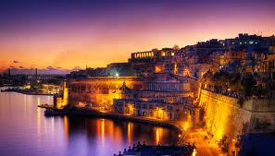
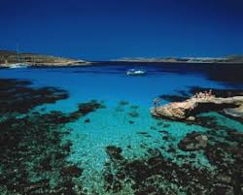
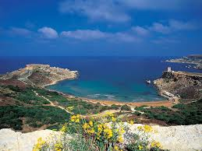
The views in Malta
The views are so nice and you would not want to ever leave it again. ☺

Slide 4
The population of Malta
The population of Malta is 399,000 that is a lot of people I don’t know if that is a world record.

Slide 5
The language in Malta
People in Malta speak Maltese and English. On the other side of the slide you will see some Maltese writing .

Slide 6
Facts about Malta
Malta is a southern European country in the Mediterranean Sea. It lies 80 km south of Sicily, 284 km east of Tunisia and 333 km north of Libya.
Malta population growth rate is 0.359%
Malta Exports machinery and mechanical appliances; mineral fuels, oils and products; pharmaceutical products; printed books and newspapers; aircraft/spacecraft and parts thereof; toys, games, and sports requisites
Malta climate mild, rainy winters;
hot, dry summers
Since about the mid-1980s, the island has transformed itself into a freight transshipment point, a financial center, and a tourist destination.

Slide 7
The culture of Malta
The Maltese archipelago consists of Malta, Gozo, Comino, Cominotto, and Fifla, plus a few minute limestone outcroppings. Over 92 percent of the inhabitants live on Malta, by far the largest island, and the rest live on Gozo except for a few farmers on Comino. Although all residents call themselves Maltese, people on Gozo also are called Gozitans. The earliest written reference to Malta is in the biblical account of Saint Paul's shipwreck. The population as of July 1999 was 369,451, of whom 341,906 lived on Malta and 27,545 lived on Gozo except for a handful on Comino. Live births in that year were 4,826 for a birth rate of 13.1 per thousand. The fact that the estimated national population as of July 1999 was 381,603 indicates that it is continuing to grow. In part, this is because the emigration rate has been declining. Singapore is the only country more densely populated than Malta.

Slide 8
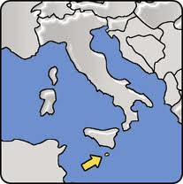
Where is Malta
Malta is a small island to the south of Italy.

Slide 9
DID YOU KNOW☺!☺!
The Maltese people like a book and movie called the Maltese falcon I haven't seen it my self but it I’m sure it is good
Irishman, Richard More O’ Ferrall was appointed as the first civil governor of Malta in 1847

Slide 10
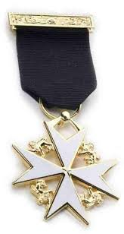
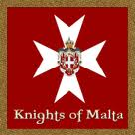
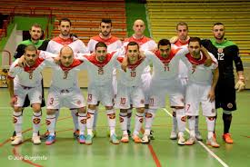
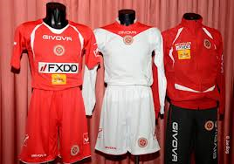
Famous Maltese people
The knights of malta The Hospitallers probably arose as a group of individuals associated with an Amalfitan hospital in the Muristan district of Jerusalem, which was dedicated to St John the Baptist and founded around 1023 by Blessed Gerard Thom to provide care for poor, sick or injured pilgrims to the Holy Land. [Some scholars, however, consider that the Amalfitan order and Amalfitan hospital were different from Gerard's order and its hospital]

Slide 11
