Slide 1
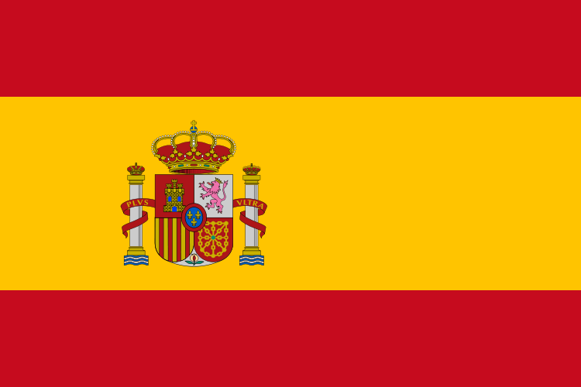
Spain
Spain is located in the extreme south-west of Europe. It takes approximately 23 hours 11 minutes. Spain's currency is euro. Spain joined the eu in 1977. The population of Spain is 47.27 million. The capital is Madrid. The language is Spanish. There national day is the 12th of October. The size is 504,782 km

Slide 2
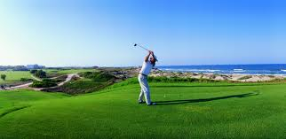
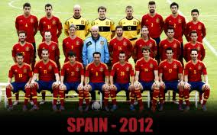
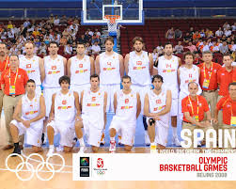
Spain's sports
In Spain they do all kind of sports like football, basketball, tennis, cycling, handball, motorcycling, golf, water sports bull fighting and skiing.

Slide 3
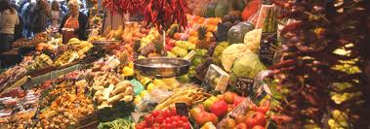
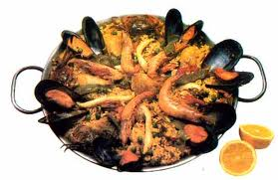
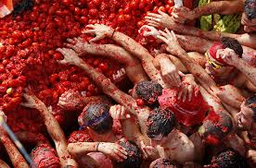
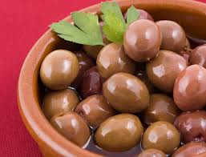
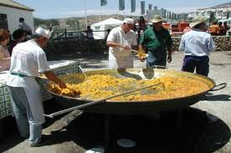
What people in Spain eat
People in Spain like food like Cochinillo Asado (Roast Suckling Pig) rabbit in salmorego, wrinkled potatoes and spicy sausages.

Slide 4
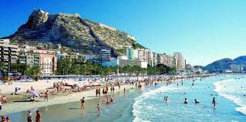
Spain's culture
I have been to Spain many times the first time I went I was only a couple of months old. I think Spain has so much things to do you can do paragliding, scuba diving or you could just lie on the beach.

Slide 5
Spain's language
Buenos díaz is how you say good morning in Spanish.
Pan is how you say bread in Spanish.
Hola is how you say hello in Spanish.
Animales is how you say animals in Spanish.
Libro is how you say book in Spanish.
Pastido is how you say party in Spanish.

Slide 6
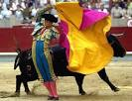
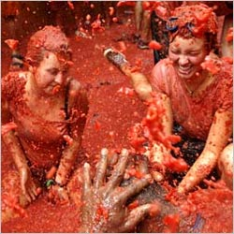
What Spain is famous for
Spain is famous for bullfighting, excellent beaches, meat, fish, Festivals of tomatoes, Sherry (a type of wine),Great museums.

Slide 7
How to get to Spain and how long it takes
You can take a boat and a plane to Spain and it takes around to hours to get to Spain on a plane.

Slide 8
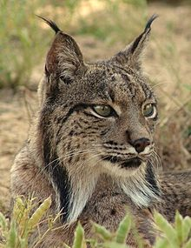
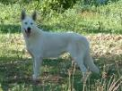
Plants and animals
Many plants and animals can be found in Spain. Spain's most common plants are oak olives and grapes.
Rabbits are commonly found in Spain while wolves wildcats and deer are rarer.

Slide 9
The Spanish Civil War
In the early 1900s Spain was tortured by a political problems. In 1936the Spanish civil war broke out between the republications and the army. After nearly three years of fighting the military took over Madrid on 28 march 1939.On April 1st , military leader General Francisco Franco declared himself chief of state.

Slide 10
People and Lifestyle
Over the centuries, many groups of people have settled in Spain, including the Phoenicians, Romans, Visigoths and Moors. Today 42.27 people live in Spain.
In the twentieth century, many people moved from rural areas to cities such as Madrid, to look for work. Most people lived in coastal areas such as Valencia.

Slide 11
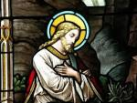
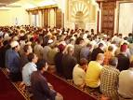
Religion
More than 94 percent of the total Spanish population is Roman Catholic. With over 60,000 Catholic Churches, Monasteries and Convents in Spain, Catholicism has played a significant role in Spanish history.

Slide 12
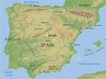
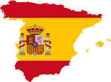
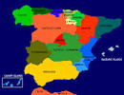
Images of Spain

Slide 13
Spanish architecture
Spanish architecture shows the influence of the various civilisations that have settled in the country, such as the moors, the Celts, the French and the North Africans. The most famous building in Spain is the Alhambra, a magnificent palace built by the Moors. One of the most renowned Spanish architects is Antonio GaudÍ.

Slide 14
Famous People
There is so much famous people in Spain like Kane a wrestler, Enrique Iglesias a singer, Fernando Torres a soccer player, Pablo Picasso, Rafael nasal a tennis player, Xavi soccer player, Antonio Banderas a movie actor, Nathalie Ramos a movie actor, Penelope Cruz a movie actor, Iker Casillas a soccer player, Andres Iniesta a soccer player, David Villa a soccer player, Juan Mata a soccer player, Gerard pique a soccer player. Salvador Dali an artist, Sergio Ramos a soccer player, Hernando Cortes an explorer, David Villa a soccer player and Cesc Fabregas a soccer player and there is way more.

Slide 15
Top 5 hotels in Spain
There is a lot of hotels in Spain I will tell you the top 5. Alma Barcelona is no.1 and is located in Barcelona no.2 is vincci seleccion Alysia hotel Boutique and Spa located in bedalmandena no.3 is seaside grand hotel residencia located in maspalomas no.4 is hotel primero primera located in Barcelona no.5 is valbusenda resort.

