Slide 1
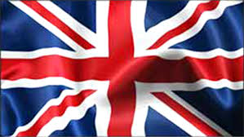
United Kingdom/Great Britain
The United Kingdom is a famous country off mainland Europe. It has a rich and famous history. Let's begin!

Slide 2
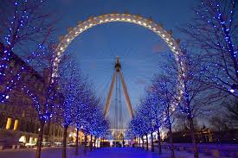
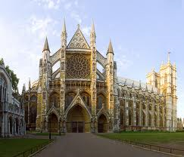
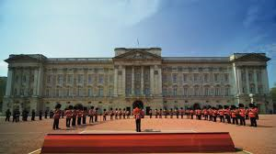
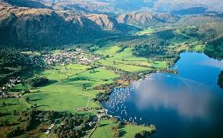
7. Westminster Abbey
Famous Landmarks of Great Britain Part 1!
8. London Eye
6. Buckingham Palace
5. Lake District

Slide 3
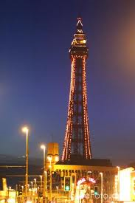
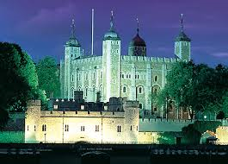
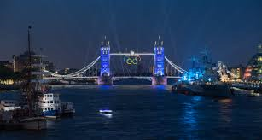
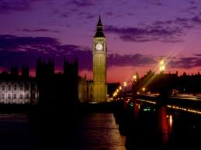
3. Tower of London
Famous Landmarks Part 2
4.Blackpool Tower
1. Big Ben
2. Tower Bridge

Slide 4
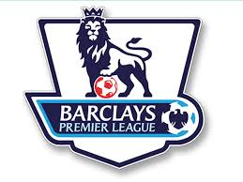
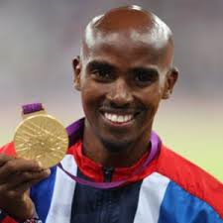
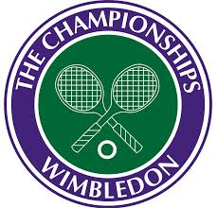
United Kingdom: Sports!
The UK has a great love for football, tennis and athletics. Great sportsmen include Mo Farah, Andy Murray, and Frank Lampard. The Premier League in England is a huge annual event, 2014’s ending with Manchester City winning by 2 points over Liverpool.

Slide 5
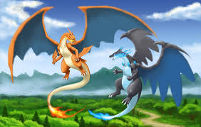
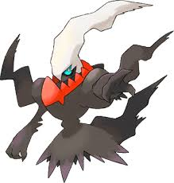
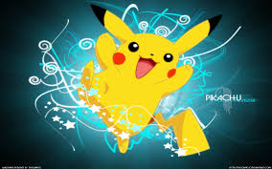
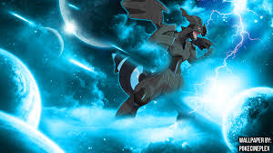
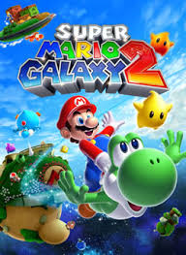
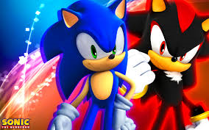
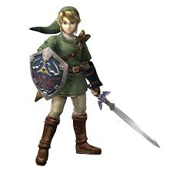
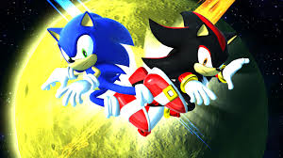
UK: Gaming
Let’s be honest, from me, you saw this coming. The UK is quite a large fan, with a lot of love, believe it or not, for Nintendo! (Yes!) The Official Nintendo Magazine is based in London, Super Mario is HUGE in the UK, The Legend of Zelda is pretty big in sales-terms, Pokėmon Black/White 2 was the biggest selling game in British history. Microsoft’s Xbox, Sony’s PlayStation and Sega’s Sonic the Hedgehog are also huge in Great Britain.
Zekrom, Mega Charizards, Darkrai and Pikachu, the 4 most famous Pokėmon of all 718.
Sonic and Shadow the Hedgehogs, the two most famous Sonic Characters.
Mario and Yoshi on Super Mario Galaxy 2 Logo.
Link from The Legend of Zelda.

Slide 6
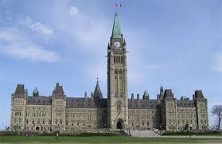
Uk: Politics
And we come to the boring bit. David Cameron is Prime Minister, other important figures include Ed Milliband, Nick Clegg, and, uh, does it really matter? I’m 11, politics doesn’t interest me. SLIDE DONE!

Slide 7
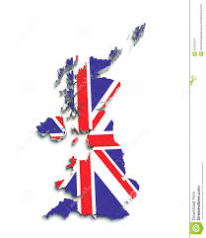
UK: History
Great Britain has a reason for its name. From the poetry of William Shakespeare to the ship-building of Isimbard Kingdom Brunel and the heroics of World War II, they’re fantastic. Founded on May 1 1707,they’ve never looked back.

Slide 8
UK: Culture
They sing, dance and get heavily drunk, the British people! (Just Kidding, don’t take me to the tower. ☺) They are a great people, celebrating every event like it was their last. They have a “Classic English Breakfast™”☺ regularly and often have Fish and Chips, A “Fry-Up” or a “Sunday Roast". Fast Food is big too. They love their soaps, and comedy channels such as Dave and BBC Three are big. And yet, knowledge channels like BBC Four and Yesterday are also much-loved.

Slide 9
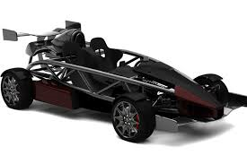
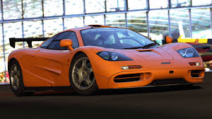
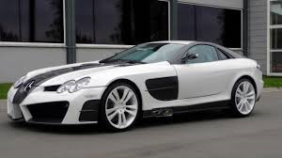
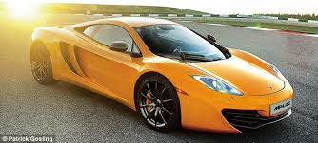
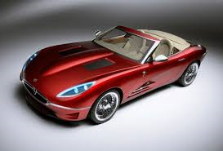
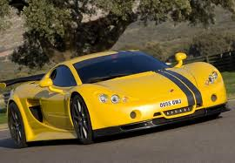
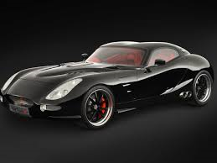
UK: CARS
It’s hard to explain the British car industry, so I’ll just show you!
McLaren F1
McLaren Mercedes
Ariel Atom.
Assorted British Supercars.

Slide 10
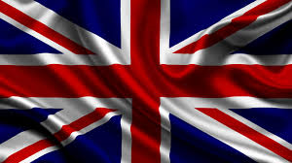
Finale!
Great Britain: Fantastic, amazing, everything a good country should be. I got lucky getting this country. And I’m happy about it.

