Slide 1
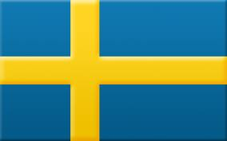
Sweden
By: Aisling Rafferty

Slide 2
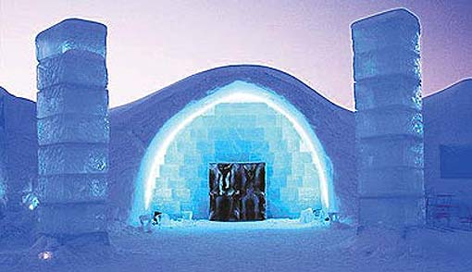
Facts about Sweden
The population of Sweden is 9.2 million. The urban population of Sweden is almost 85 %.
A popular souvenir is the road sign for moose-crossing. Every year a huge number of these signs are stolen from Swedish roads.
Between 1850 and 1910 more than one million Swedes migrated to the USA.
The Nobel Prize Ceremonies are held in Sweden and Norway every year on December 10th.
IKEA and H&M are both modern Swedish retail shops.
On an average, Swedish women have their first child at 30 years of age.
Sweden has the highest number of McDonald restaurants, per capita, (per person) in Europe.
The first ice hotel of the world was built near the village of Jukkasjärvi, in Kiruna district of Sweden.
The Kingdom of Sweden is the fifth largest country in Europe.

Slide 3
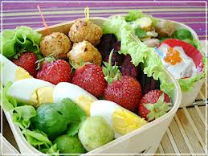
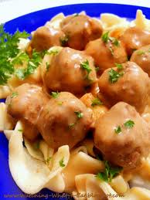
Food
Potatoes are the main side to nearly every Swedish meal all year round. Pancakes, soups, casseroles, and even whole buttered or sugared potatoes can be found on the plate in any Swedish home. As the main dish, one may also find kalops, or meat stew with onions, vegetables, and spices. The meat of choice is typically deer. Served with the meat and potatoes is blodpudding, or blood pudding that is eaten with lingongberry jam and bacon.
Real Swedish Pancakes
Ingredients: 2 eggs, 1 1/4 cup flour, 2-2 ½ cups of milk, 1 teaspoon of salt, butter
Directions:
1) mix eggs, flour, and salt
2) slowly add milk, beat batter smoothly
3) heat the skillet, add butter
4) fry pancakes on both sides
5) serve

Slide 4
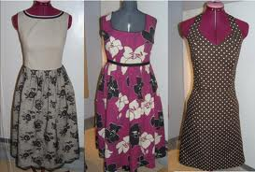
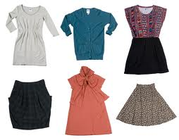
Clothes
The Swedes have their own ultra modern, sleek style.
Swedish households say it all, gorgeous and beautifully decorated. However, being stylish in Sweden is expensive.
From classic, clean lines to avant-garde, from everyday items to haute couture, Swedish fashion brands such as Filippa K, Cheap Monday and Acne have built up a strong reputation around the world

Slide 5
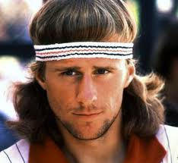
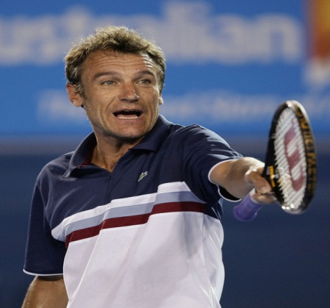
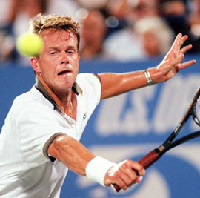
Sports
Sport & leisure in Sweden
Sweden is a nation of amateur athletes and sports enthusiasts. Swedes have a long history of international success in ice hockey, soccer, golf, skiing, athletics and especially tennis. In fact, Sweden has won the world championships eight times and the Olympics twice in ice hockey. It has also produced three of the best tennis players in history — Björn Borg (11 grand slam titles), Mats Wilander (7) and Stefan Edberg (6).

Slide 6
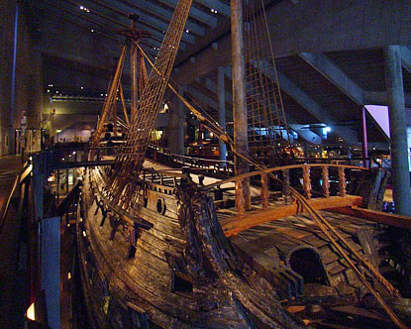
Early History of Sweden
Sweden's early history, like its day-to-day life, is intimately wrapped up with the natural rhythms of season and climate.
It was the end of the Ice Age that brought the first inhabitants to Scandinavia more than twelve thousand years ago, as the receding glaciers and the warming climate turned barren permafrost into lush plains and vast forests.
By 8,000 BC, there were extensive settlements in the region, but dropping temperatures pushed the inhabitants southward to the coasts. A few thousand years later the cycle reversed, and once again the interior became productive, fertile ground.
This back and forth movement between the land and the water, between farm and boat, characterizes Swedish culture even today, although the cycle now follows season, holiday, and personal preference.

Slide 7
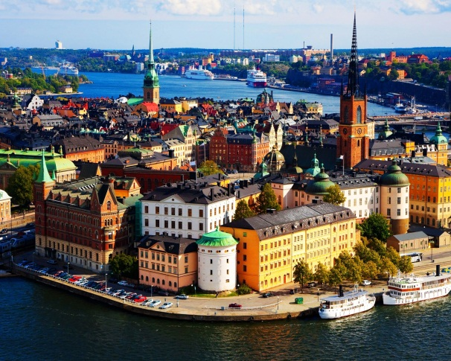
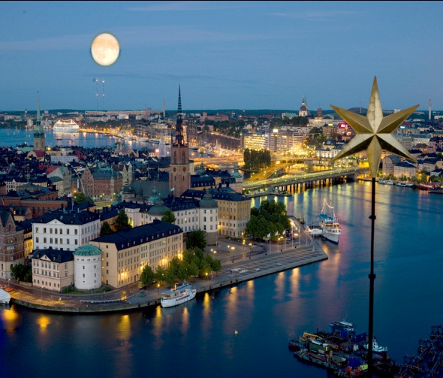
Stockholm
A trip to Stockholm can provide a wealth of opportunities for sightseeing, sampling local food and immersing yourself in Sweden's rich culture and history.
This capital city, situated along the Baltic Sea in south-eastern Sweden, is an important hub for business travellers -- it is home to major companies, such as Ericsson -- but also attracts tourists .

Slide 8
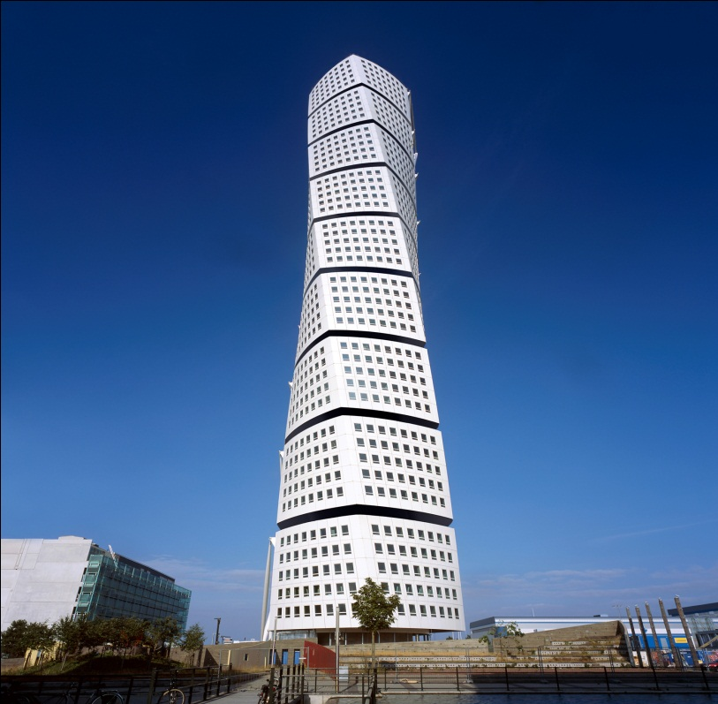
TURNING TORSO
Turning Torso is the tallest skyscraper in Sweden.
Name: Turning Torso Height: 190 m Number of floors: 54 Number of elevators: 3 (+2) Number of stairs: 1 Number of cubes: 9 Number of floors in every cube: 5 Area in every floor: 400 m2 Turning: 90 degrees Model: human body in motion

Slide 9
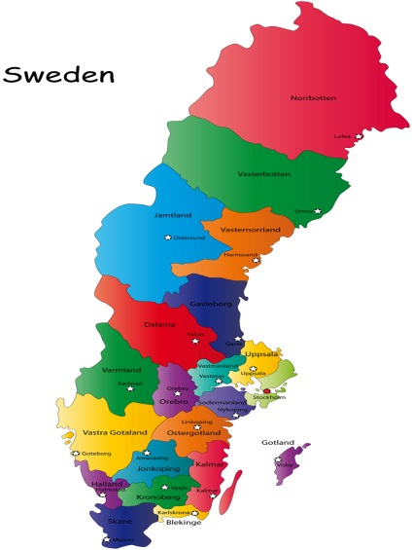
Geography
Sweden, which occupies the eastern part of the Scandinavian Peninsula, is the fourth-largest country in Europe.
The country slopes eastward and southward from the Kjólen Mountains along the Norwegian border, where the peak elevation is Kebnekaise at 6,965 ft. (2,123 m) in Lapland.
In the north are mountains and many lakes. To the south and east are central lowlands and south of them are fertile areas of forest, valley, and plain.
Along Sweden's rocky coast, chopped up by bays and inlets, are many islands, the largest of which are Gotland and Öland.

Slide 10
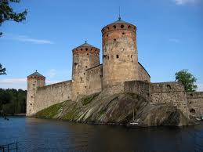
History
The first mention of Sweden is found in Tacitus's Germania, where reference is made to the powerful king and strong fleet of the Sviones. In the 11th century, Olaf Sköttkonung became the first Swedish king to be baptized as a Christian. Around 1400, an attempt was made to unite Sweden, Norway, and Denmark into one kingdom, but this led to bitter strife between the Danes and the Swedes.
In 1520, the Danish king Christian II conquered Sweden and put leading Swedish people to death. Gustavus Vasa (1523–1560) broke away from Denmark and fashioned the modern Swedish state. He confiscated property from the Church in Sweden to pay Sweden's war debts. He justified his actions on the basis of Martin Luther's doctrines, which were being accepted nationwide with royal encouragement. The Lutheran Swedish church was eventually adopted as the state church.

Slide 11
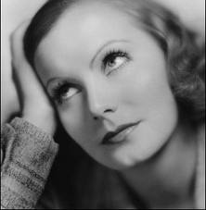
Garbo
Swedish actress Greta Garbo was a famous Hollywood movie star in the 1920s and 1930s. She began acting in silent movies. In the course of her career, Garbo starred in twenty-seven motion pictures and was nominated four times for Oscar's Best Actress award for the films ‘Anna Christie’ (1930), ‘Romance’ (1930), ‘Camille’ (1937) and ‘Ninotchka’ (1939), but, oddly enough, she never won.
However, in 1954 she received a special Academy Award for her memorable portrayals. Her most notable silent films include ‘The Torrent’ (1926) and ‘Love’ (1927). It was not until 1930 and ‘Anna Christie’ that the audience could first hear her low, heart-breaking voice. Garbo's subsequent talking films such as ‘Mata Hari’ (1932), ‘Grand Hotel’ (1932), ‘Queen Christina’ (1934) and ‘Anna Karenina’ (1935) won her enthusiastic responses from fans, as well as from critics

Slide 12
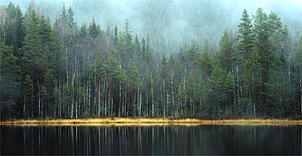
Products
Sweden's many forests of spruce, pine and other softwoods supply a highly developed sawmill, pulp, paper and finished wood product industry. Also known for Volvo and SAAB cars.

Slide 13
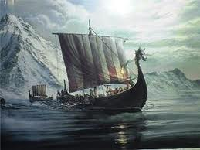
The Vikings
A thousand years ago the Vikings of Scandinavia sailed and rowed their great open boats across the seas to Normandy, Iceland, Ireland and America with no protection but that of a huge dragon's head prow.

Slide 14
Abba
ABBA were a Swedish pop group formed in Stockholm in 1972, comprising Agnetha Fältskog, Bjorn Ulnae's, Benny Anderson and Anni-Frid Lyngstad. ABBA is an acronym of the first letters of the band members' first names. They became one of the most commercially successful acts in the history of pop music, topping the charts worldwide from 1972 to 1982. They are also known for winning the 1974 Eurovision Song Contest, giving Sweden its first victory in the history of the contest and being the most successful group ever to take part in the contest.
ABBA had sold over 370 million albums and singles worldwide and still sells millions of records a year, which makes them one of the best-selling music artists of all time. ABBA was the first pop group to come from a non-English-speaking country that enjoyed consistent success in the charts of English-speaking countries, including the UK, Ireland, the U.S., Canada, Australia, New Zealand, and South Africa.

Slide 15
Thank you !!!!!!!!!!!!!!!!!!

