Slide 1
ANNE FRANK by Emma
•Occupation: Writer
•Born: June 12, 1929 in Frankfurt, Germany
•Died: March 1945 at age 15 in the Bergen-Belsen concentration camp, Nazi Germany
•Best known for: Writing a diary while hiding from the Nazis during World War II

Slide 2
In May 1940 The Netherlands is occupied and there are big changes for the Frank family. Restrictions keep mounting, both for individuals and for Otto's business. When Margot receives a call-up for a German work camp on 5 1942, Otto and Edith decide the dangers have become too great. They take their family into hiding in the hiding place they prepared months before.
Born in the city of Frankfurt in Weimar Germany, she lived most of her life in or near Amsterdam, in the Netherlands.
Otto Frank decided his family should leave, the Netherlands. In 1934 they moved to the city of Amsterdam in the Netherlands. Anne was only four years old. Before long Anne had made new friends, was speaking Dutch, and was going to school in a new country. Anne and her family felt safe once again.

Slide 3
Her diary
Anne Frank kept a diary to hopefully start a career in writing. She would take some sentences out of her diary and put them into a book and that’s what she was hoping to do to start a book. After she had passed away her father (Otto Frank) published her diary. It was transformed into a play. It was very famous at first and it still is today you can see it in the museum in Amsterdam

Slide 4
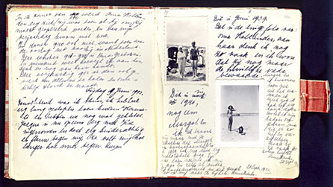
An image of Anne franks diary

Slide 5

Concentration camp!!
Poor Anne Frank was captured and sent to a concentration camp were she was killed in a gas chamber. The only one in her family that survived was Otto Frank . But it wasn’t just Anne Frank’s family who was killed in the concentration camp many others were killed in gas chambers
Gas chambers that Hitler used

