Slide 1
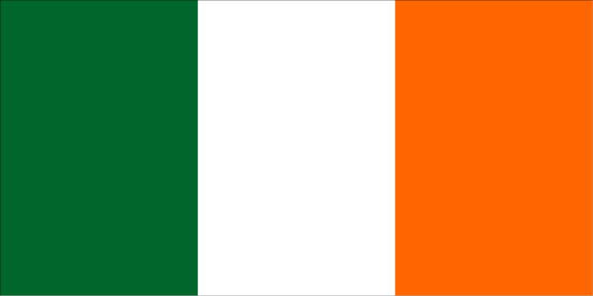
IRELAND
Ireland

Slide 2
The capital
The capital of Ireland is Dublin.
The population of Dublin is approximately 1,273,069.
The President of Ireland Michael D. Higgins resides in Áras an Uachtaráin in Phoenix Park in Dublin.
Our capital city offers many facilities such as the Zoo, Croke Park, Aviva Stadium, the Convention centre, RDS and many Art galleries and museums.
There are many ways to travel around the city - for example on foot, bicycle, car, bus and the Luas.

Slide 3
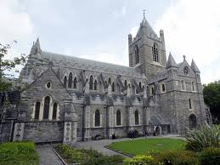
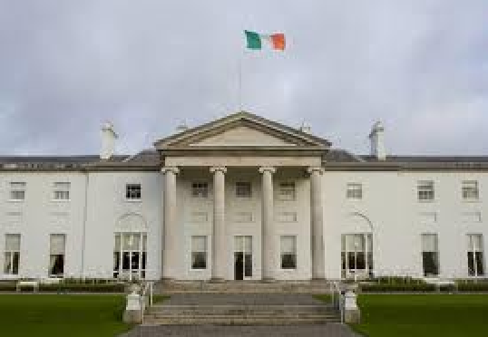
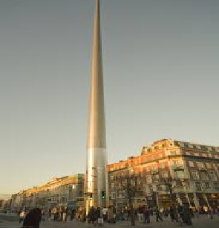
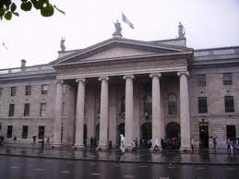
Images of Dublin

Slide 4
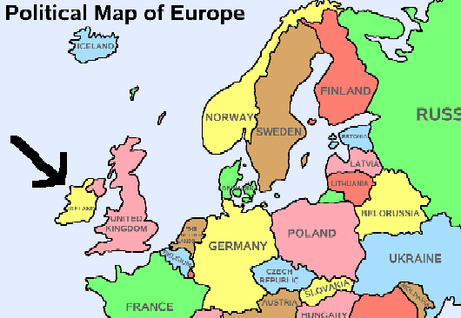
Did you know
Did you know Ireland has the presidency of Europe for the next 6 months!!!
[January to June 2013]

Slide 5
Sites to see
Ireland is a beautiful country . Its full of wildlife, green trees and wonderful sites.
A few of its famous sites are the Giants Causeway and Harland and Wolf ship yard in Belfast
There are also places were you could take children
for example Funtasia, Tayto Park and Aqua Land or just simply take them to the cinema.

Slide 6
CELEBRATION DAY
Irelands celebration day is the 17th of March its also a national holiday
We celebrate the 17th of March for St. Patrick.
Ireland is not the only place that celebrates St. Patricks day for example America has a huge celebration for St. Patricks Day they even dye the rivers green.
We celebrate St Brigids Day on February 1st.
.

Slide 7
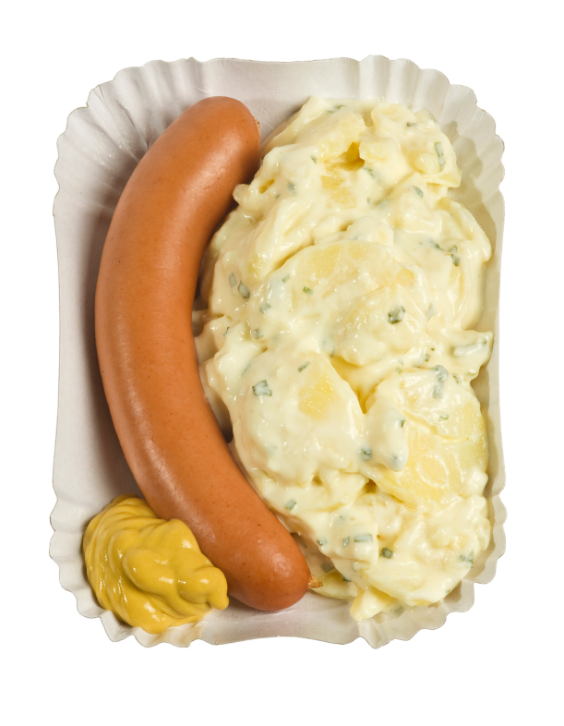
Food and Drink
Stew and bacon and cabbage are very common meals in Ireland along with bangers and mash.
Ireland exports a lot of food such as duck, Guinness, beef , Baileys Cream and horse meat.

Slide 8
Shape of Ireland
As you can see Ireland is kind of like the shape of a pig.
Ireland is an island so to get to another country you need a boat or a plane.

Slide 9
Irish history
The first known settlements in Ireland were about 8000bc - now that's a long time ago!!
The Celts arrived in Ireland in approximately 600bc they brought with them new customs and skills which helped the Irish.
Around the time of 432AD the most famous Irish missionary arrived his name was Patrick and he spread the word of Christianity.

Slide 10
Irish Products
Irish companies produce lots of products every year such Silver hill duck farm, boots, software for computers, dairy products and, beef and many, many more
Ireland develops a lot of computers and software. Some of the biggest computer companies in the world have factories in Ireland and they employ a lot of people
There are also lots of companies which make chemicals and medicines.

Slide 11
Myths and legends
There are lots of myths and legends about Irish history a few of them are
Fionn and the giant,
Fionn and the dragon,
Fionn and the Salmon of Knowledge,
Tír na nóg
Deirdre and Naoise or the Sons of Uisne
Cuchulainn
The Táin

Slide 12
Famous People
There are lots of famous people in Ireland such as Rory Mc Ilroy, Paul Galvin, Brendan O Carroll, [also known as Mrs Brown] Ryan Tubridy, Shea Given, Tommy Bowe and hundreds more.
Shea Given, Paul Galvin and Tommy Bowe are all famous for football.
Rory Mcilroy is famous for golf.
Brendan O Carrol and Ryan Tubridy are famous for TV shows.
U2 are one of the biggest music bands in the world

Slide 13


finale
I think by now I have proved to you that Ireland is a wonderful country.
By MIA

