Slide 1
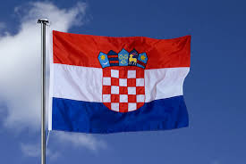
☺Croatia☺
By Niamh

Slide 2
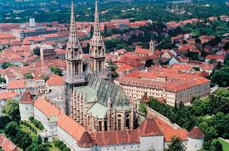
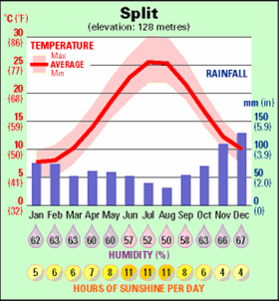
☺ Facts about Croatia ☺
Croatia
Capital: Zagreb
Dialing code: +385
Currency: Croatian kuna
Continent: Europe
National anthem: Lijepa nasá domovino
Government: Parliamentary republic, Parliamentary system
Climate: Usually warm

Slide 3
☺ Tourist Attractions ☺
This is the island of Hvar
Hvar , the island in Adriatic Sea, is the longest and the sunniest Croatian island and one of the most beautiful islands in the world. It is a part of the central Dalmatian archipelago with the area of 299.6 sq km (length 68.2 km, width up to 10.5 km) and population of 10,648 inhabitants (2011).

Slide 4
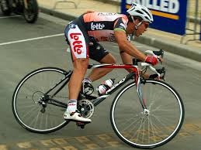
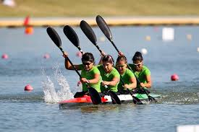
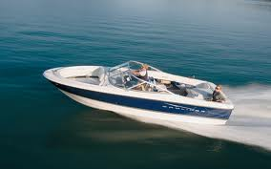
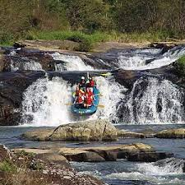
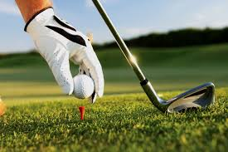
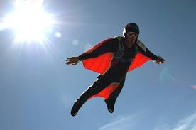
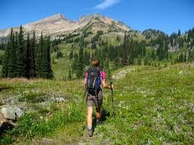
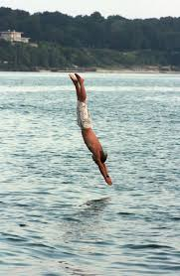
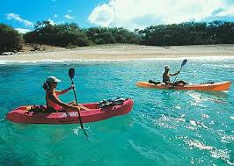
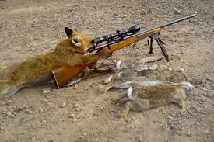
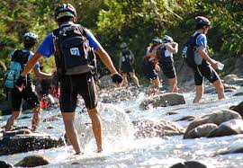
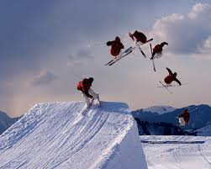
☺ Sports ☺
There are lots of sports in Croatia such as:
Cycling
Golf
Kayaking
Canoeing
Flying
Hunting
Nautics
Hiking
Adventure racing
Rafting
Diving
Skiing
Sport fishing
Welness

Slide 5
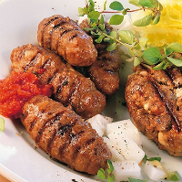
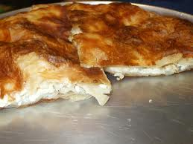
☺Food☺
Originally brought to Croatia by the Ottoman empire Cevapcici is a meat ball dish made from a variety of minced meats. The meat balls are usually spicy and a frequenly served with one of our other Croatian food favourites, Ajvar. The dish is comprised of 5-10 pieces and is often finished off nicely with a local variety of flat bread.
Burek is a classic pastry dish that is not just found in Croatia but right across the Balkans. Its a bit like a Cornish pasty but is made from flakey thin pastry rather than the heavy shortcrust. Bureks come in a variety of types and flavours. The most common and popular varieties contain cheese or meat.

Slide 6
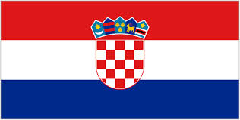
☺History☺
This is a timeline of the history in Croatia

Slide 7
☺The End☺
By

