Slide 1
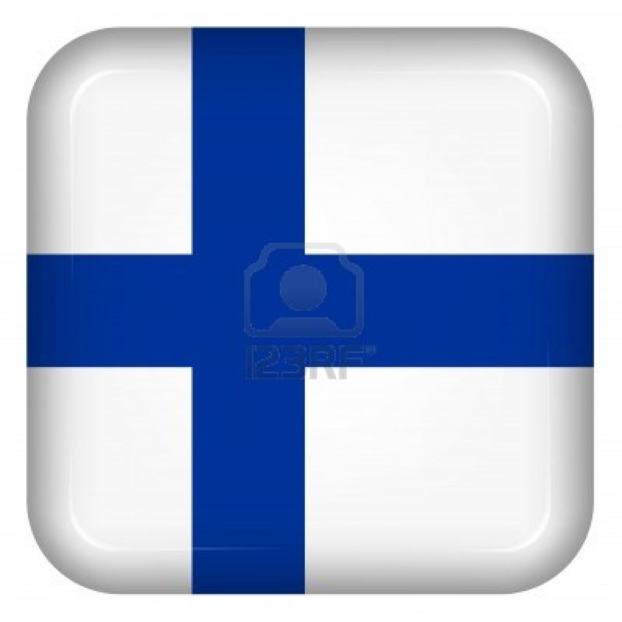
Finland
Finland is part of Scandinavia and of Europe.
The capital of Finland is Known as Helsinki.
Ever since 1986 an Irish Festival is held in Finland.

Slide 2
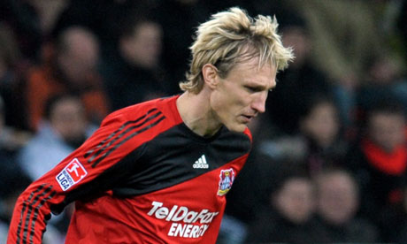
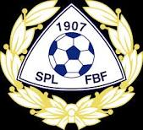
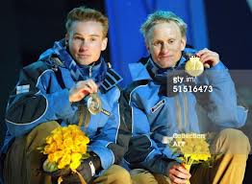
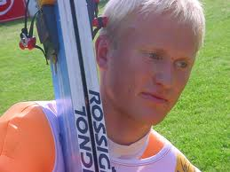
Sport in Finland
Sport in Finland is not great. However, below you can see the greatest Finnish athlete of all time, Sammppa Lajunen. Finland haven’t won a Gold Medal since 2002,when Sammppa won 3 of their 4 golds in the Nordic Combined. Sadly, the football team haven’t won a single trophy.
Sami Hyypia , the best Finnish footballer of all time ,played at Malmo for 4 years ,most famously 10 years at Liverpool FC, and the last 2 years of his playing at Bayer 04 Leverkusen, the club he now coaches. He only got one trophy , the 2005 Champions League win over AC Milan.

Slide 3
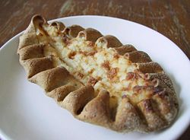
Food In Finland
Finland is famous for pickled herring, lihapullat and ravlax.
Below you can see a pastry dish known as Karelian pasty ,or Karjalanpiirakka. Blimey,
What a mouthful!

Slide 4
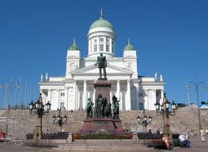
History of Finland
For a long time, Finland was ruled by neighbouring countries Sweden and Russia, who, ironically gave them independence in 1917.

Slide 5
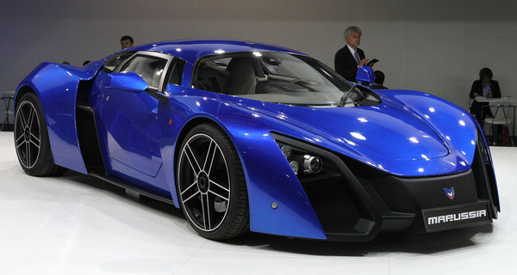
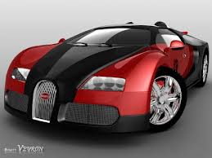
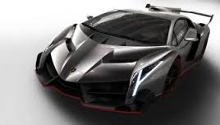
Cars of Finland

