Slide 1
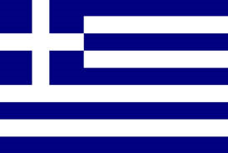
Greece
Hi my name is Anna I am here to tell you about Greece☺ .Greece’s capital city is Athens and it’s national day is the 25th of March

Slide 2
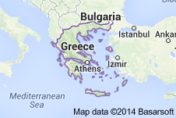
Where is Greece?
Greece is located in the southeast of Europe .It is on the coast of Europe. Greece is surrounded by Bulgaria and the sea

Slide 3
GREECE HISTORY
Greek history spans beyond the borders of the modern state and back. The Greek state was established in 1828 after the Greek Revolution of 1821. During the 19th and early 20th centuries, Greece managed to expand its boundaries to include the then subjugated Greeks of the Ottoman Empire. Greece participated in World War I on the side of Entente, and later the Greco – Turkish War of 1919 broke out. During World War II, Greece greatly contributed to the Allied forces and efforts and was liberated in 1944. A five – year civil war broke out afterwards. During the 1950s and 1960s, Greece invested in tourism. In 1967, democracy was overthrown by a military coup d’état and the Regime of the Colonels followed. In 1974, democracy was restored and since then, Greece recovered significantly. Since 2009, Greece has been plagued by a financial crisis, triggered by the Great Recession of 2008 and the sovereign debt of the country.

Slide 4
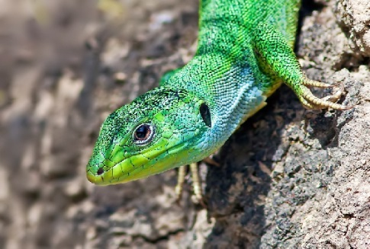
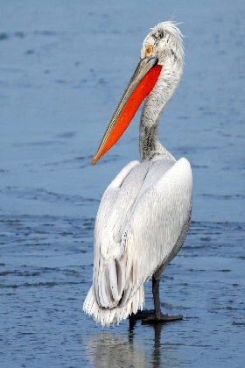
Wildlife in Greece
There are 425 bird species recorded in Greece, 243 of those species breed in the Country. That is a huge number for such a small place, making Greece very important for European bird life and a great place. Greece has around 70 different species of to visit for bird watching. Greece has around 70 different species of reptiles and amphibians. That is more than either France or Spain, which are both about four times the size! These include some endemic species, such as the Milos Viper (west Cyclades islands), The Peloponnese Wall Lizard (only in southern Greece) and the Levant Skink (Rhodes).

Slide 5
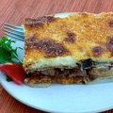
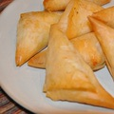
Food in greece
Moussaka perhaps the most widely recognized of all Greek dishes, this oven-baked casserole of layered eggplant and spiced meat filling topped with a creamy béchamel will be the highlight of any Greek meal
These finger-friendly triangles are made with phyllo pastry sheets and filled with a delicious mixture of Greek cheeses

Slide 6
Culture in Greece
Greece is one of the oldest nations in Europe, with a history going back thousands of years. The culture of ancient Greece has had a major influence on the development of Western civilization in such areas as Drama and Dramatic Arts, Art, Architecture, Literature, Music, Philosophy, and Mythology.

Slide 7
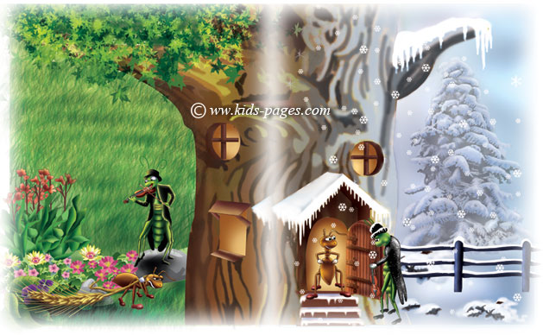
Aesop’s Fables
The Ant and the Grasshopper One summer's day, a merry Grasshopper was dancing, singing and playing his violin with all his heart. He saw an Ant passing by, bearing along with great toil a wheatear to store for the winter. “Come and sing with me instead of working so hard”, said the Grasshopper “Let’s have fun together.” “I must store food for the winter”, said the Ant, “and I advise you to do the same.” “Don’t worry about winter, it’s still very far away”, said the Grasshopper, laughing at him. But the Ant wouldn’t listen and continued his toil. When the winter came, the starving Grasshopper went to the Ant’s house and humbly begged for something to eat. “If you had listened to my advice in the summer you would not now be in need,” said the Ant. “I’m afraid you will have to go supperless to bed,” and he closed the door. It is best to prepare for the days of necessity.
Aesop's fables were believed to be written by a Greek slave around 600 BC. Every story ends with a moral.
Here is one of Aesop’s story’s about an ant and a grasshopper.

Slide 8
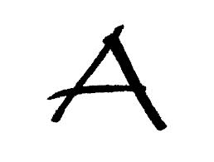
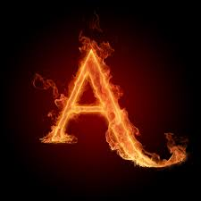
The end
By

