Slide 1
All About Greece
By Aoibheann Treanor

Slide 2
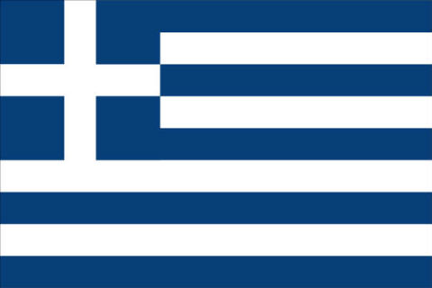
GREECE
The Capitol of Greece is Anthens. It is in the North of Greece! The size of Greece is 131,957km²!!! The population is 11.1 million, that is loads more than Ireland. The language they speak as you can guess is Greek! Their National day is the 25th of March! It is a big day for the Greeks! The Greek flag is blue and white!!!

Slide 3
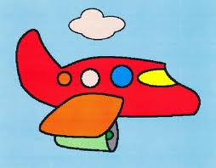
HOW TO GET TO GREECE☺
Never mind talking about Greece! If you want to go to Greece first we will find out how to get there!!! From Dublin to Greece it takes a day and 12 hours!!!! That is approximately 472 km!!!! So enjoy your holiday ☺☺

Slide 4
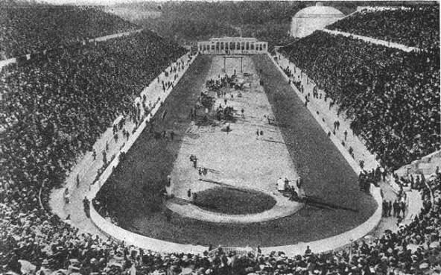
THE OLYMPICS
The Famous Olympics were actually made by the Greeks!!!! The ancient Greeks loved competitions of all sorts, especially sporting competitions. The Olympics were not the only competition games held in ancient Greece, but they were the most popular.
The following is a humorous look at five ancient Greek city-states. In truth, the Greeks took the games quite seriously. Nearly all the ancient Greek cities sent teams to participate in the ancient Greek Olympics.
If two or more Greek city-states happen to be at war with each other when the game date arrived, war was halted for the duration of the games.
Everyone wanted their city-state to win!

Slide 5
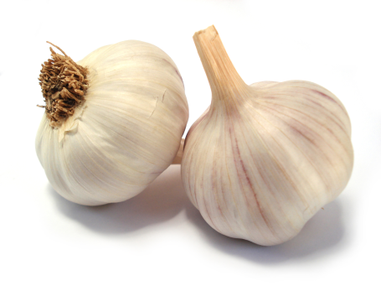
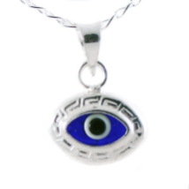
5 GREECE SUPERSTITIONS
1. Greece do not eat beans as they think they contain the souls of the dead☺
2.The Evil eye [lucky eye] can charm someone by just looking at them. It can be gave to be a evil person [superstition]!
3. Greeks hang little blue eyes around their necks and wrists. You can get these in almost any jewellery or souvenir shop. Blue stones are also good, since the colour blue is considered a protective colour. The reason the colour blue and the painted eye are used is that both are thought to ward off the evil of the eye.
4. Garlic: Garlic is another way to ward off the evil eye, and one can sometimes see it hanging in a corner of some houses. Garlic, as well as onion, is also considered of having a great healing power by many Greeks. If someone is feeling ill, they will advice him to eat garlic.
5. Spiting: Some Greeks believe that spitting chases the devil and the misfortune away. That is why when someone talk about bad news (deaths, accidents, diseases etc…) the others slightly spit three times saying “ftou”. Another example is that someone that compliments a baby, a child or even an adult for its beauty, has also to spit 3 times on the complimented person.

Slide 6
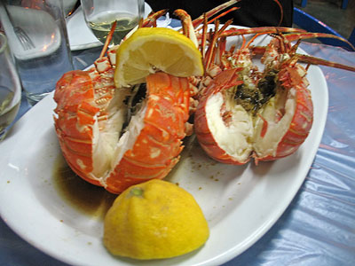
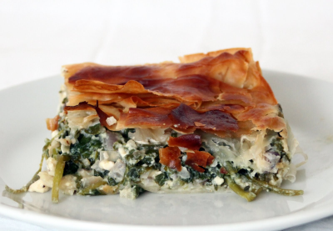
FOOD
The Greeks have a lot of different kinds of foods!!! Such as Moussaka (aubergine and meat dish), keftdes ( meatballs, baklava (a sweet pastry dessert) and loads more!!! The Greek diet was very healthy. Food in Ancient Greece consisted of grains, wheat, barley, fruit, vegetables, breads, and cake. The Ancient Greeks grew olives, grapes, figs and wheat and kept goats, for milk and cheese. They ate lots of bread, beans and olives.
In the Summer months there were plenty of fresh fruit and vegetables to eat and in the winter they ate dried fruit and food they had stored like apples and lentils. As most of the Greeks lived very near the sea, they also ate a lot of fish, squid and shellfish.

Slide 7
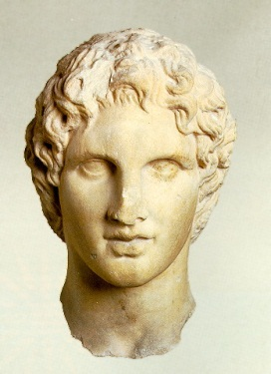
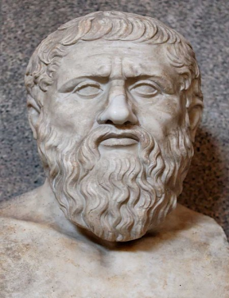
FAMOUS GREEKS
There are a lot of famous Greeks
Some of the most famous Ancient Greeks include:
1. Plato (c.429-327 BC) - He was a brilliant student of Socrates and later carried on his work. He gathered Socrates' ideas and wrote them down in a book. Plato founded the world's first university. He wrote down his teachings and people all over the world, even today, study the Greek philosophers
2. Alexander the Great
Alexander the Great was born in 356 B.C. in Pella, Macedonia, the son of Philip of Macedon, who was an excellent general and organizer. He was called 'the Great' because he conquered more lands than anyone before him and became the overall ruler of Greece.
3. Parmenides - watched an eclipse of the Moon in about 470 BC, and noticed that the Earth's shadow was curved. He worked out that if the shadow was curved, then the Earth must be round.
And many more !!

Slide 8
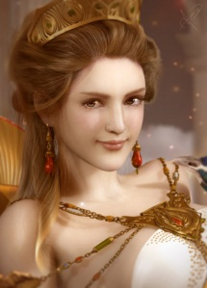
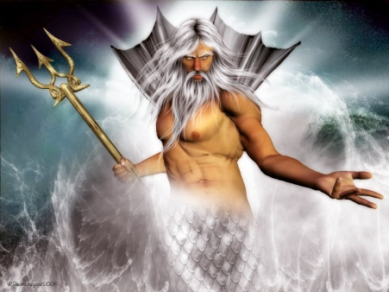
GREEK GODS
Ancient Greece had a lot of Gods!!! Each God was for a different thing! They might have a door god or even a bathroom god!! Here are some of the Gods!!
1. Wife of Hephaestus. Goddess of love, desire and beauty. Aphrodite rises from the foam of the waves of the sea, enchanting anyone who sees her and inciting feelings of love where ever she goes.
The myrtle is her tree. The dove, the swan, and the sparrow her birds.
2. Hera
Married to Zeus. Hera is the goddess of marriage. Her sacred animals are the cow and the peacock.
Symbol or Attribute: The peacock
3. Poseidon
Brother of Zeus. The God of the sea and worshiped by seamen. He married Amphitrite. His weapon is a trident, which can shake the earth, and shatter any object. He is second most powerful god.
Symbol or Attribute: Three-pronged trident

Slide 9
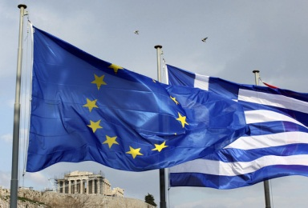
GREECE IN TROUBLE ???
Greece is in trouble because it took on too much debt.
But other countries have agreed to help Greece by lending the country more than 130-billion euros. Euros (€) are the units of money used in 17 countries in Europe including Greece, France and Germany.
The countries that have agreed to bail Greece out of its money problems are demanding something in return. They are insisting that the government of Greece spend less.
For example, Greece must pay its workers less. It must also reduce the amount of money paid to workers once they retire.
These cuts to spending that will affect the people of Greece are called “austerity measures.”
If the plan goes ahead, the austerity measures will also reduce, or cut, the amount of money spent on health care and education. This will have an effect on hospitals and schools in Greece.
Spending on the military to defend the country will also be cut, along with special payments to families that have at least three children.
Many Greeks are not happy about the planned spending cuts which will add up to more than three billion euros. Thousands have been protesting by marching in the streets of several cities in Greece.

Slide 10
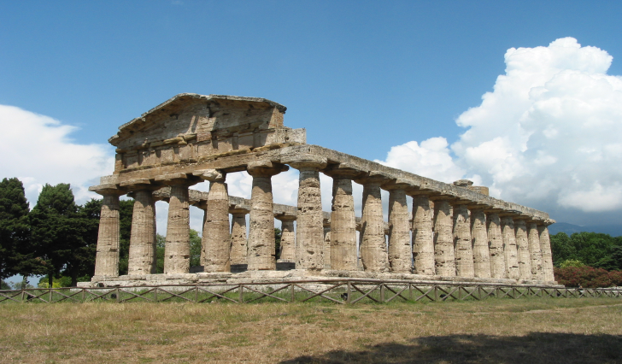
FAMOUS BUILDINGS !!☺
The Parthenon built on the Acropolis in Athens, was the chief temple to the goddess Athena. The Parthenon is 14 metres and it opened in 438 BC!! Also there is The Athena Temple which is a temple in memory of the great God Athena!!! Greece has brilliant temples and buildings !!!!

Slide 11
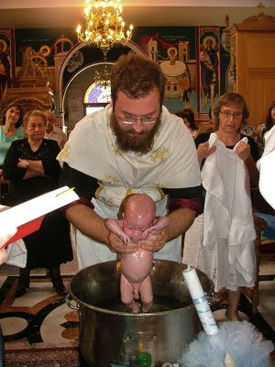
GREECE TRADITIONS ☺☺
1. Baptismal day is one of the most important days in the life of a Greek orthodox. Sacrament of Baptism usually occurs the first year after the baby is born. The baby is called baby and doesn’t have a name until it is baptized.
The baby is wrapped in a white towel. Then the priest blesses the water of the baptismal font and adds olive oil brought by the godparents. He then immerses the baby three times in the blessed water, saying the chosen name (usually the same as the grandmother’s or the grandfather’s name). The baby receives the sacrament from the priest who blesses the baby with “myrrh” (olive oil blessed by the Patriarch) as well as the baby’s clothes. Then, the baby is dressed with white clothes and the priest puts a gold chain with a cross on the baby’s neck and gives the baby its first Holy Communion.
The ceremony is followed by a celebration at the family’s house or a restaurant.
2. It is a custom in Greece for people to engage themselves before marrying each other. The man has to ask the hand of the woman from her father.
When all is agreed about the wedding, the priest is invited to bless the engagement rings and places them on the left ring-finger of the man and woman. The guests wish “kala stephana” (good crowns = have a good marriage) and “I ora I kali” (that the good hour comes = the marriage) to the couple.
This custom is mostly followed outside Athens (islands and the rest of Greece, in villages), when it tends to disappear

Slide 12
THE END ☺☺☺☺☺
By Aoibheann xx

