Slide 1
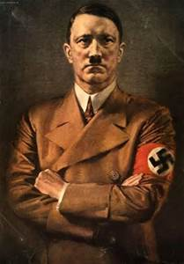
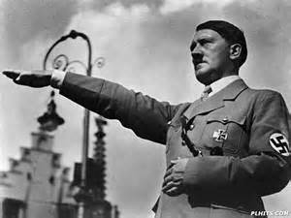
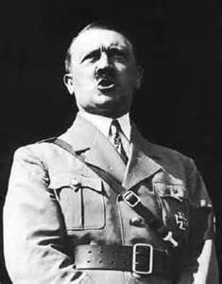
Hitler.
This is Cara and Eve’s project on Hitler.
We are learning about
Famous Europeans so we decided to do ours on Hitler and World War 2.
Hope you enjoy.

Slide 2
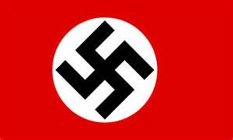
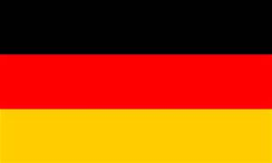
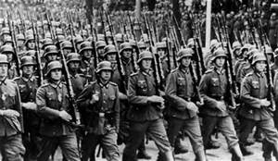
Facts about Hitler.
Hitler was a very cruel and mad man.
He put Jews into concentration/prison camps
His full name is Adolf Hitler!
He was the leader of the Axis.
He was born in a small Austrian town called Braunau near the German border.
He was born on the 20th of April 1889.
On the 30th of April 1945 Hitler shot himself in the head because he had lost the war and he would be put in prison and killed my his enemy.

Slide 3
What Hitler did

Slide 4
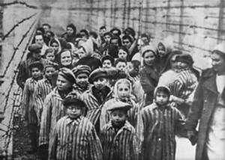
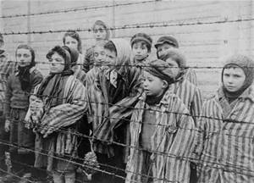
Concentration camps
Concentration camps where horrible places where the German solders and Hitler put Jewish people to starve to death. He also put them in gas chambers.
They wore a special striped outfit and they had a number sewn into them. It was possible that the outfit could have been passed down from people that had all ready been killed. They were never washed or cleaned.
There is a book called the “The Boy in the Striped Pyjamas” that is based on WW2. It is about a boy that that was in a concentration camp and was gassed. It is a very sad story.

Slide 5
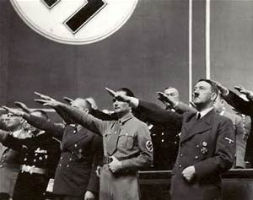
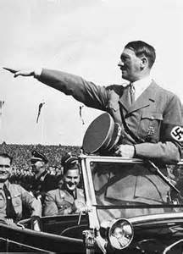
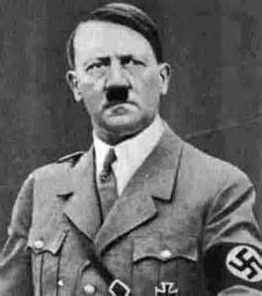
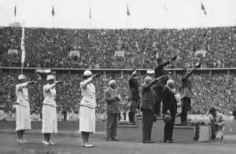
Hitlers salute
Every time Hitler entered you had to stick out your hand in front of you as a salute to him.

Slide 6
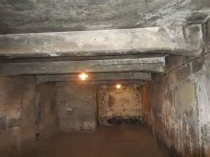
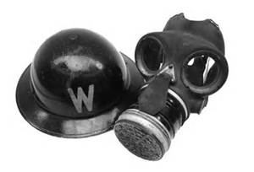
Gas chambers
The German solders put the Jews in to rooms called gas chambers. They released a gas into the room to make you feel sleepy and after a while you would suddenly stop breathing.
Gas chambers were open rooms with nothing in them.
Everybody carried a gas mask around with them if they wanted to live. Even children were put in gas chambers and were left to die.

Slide 7
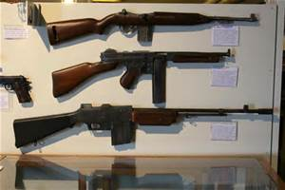
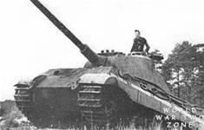
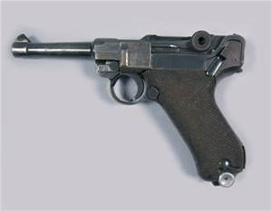
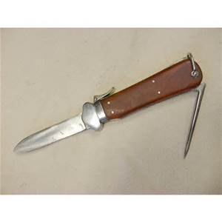
Weapons.
In World War 2 people used lots of different type of weapons such as pistols, rifles, sub- machine guns, machine guns, anti tank weapons, grenades, mortars, flamethrowers, sniper rifles, shot guns, pocket knives and assault rifles.

Slide 8
The end!!
Thanks for watching!
By Eve and Cara!

