Slide 1
Italy!
Hello or Ciao! I am here today to show you about Italy!
Italy’s flag colours are green, white and red. Italy is a very nice country!

Slide 2
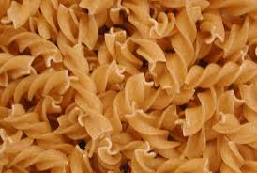
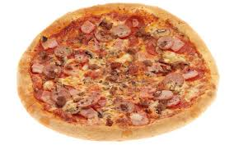
Food
The food in Italy is very nice! Italy is the home of pizza and pasta. Italians have a great appetite for gelato, which means ice-cream. Pizza is a circle made of dough topped with any topping. Here are some common ones, tomato sauce and cheese, ham and pineapple, salami and pepperoni. Pasta is very popular too in Italy. Most common are, spaghetti, bowtie pasta, fusilli, tagliatelle and penne.

Slide 3
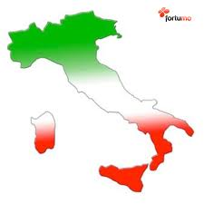
Facts
Did you know that Guglielmo Marconi, who invented the radio, was half Irish and half Italian?
The colours of the flag represent virtues: hope(green) faith(white) and charity(red) .
The Italian Republic’s nickname is “Bel Paese” which means beautiful country.
Did you know that Italy is formed into a boot-shaped peninsula?
In several cities in Italy people travel around the town by boat, Venice is the most famous city for canals.

Slide 4
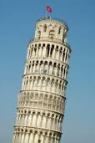
Italy’s attractions
Now Italy has many great attractions, like its food! I know we can get pizza and pasta around the world but Italian pizza is 10 times better! The Leaning tower of Pisa is a HUGE attraction in Italy. Many people wonder how it leans, well let me tell you. Construction for the bell tower began over 800 years ago, in 1173. What the architects failed to realize was that the soil was unstable, and that a mere three-meter foundation to support the tower would not be enough. After the first three stories were constructed, the ground began to sink, and the tower began to lean. Now it may look to people that its leaning so far that it will fall, but the tower is supported. It stopped leaning for almost a century, the soil was settling and getting dry, supporting it. The Leaning tower of Pisa leans just 1 millimetre each year.

Slide 5
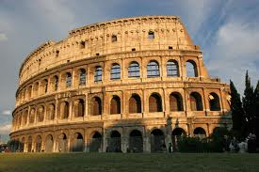
The Capital: Rome
The Capital of Italy is Rome. It was said to be founded by twin brothers called Romulus and Remus according to legend. Romulus and Remus had a fight over the city name. So they battled each other and Romulus killed Remus, and that is how Rome got its name. History in Rome wasn’t a very happy history, if you were poor in ancient Rome, you wouldn’t have the best life. In ancient Rome people were born into slavery, yep, every person who was poor or bad were slaves. Slaves had to clean bathrooms, rooms, sleep on hard ground and clean the vomit room!
Once again, yes, a vomit room. People in ancient Rome used them at feast nights so they could eat more. Don’t get me? I’ll tell you. On feast nights the table was FILLED with food, and many people got full real quick. So they went to the vomit room to, well… you know what I mean… And after that business they would eat even more!

Slide 6
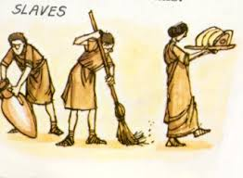
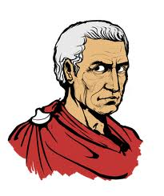
The Roman Empire
The Roman empire is the most famous thing about Italy. The Roman empire was terrible for poor people, and they were known as the slaves. The rich people were lucky, but there was only a few who were rich. Slaves had a really tough time doing their work, and if they try to escape well… They would be sent into the coliseum to battle a lion, and well, you know who would win. Luckily that’s history in Italy, because if you were thinking about spending your holidays there well I hoper I didn’t scare you!
The Roman Empire was ruled by many Roman emperor. The most famous emperor was Julius Caesar. He was famous because he was an expert at conquering places, this must mean his soldiers were powerful, and so was he.

Slide 7
Myths and Legends
There are many myths and legends about the Romans, here’s a list of a few but I’ll only tell you one. Romulus an Remus, Androcles and the lion, Baby Mercury, Apollo and Cassandra, The Trouble with Oracles and Pluto and the King. The one I’m telling is Androcles and the lion. Years ago there was a slave called Androcles, and he escaped his owners and fled to the mountains.
He hi in a cave overnight. When he woke in the morning a lion was entering the cave! The lion was growling and looked very cross.
Androcles saw that there was a thorn in the lions paw and he removed it.
One day soon afterwards Androcles was captured by Roman soldiers and taken to the Colosseum.
He was thrown into the arena and a lion was let out.
The Romans liked to punish escaped slaves and make an example of them.
To their surprise the lion walked up to Androcles and licked his hand. It was the same lion that Androcles had saved.
The emperor was impressed and Androcles was given his freedom.

