Slide 1
Lithuania ☺
By Ernesta Laureckyte! ☺

Slide 2
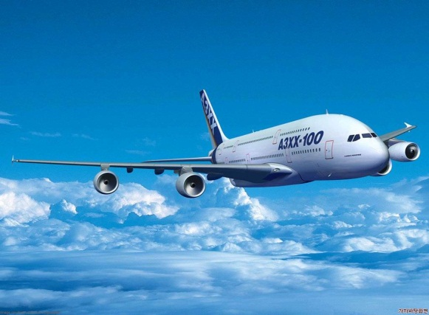
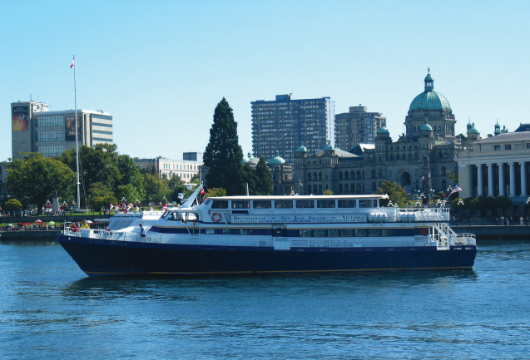
Where is Lithuania?
Lithuania is a country with a small population which is located in the continent/region of Europe. Lithuania is a costal country but also boarders the countries Latvia ,Belarus, Estonia and Poland. Its biggest cities and towns include Vilnius, Kaunas, Klaipeda and Šiauliai.
It takes three hours to fly on a plane from Dublin Ireland. You can’t sail to Lithuania straight away you have to go to other countries and then get into a different boats and the go off again.

Slide 3
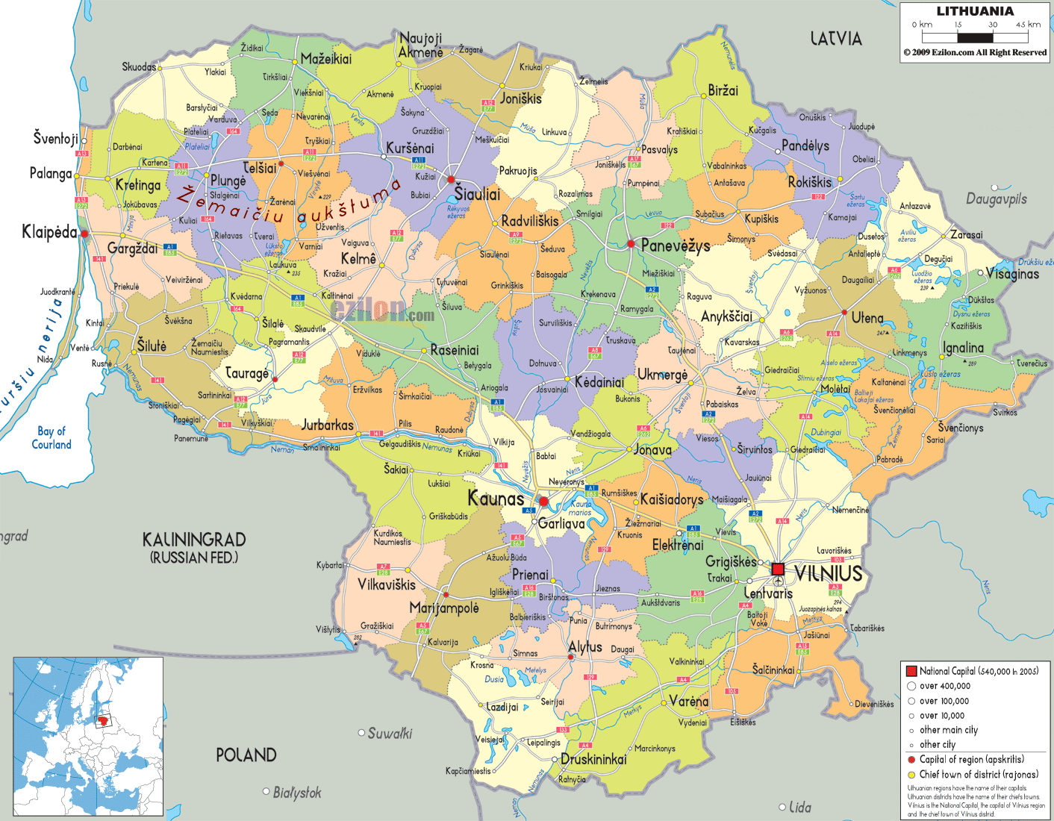
Lithuania
Gediminas castle
Legend has it that the Grand Duke Gediminas had a dream in which he saw and iron wolf howling like 100 wolves where the castle know stands. He thought the dream meant that it was god’s will that the castle be built there and so in 1230 it was.

Slide 4
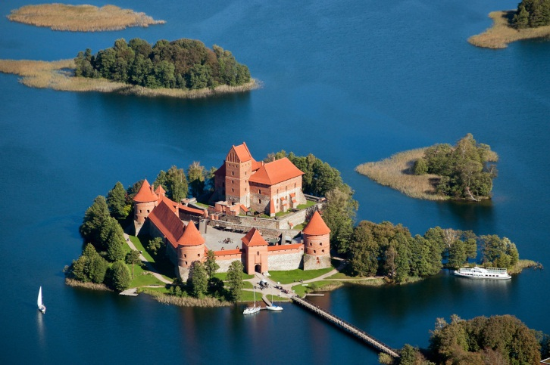
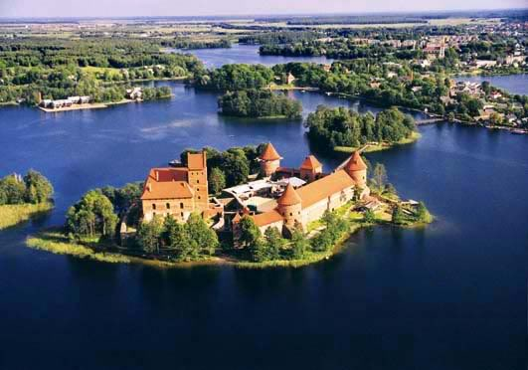
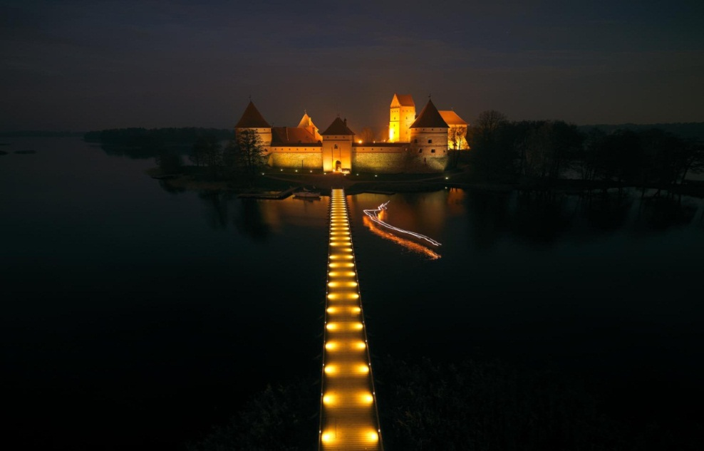
Trakai
The historic capital of Lithuania, Trakai is noted for it’s beautiful surroundings as well as Trakai Castle which is an excellent example of Gothic architecture. It was home to Grand Duke Vytautas before Vilnius became the Lithuania capital.

Slide 5
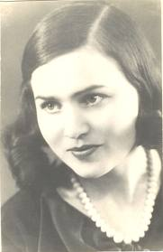
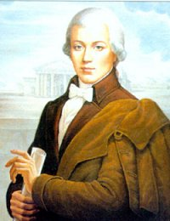
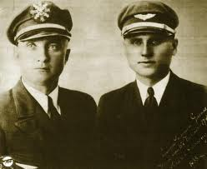
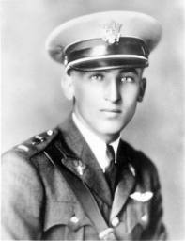
Famous Lithuanians
Salomeja Neris (poet), Laurynas Gucevicius (architect), and Steponas Darius and Stasy Girenas (pilots). Did you know?
In 1935, Lithuanian American pilot, Feliksas Vaitkus, became the sixth person to fly solo across the Atlantic and landed in afield in Ballinrobe, Co.Mayo.

Slide 6
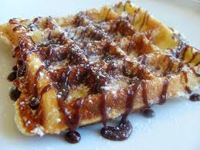
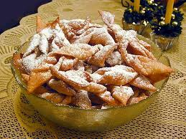
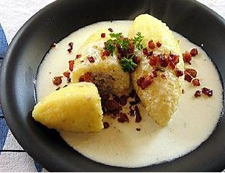
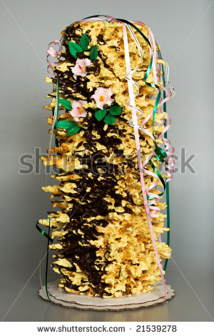
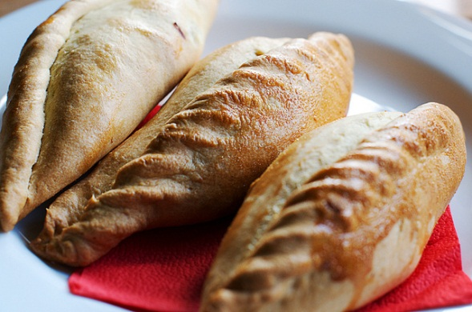
Food
Lithuanian's enjoy kibinai (similar to Cornish pastries), cepelinai (meat filled dumplings), and sweet or savoury pancakes.
Mostly the desserts are cakes.

Slide 7
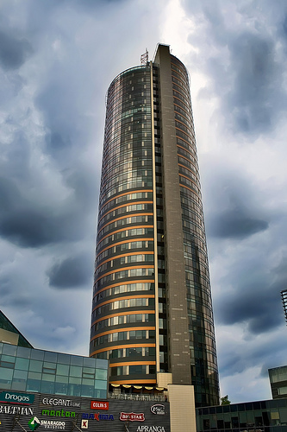
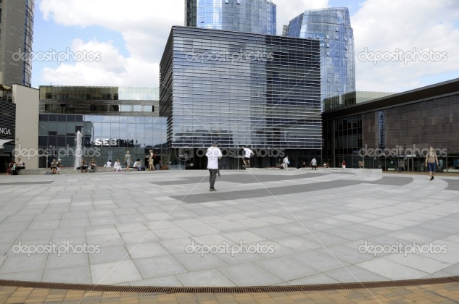
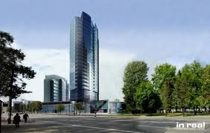
Biggest building's in Vilnius
Europa tower Vilnius 129 m ^{[3]} 33 floors built in 2004.
Helios city tower A Vilnius 96 m ^{[3]} 27 floors built in 2006.
Europe square apartment Vilnius 95 m ^{[4]} 27 floors built in 2004.
Vilnius Business Harbour Tower A 86 m ^{[5]} 24 floor built in 2008.
Reval Hotel Lietuva Vilnius 85 m ^{[6]} 23 floor built 1983.
Municipality Building Vilnius 77 m ^{[9]} 20 floors built 2004.
Vilnius Gate Apartments Vilnius 77 m ^{[10]} 18 floors built 2007.

Slide 8
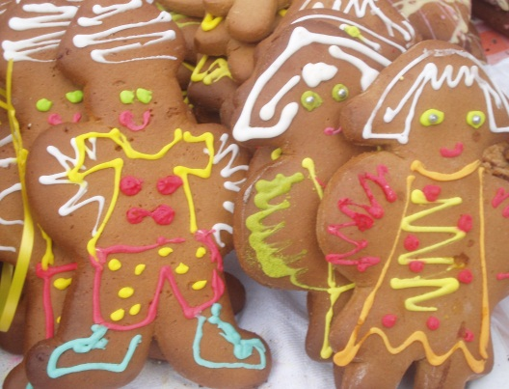
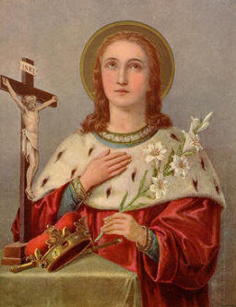
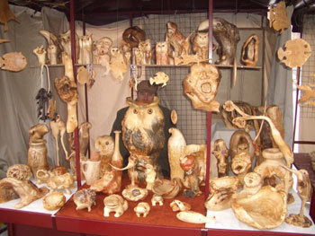
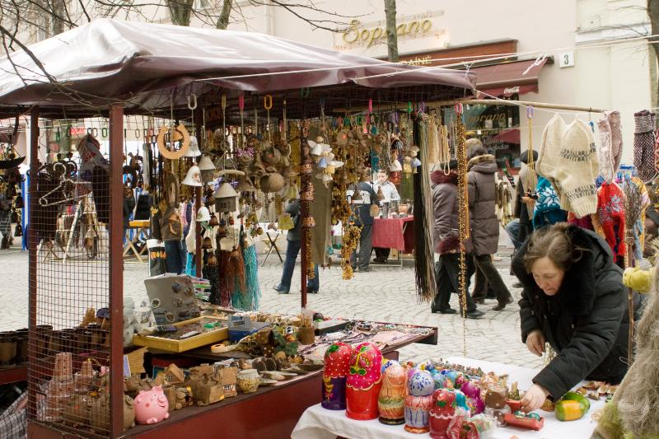
Traditions
Kaziuko mugė is a large annual folk arts and crafts fair dating to the beginning of the 17th century. It was originally held at the two main markets in Vilnius, Lithuania, as well as in the city streets.
The fair is traditionally held on the Sunday nearest to St. Casimir's Day, March 4, the day Saint Casimir died. In Lithuania, Kaziuko mugė means "Little Casimir's" Fair (Kaziukas is a diminutive of Casimir). Today, Kaziuko fair also features music and dance; it attracts tens of thousands of visitors and many craftsmen from all over the country as well as from neighbouring states such as Latvia, Russia, and Poland.

Slide 9
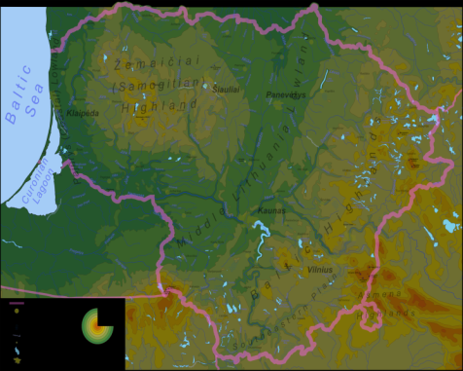
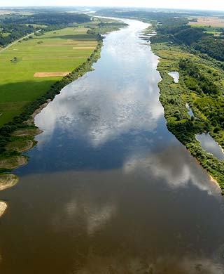
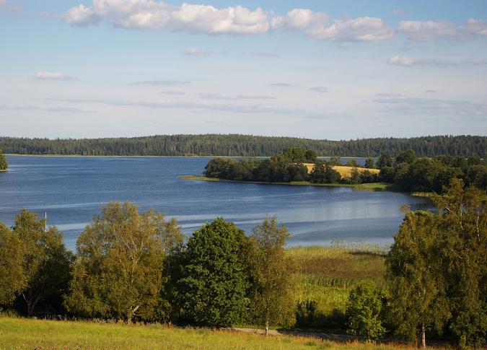
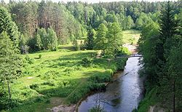
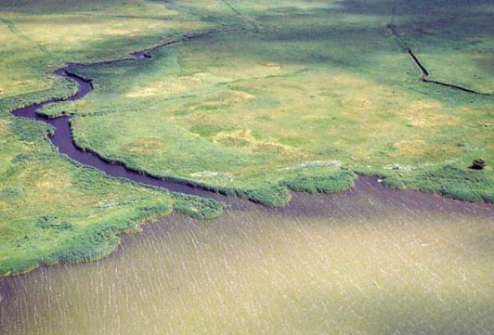
Lithuania Landscape ☺
Lithuania has lots of forests It has mountains and there is lots of beautiful wild flowers.
There’s lots of rivers and lakes most of the lakes are suitable to go to swimming.
Neman is the longest river in Lithuania (length 937 km - in the territory of Lithuania - 359 km)
Druksia the area is 4479.0 and the depth is 33.3.
Dainava is the largest forest in Lithuania it is in the
Southern Lithuania.

Slide 10
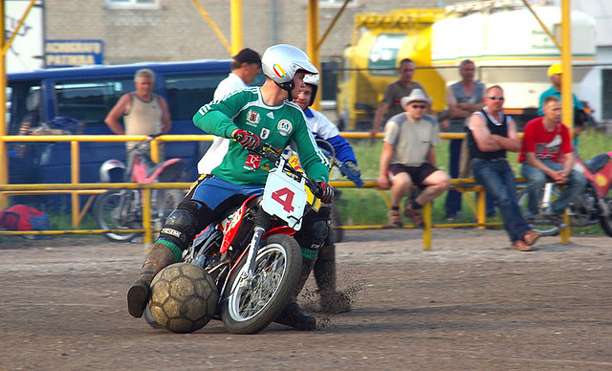
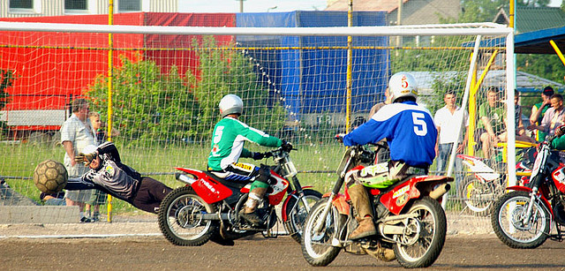
Sports ☺
Basketball is one of the biggest sports in Lithuania it is very popular.
Motoball is another popular sport people go on motor bikes and there is a football and the start driven around and kicking the ball with one foot and the goalkeeper doesn’t doesn’t stay on a motor bike.

Slide 11
THE END!!! ☺ ☺ ☺ ☺ ☺
HOPE YOU ENJOYED.

