Slide 1
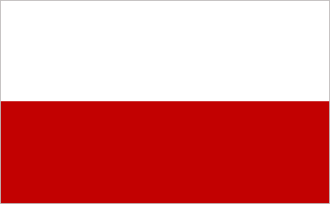
Poland

Slide 2
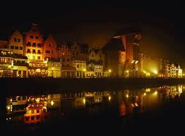
Poland’s Profile
Capital: Warsaw
Size:313,000km2
Population: 38.1 million
Language: Polish
National day: 11th November.

Slide 3
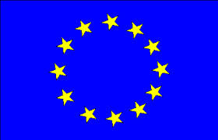
Poland joining the EU
Poland
Poland and the EU
Poland’s Capital city is Warsaw. Poland’s national symbol is the White Eagle. Poland has seven neighbours Germany, Czech Republic, Slovakia, Lithuania, Belarus, Ukraine and Russia.
Poland joined the EU in 2004. Poland is the sixth largest country in the EU.

Slide 4
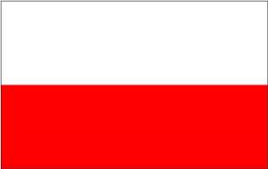
The Polish Flag
The Polish flag is red and white. As you can see the white is at the top and the red is at the bottom. Here is a picture of the Polish flag.

Slide 5
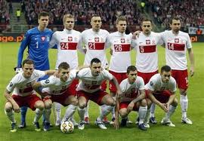
Sport in Poland
Sport in Poland is very popular. These are some sports in Poland : football, volleyball, handball and speedway. Poland love sport that much Poland and Ukraine co-hosted the UEFA Euro football tournament. Beside is a picture of the Polish football team.

Slide 6
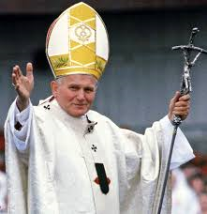
Pope John Paul II
Pope John Paul II is a very famous pope because he was the first pope from Poland.
Since then Poland had a lot of interest in what the pope is doing.
Poland is so fond of popes that they have a pope channel, a pope channel is a channel where you can just turn it on and the news about the pope is always on it.

Slide 7
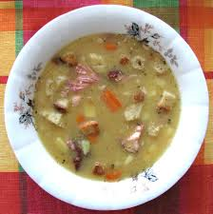
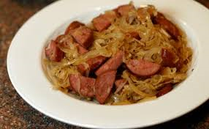
The food they eat
Poland is home to zurek (a type of sour soup). The national dish is bigos ( cabbage and meat).

Slide 8
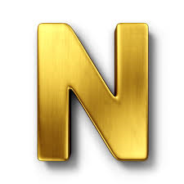
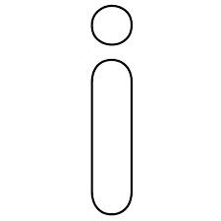
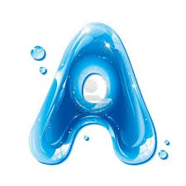
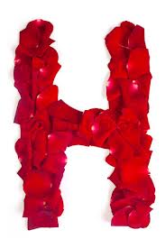
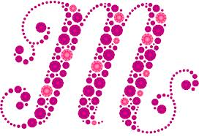
The End
By

