Slide 1
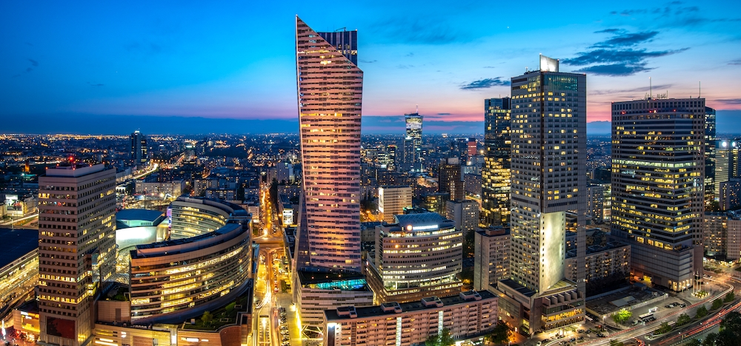
Poland
By Marcel

Slide 2
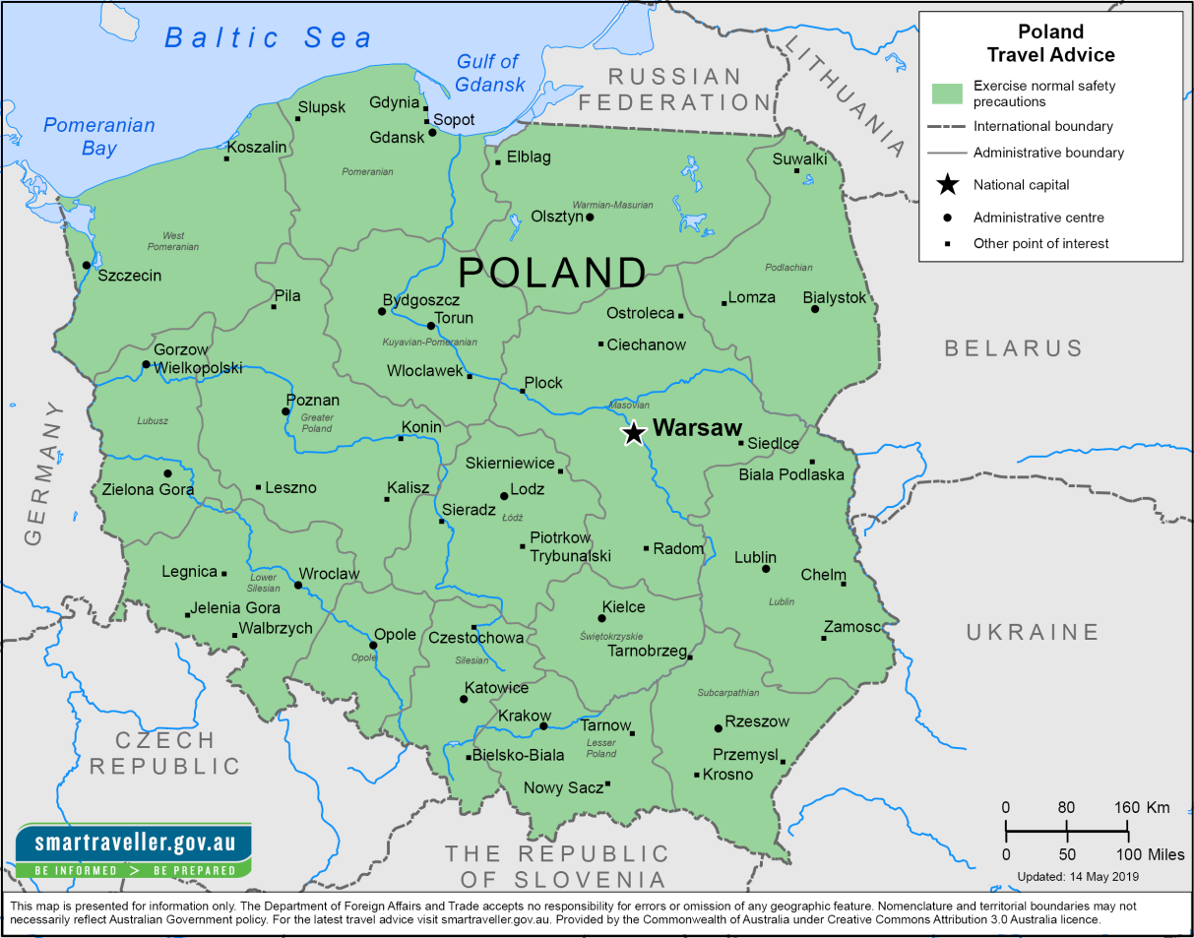
The population of Poland
There are currently 37 million people living in Poland

Slide 3
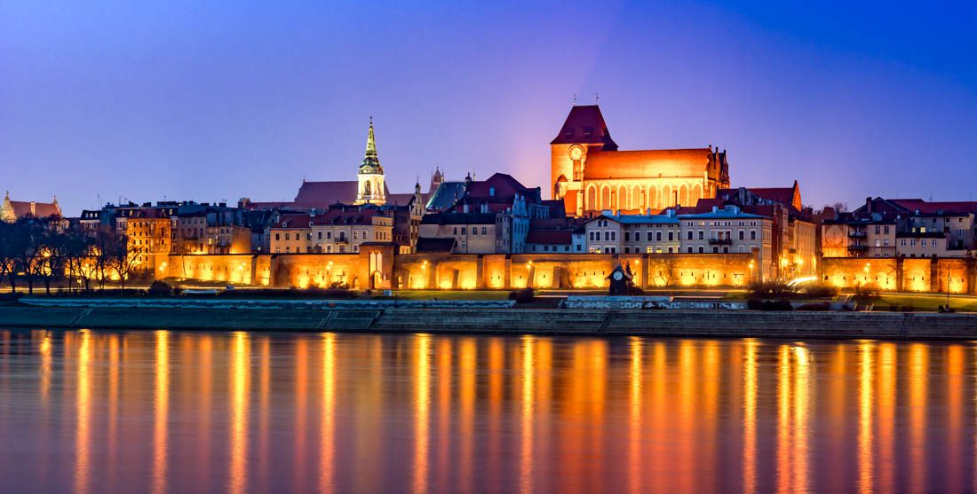
Capital and big cities
The capital of Poland is Warsaw (1.8million people)
Other big cities are...
Kraków
Gdańsk
Poznań

Slide 4
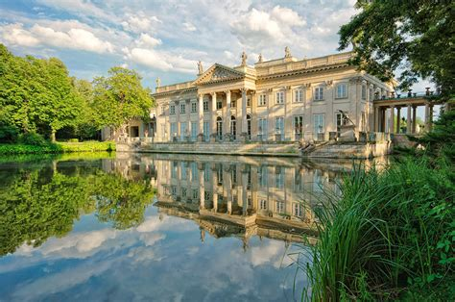
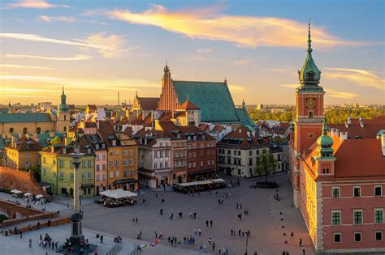
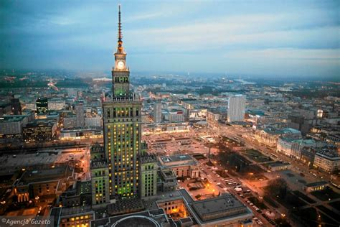
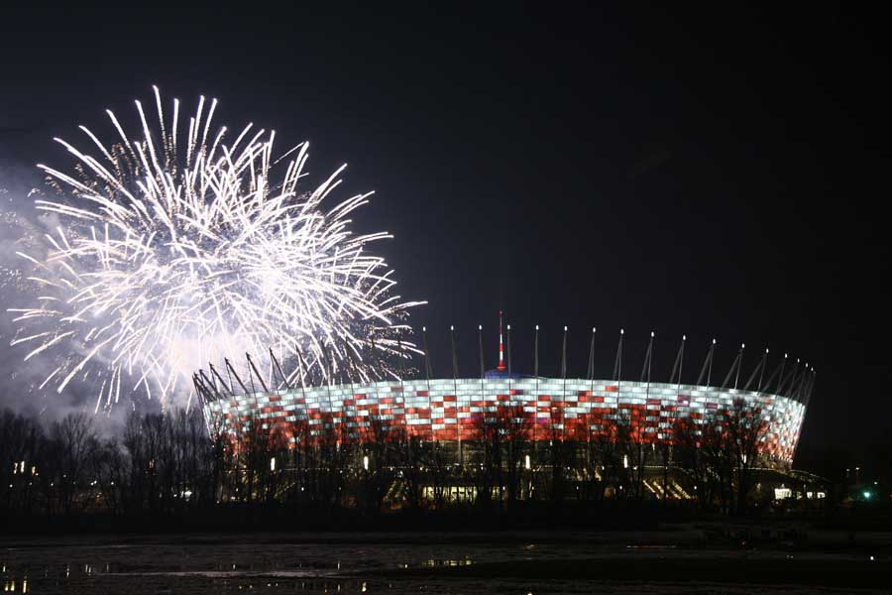
Landmarks In Warsaw
The Palace Of Culture
Łazienki
PGE National Stadium
National Museum In Warsaw

Slide 5
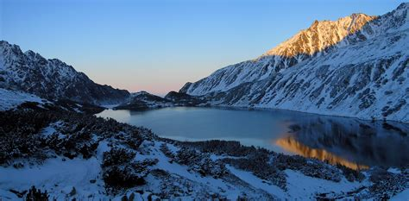
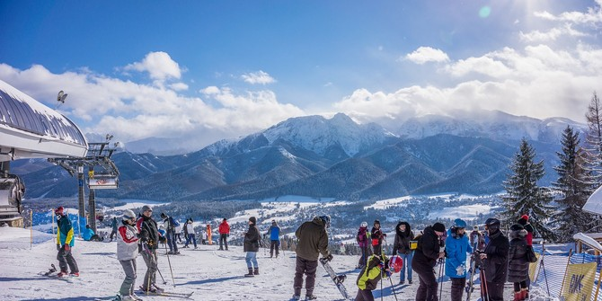
Winter in Poland
Tatra Mountains
Skiing

Slide 6
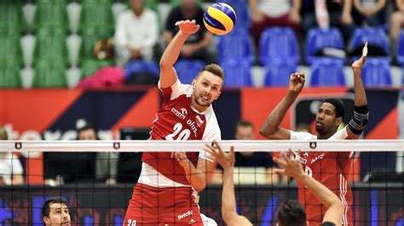
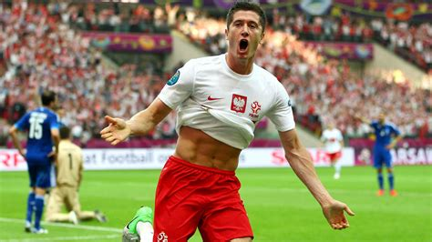
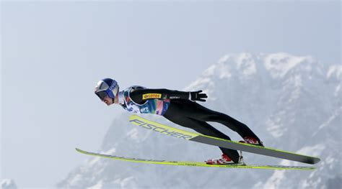
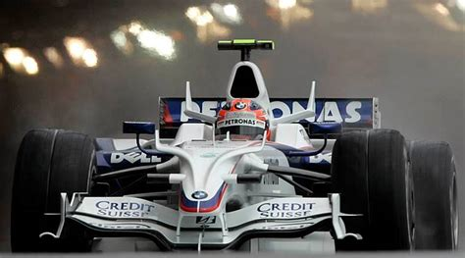
Sport
Soccer-Robert Lewandowski
Volleyball- Michał Kubik
Ski jumping-Adam Małysz
F1 /Rally-Robert Kubica

Slide 7
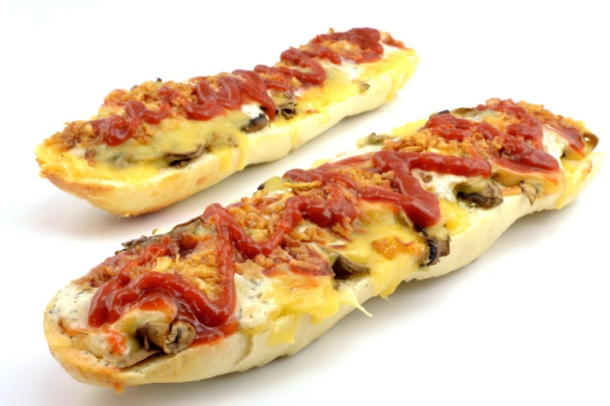
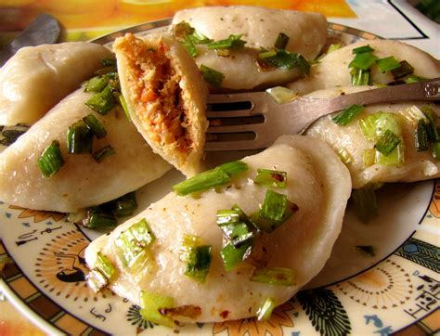
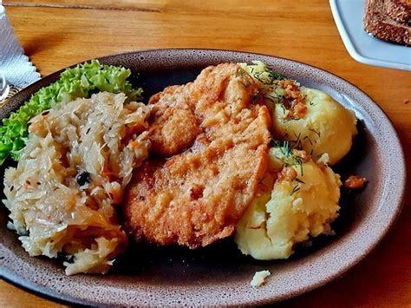
Food
The Most Popular Food In Poland :
Dumplings
Schabowy
Zapiekanka
Rosół

Slide 8
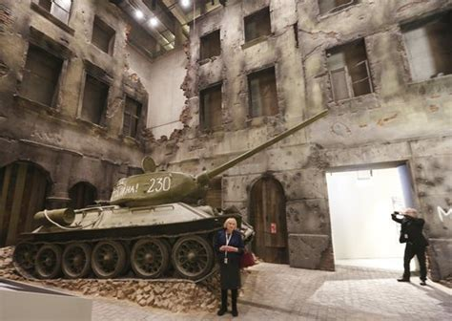
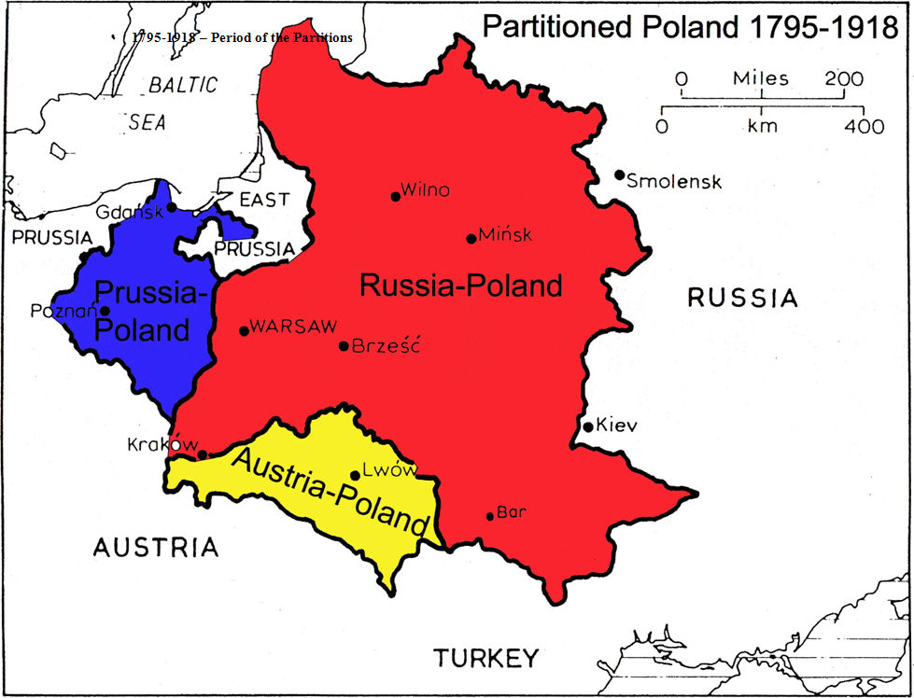
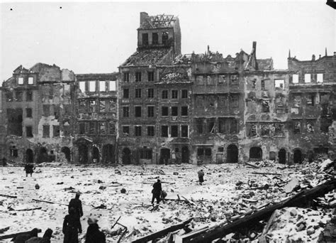
Recent History
1795 – start of the partitions of Poland (Russia/Austria/Germany)
1918 – Independence after First World War
1939 – Russia and Germany invaded Poland – Second World War began

Slide 9
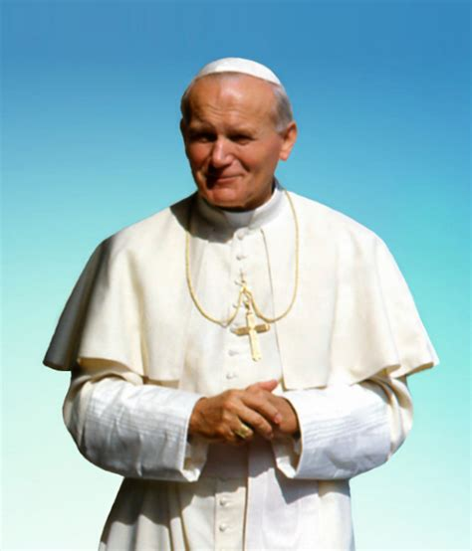
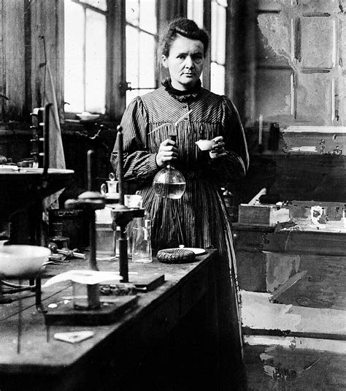
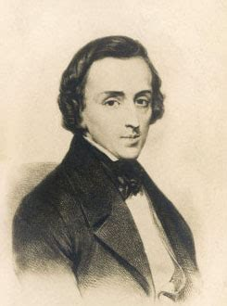
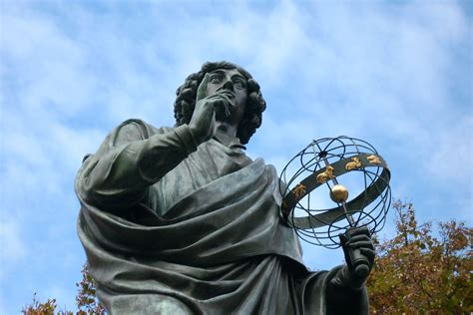
Famous People
John Paul II – the Pope
Maria Skłodowska – a scientist
Mikołaj Kopernik – an astronomer
Fryderyk Chopin – a composer

Slide 10
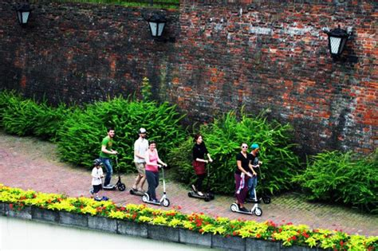
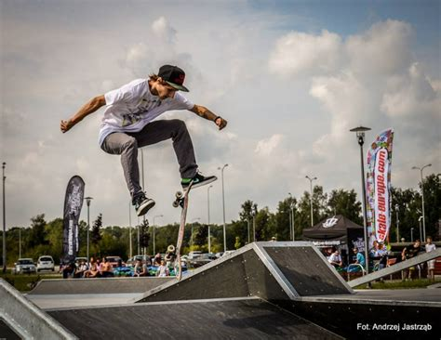
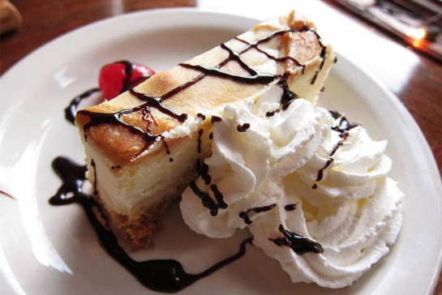
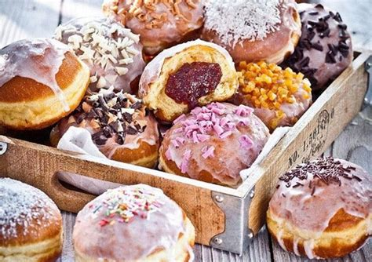
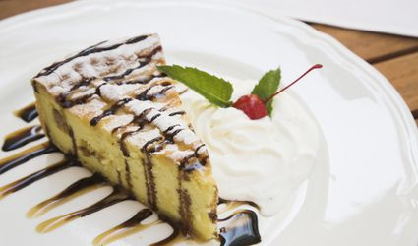
My Favourite Thing About Poland

