Slide 1
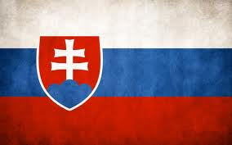
SLOVAKIA
The inventor
of the Military parachute is Stefan Banic

Slide 2
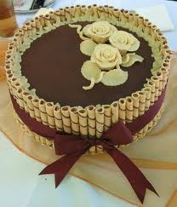
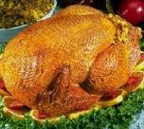
SLOVAKIA FOOD
Slovakia have lots of turkey
Some foods in Slovakia have cheese and cabbage

Slide 3
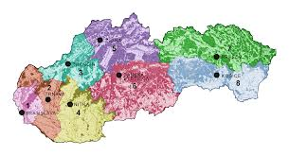
SLOVIKIA city's
In SLOVAKIA there are big city’s all around you and strangers don’t talk to strangers

Slide 4
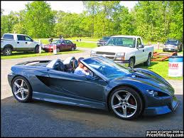
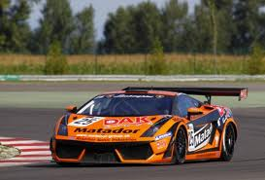
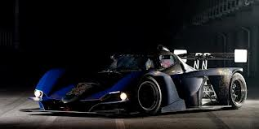
SLOVAKIA RACEING CARS
Slovakian race car rally’s are fun to watch
at day time so you don’t fall a sleep

Slide 5
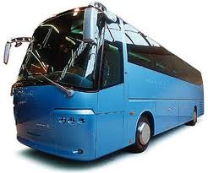
Slovakian buses
Some Slovakian buses are big and some are small

