Slide 1
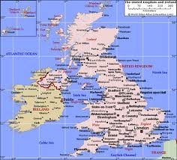
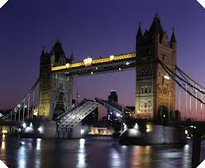
The countries of the UK are England, Northern Ireland, Scotland and Wales.

Slide 2
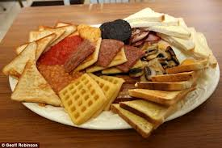
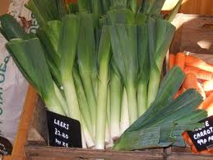
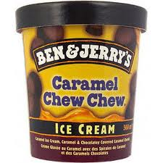
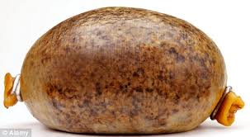
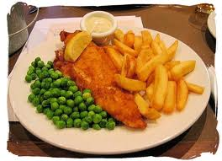
UK food
The people in UK traditionally eat a fry in the morning it usually has toast, french toast,eggs,bacon and sausage.They also like to eat fish and chips.They like Ben and Jerry's ice cream.The Scottish like to eat something called a haggis.Leeks are the national symbol of Wales and are used in many dishes like soup.

Slide 3
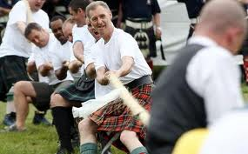
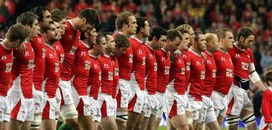
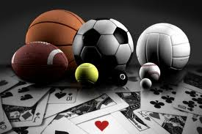
UK sports
The people in UK like a lot of sports like rugby, soccer, cricket, tennis, snooker, swimming and loads more. The Scots like to play tug of war, it’s a sport where two teams pull on a rope and the first team that falls into the muck loses. It’s a sport of strength.Wales have a very strong rugby team and they have won loads of trophies. The Olympics was held in London this year.

Slide 4
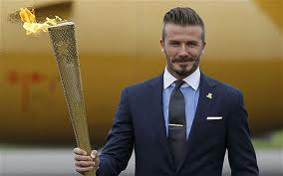
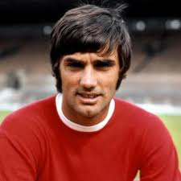
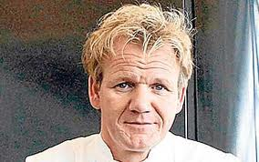
Famous UK people
David Beckham is a soccer superstar he was also asked to light the Olympic torch.Gorden Ramsey is a famous Scottish cook.George Best is a famous football player from Northern Ireland he played for Manchester united
in midfield.

Slide 5
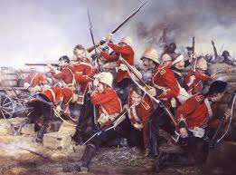
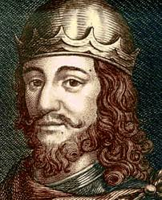
UK History
The British Empire controlled vast territories throughout the world for more than 300 years. In the 1800s and early 1900s, the empire ruled more than a quarter of the worlds population and one-fifth of it’s land mass. Robert the Bruce was king of Scotland from 1306 to 1329. He won a famous victory against the English at the Battle of Bannockburn and freed Scotland from English rule. Owen Glendower(1354?–1416?) was a Welshman who rebelled against English control in Wales. He fought against the English prince Henry (later King Henry V) and became a Welsh hero. (1354?–1416?).

Slide 6
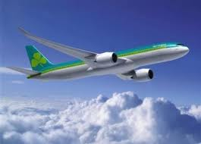
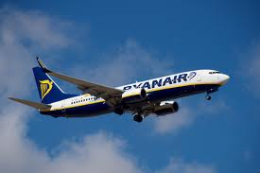
To the UK
From Dublin to Cardiff the distance is 189miles or 296.06kms and it takes 1hr 5mins to get there on a plane.
From Dublin to Edinburgh the distance is 216miles or 347.54kms and it takes 1hr 10mins to get there on a plane.
From Dublin to London the distance is 287.46miles or 462.60kms and it takes 1hr 14mins to get there on a plane.

Slide 7
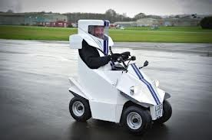
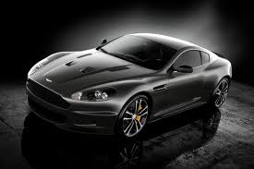
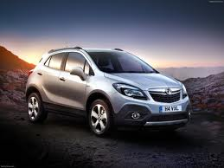
UK vehicles
Here is Jeremy Clarkson in his automobile which is in the colours of the stig Jeremy is a very silly man on top gear.
The Aston martin is a car made in the UK.A Vauxhall is another kind of car made in the UK.

Slide 8
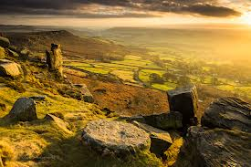
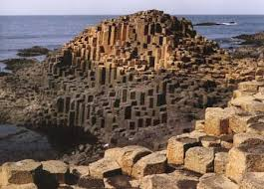
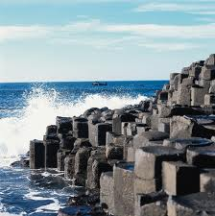
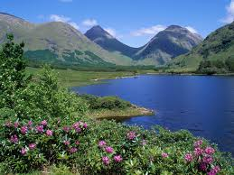
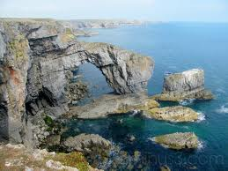
UK images

