Slide 1
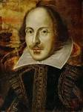
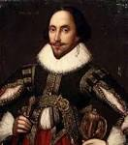
William Shakespeare
Shakespeare was a play writer an actor and a poet. He was voted the best writer in the English language.

Slide 2
Facts about shakespeare
Shakespeare wrote 38 plays.
His plays have been translated into every major language in the world.
His plays have been shown more than any other play writer ever.

Slide 3
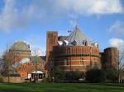
Something's that happened in his life
Shakespeare was born and brought up in Stratford Upon Avon. At the age of 18, he married Anne Hathaway, with whom he had three children: Susanna, and twins Hamnet and Judith. Between 1585 and 1592, he began a successful career in London as an actor, writer, and part-owner of a playing company called the Lord Chamberlain's Men, later known as the King's Men.

Slide 4
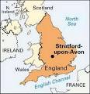
Images of where he’s from

