Slide 1
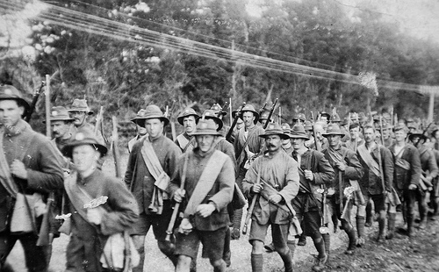
WORLD WAR 1
BY AOIBHEANN

Slide 2
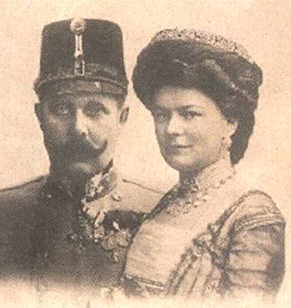
Start of World War ☹
Hello my name is Aoibheann and I am here to tell you all about The First World War!
It all started when Franz Ferdinand was asassinated with his wife Sophie Chotek. They were visiting Sarajevo for an inspection on the Austro-Hungarian troops there. It was planned that Franz Ferdinand and his wife Sophie would be met at the station and taken by car to the City Hall where they would have lunch before going to inspect the troops. A Serbian decided to end this all by shooting Franz and his wife in the car. This resulted in WAR!!

Slide 3
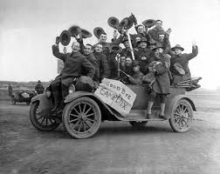
The War had begun
The Participants in World War 1 were Austria/Hungary, Britain, Germany and France. While the soldiers were going to fight they would have sung different songs, to cheer them up, because believe me they needed it! They had to leave their homes, their children and their wives just to represent their country. The soldiers that fought were true heroes.

