Slide 1
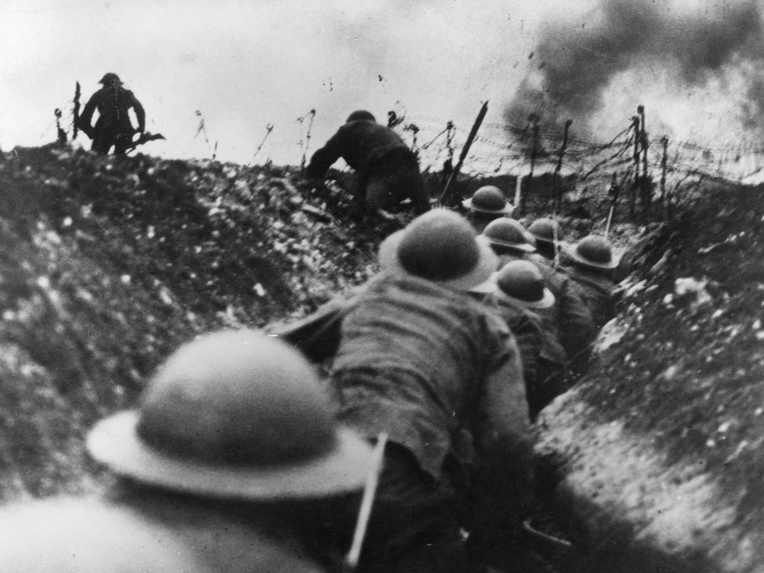
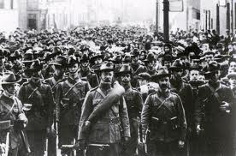
Word war 1
World war one started in 1914 World war one ended in1919

Slide 2
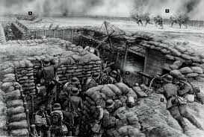
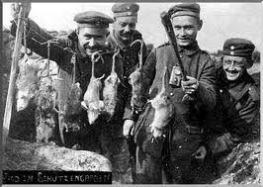
The trenches
The trenches were half full of mud and water, unfortunately before them were the French, who buried their dead soldiers in the bottom and sides of the trenches, everywhere they went to dig another trench there were dead bodies and the smell was atrocious.

Slide 3
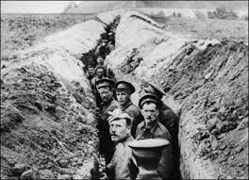
Here is what some trenches looked like!

Slide 4
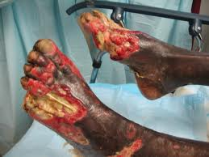
Injuries
There was a lot of injuries down in the trenches like trench foot which was really, really sore. Your foot will eventually go dead, and if it goes dead you will have it taken off whether if you like it or not because it will be no use anymore.

Slide 5
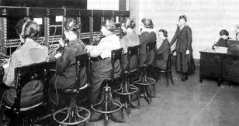
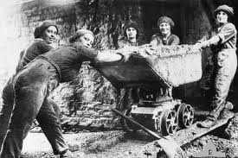
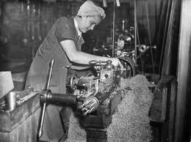
A woman’s life during war
Since all the men were away in war the women had to do all the work, like housework, weapon work, caring for soldiers (who got sent back home because of a bad injury), looking after their children( some probably with babies who need a lot of attention). The women probably got the hardest job, although the women did not get any lice or trench foot but they had no food or money so they could not feed her children.

Slide 6
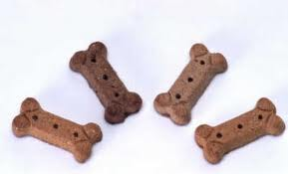
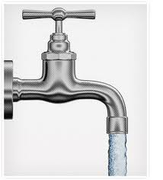
Food
Soldiers did not eat much - all they ate was water and dog biscuits - yes dog biscuits - it sounds horrible but it was all they could get”.

Slide 7
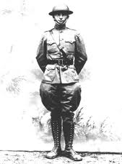
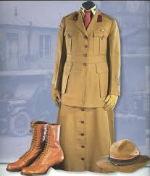
Clothes
Men had to wear big, chunky, heavy green > uniforms and big, heavy black boots and a hard, green helmet to keep them hidden (even though it did not work) and it was what they had to wear at all times.
Women had to wear a brown uniform and brown shoes and hat like you can see in this picture. >

Slide 8
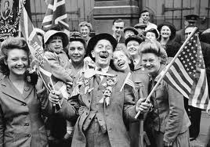
That’s my slide show about WORLD WAR 1 by Rachel

